Slide 1
Why we do what we do

Slide 2
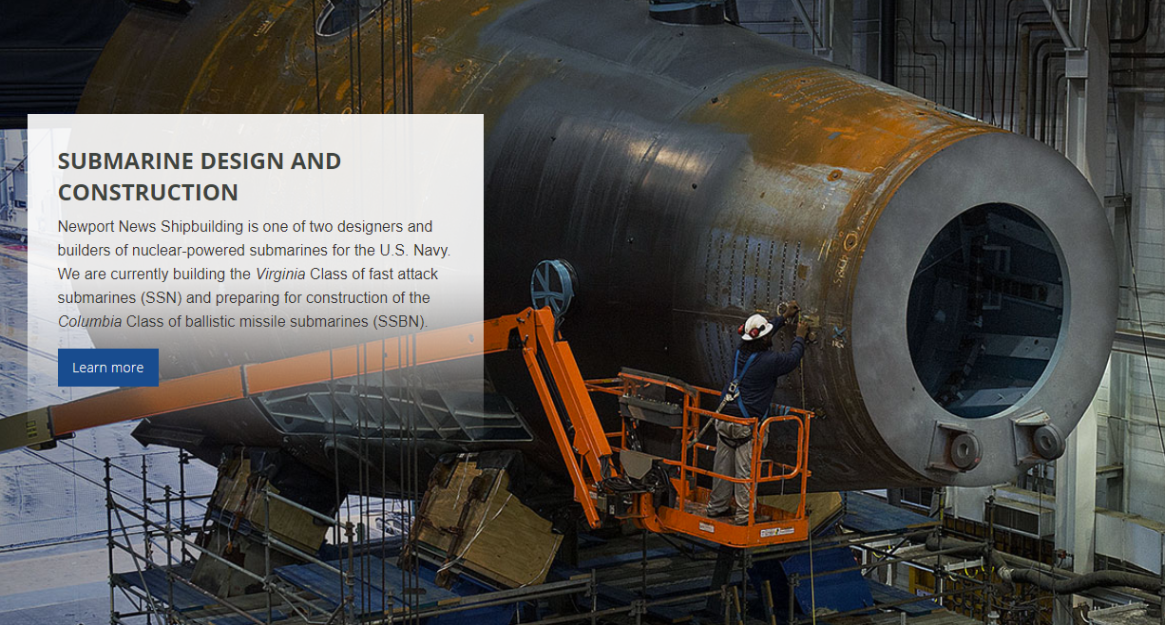
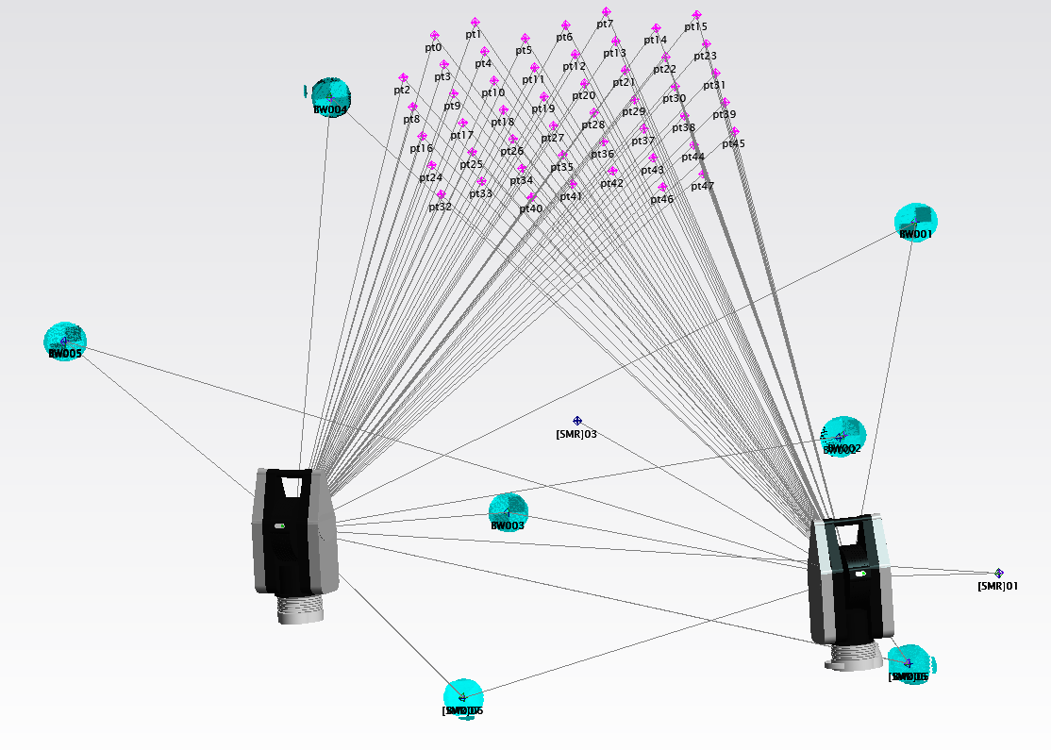
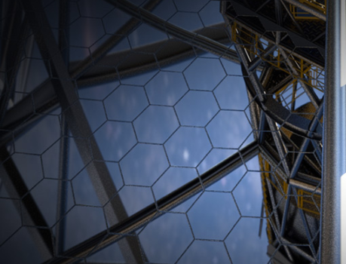
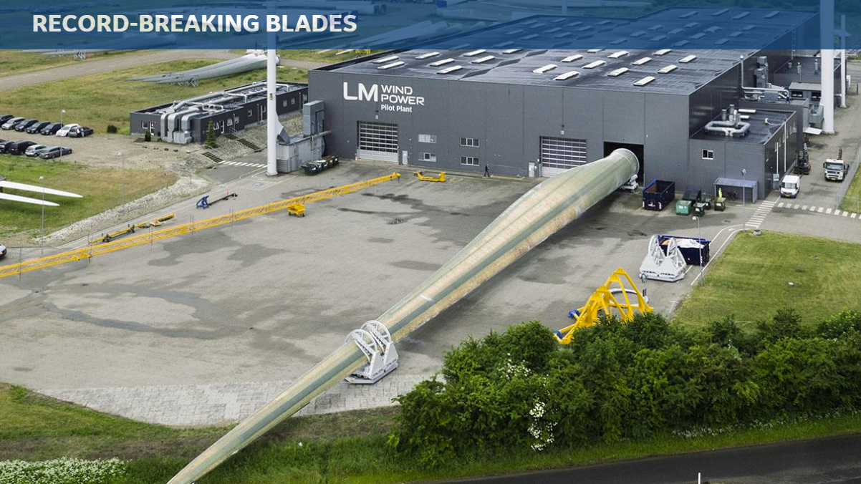
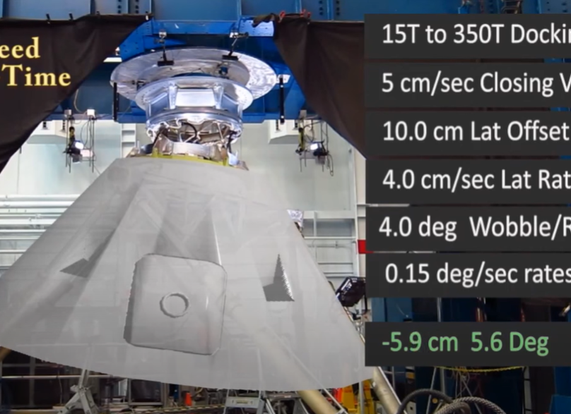
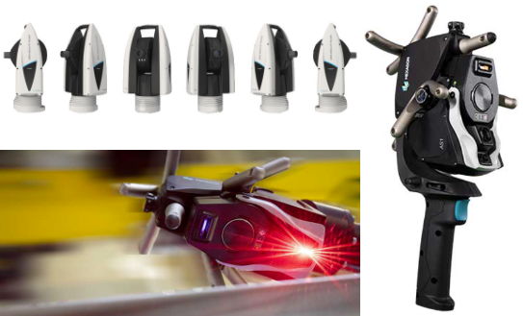
Docking Apparatus Performance
Align the hexagonal mirror segments that make up the 30m lens
Customer Support & Development
2021 Projects
Automated Synchronized ATS Monitoring of Submarine Construction
100m Blade Inspection

Slide 3
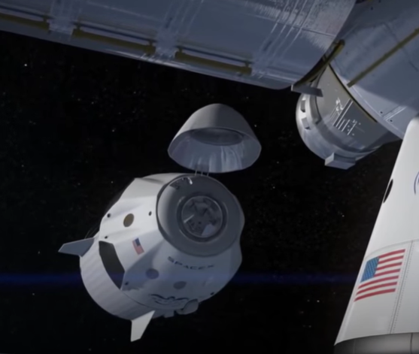
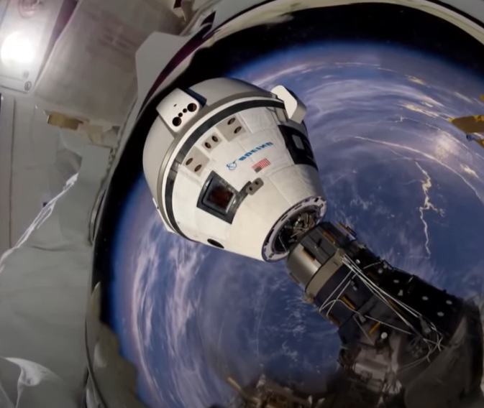
Docking Apparatus Performance
Combing Photogrammetry with tracker measurements in SA
https://www.youtube.com/watch?v=DiSJW7lafjw

Slide 4
Ben, David Mihal, and I were on a call with LM Wind Power earlier this week. The customer went out of his way to complement SA support and focus on the solution. That all starts with you and the team at HQ!
One of the reasons they dumped Polyworks about two years ago for SA, was SA support and continued development.
It makes a big difference in the market!
Scott Sandwith
These blades or so long that standard measurement practices are not possible. They now use an AT960 and LAS to scan the blades and use a UMSN network to alignment all the tracker stations. This gives them the accuracy they need. The full process from scanning through the full analysis is completely automated with a script run in SA.

Slide 5
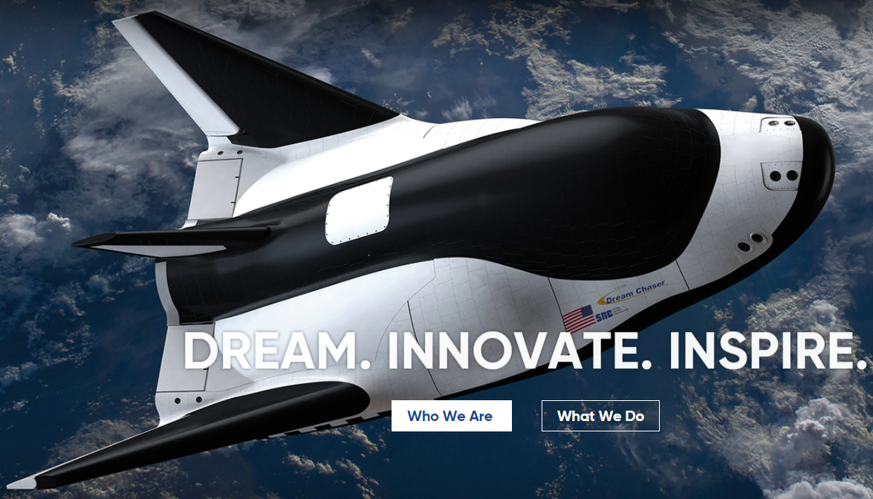
Aligning the tiles on the shuttle for Sierra Nevada Corporation
“I’m looking for a way to automate or make this process faster. We have 2100+ tiles so I can see this model getting complex very quickly as we build these relationships.”
Ryan King Sierra Nevada Corporation

Slide 6
“I know I’m new, but there’s a reason I switched to selling Inspire when I sold arms. The support this team gives customers is unparalleled, and the Hexagon hardware people are starting to realize that Inspire and SA is the way!
Via on-site Inspire training classes, I have set up an arm inspection plan for cadaver bones at Stanford Medical, scanned delivery drones for Amazon air, measured bullet casings for Hornady, measured satellites with a laser trackers, and the list goes on and on. Customers are SO happy with our software, it’s amazing to see out in the field. There’s always things to work on and improve, but I can tell you firsthand that customers are happy when they make the switch to SA or Inspire.
Without dedicated people in the Applications and Support teams, these software would not be what they are today. Thank you for your tireless efforts. I truly believe that a main part of the success of SA is due to the backbone of support you constantly give. Let us know if there’s anything we can do to help. ”
Sincerely,
Robert Nack

Slide 7
We are helping to align the hexagonal mirror segments that make up the 30m lens

Slide 8
Gents,
We’ve had a long and storied conversation about the usefulness of intensity filters in SA. Just wanted to let you guys know that we are currently using the tool you guys implemented (grayscale filtering) to keep noise from shiny surfaces out of our scan data in SA. Thanks again for the support on this!
Thanks Much,
Justin Novak
HII NNS
There are many cool projects in the hopper, but I’m most excited about the new workflows that SA and the ATS-600 open up. A monitoring project at a shipyard is meant to measure a grid of points on a part every few hours, synchronizing 2 trackers. It doesn’t need the highest accuracy, but it does need to be completely autonomous. We have proved that it is possible with MP script in SA.
Steve Seiler (Hexagon AE)

Slide 9
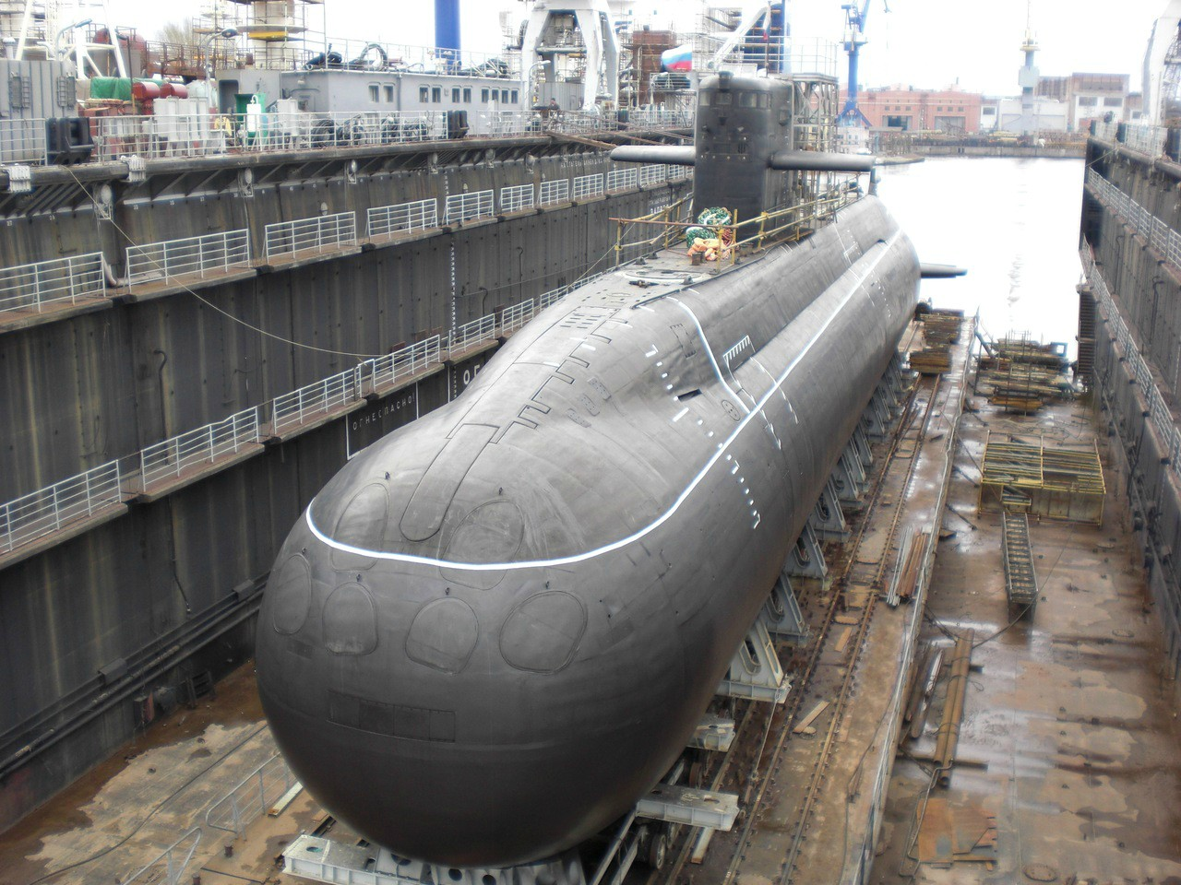
“I had a conversation with a customer while I was sitting on a plane listening to him talk about the struggles he was having with GD&T and form checks setting up the nominals when he didn’t have CAD. I told him try SA Objects fit to points. The conversation ended with “that’s why I love SA!, you guys are awesome!” Not a cool project but an often given sentiment we get to hear because we get out in front of customers.”
Richard
“I just did three days of intro training with Edwards AFB in California and every day they were super excited to learn new stuff. They were coming from CAM2 and had been very frustrated with the lack of capability. Every time they had a question about how to do something and I showed them in SA they would be like, “wow, this software is amazing!” they said that probably a half dozen times while I was there. “
Caleb
“steve seiler and I went up to portsmouth naval shipyard last week. They update their software about once a year, they are getting ready to again shortly. Typically every year before they are ready to upgrade, we will go up there and show them all of the cool new things that have been added.
This team, has been using SA for a while but embrace change. EVERY time we do this at PNS, they are excited to try all the new tools you have added. They appreciate the support you give them!”
Sincerely, Bill Anderson

Slide 10
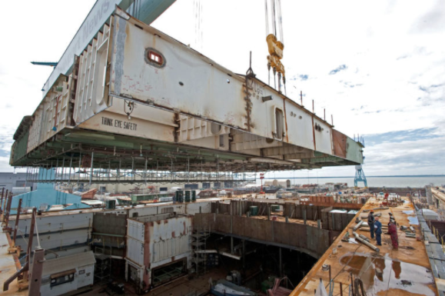
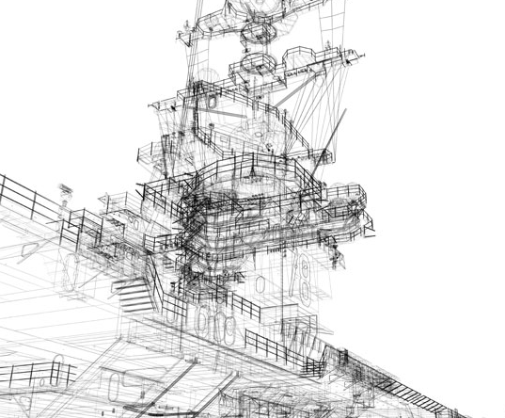
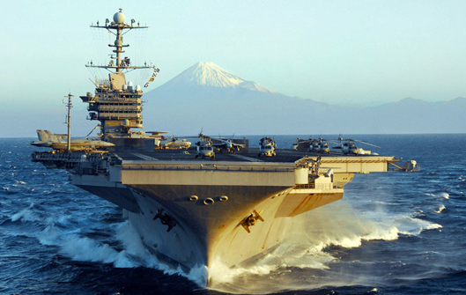
I don’t even know what all SA in involved in at NNS.

Slide 11
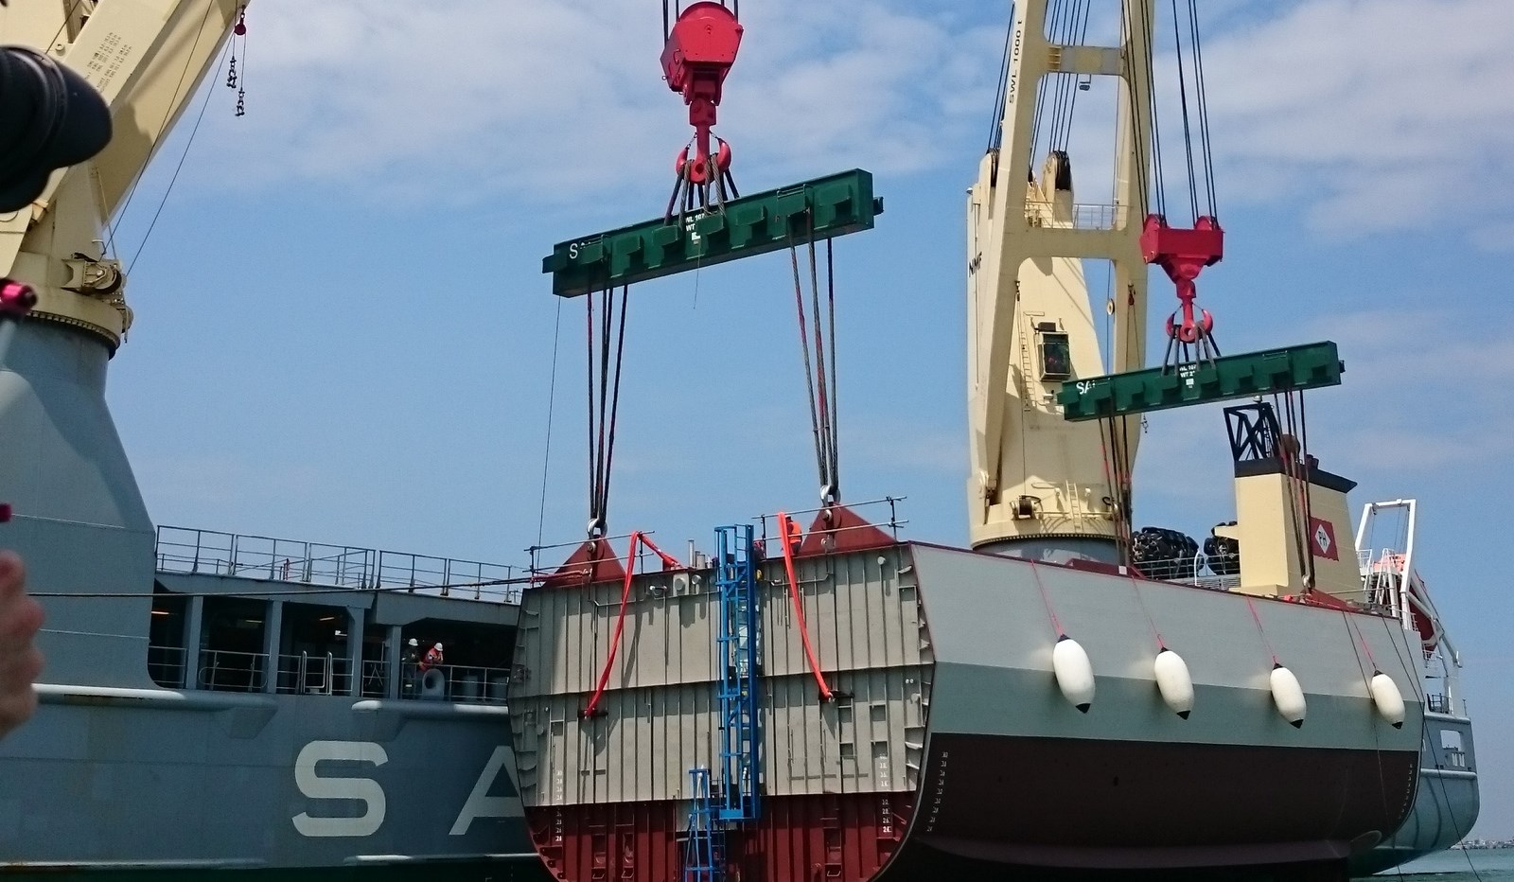
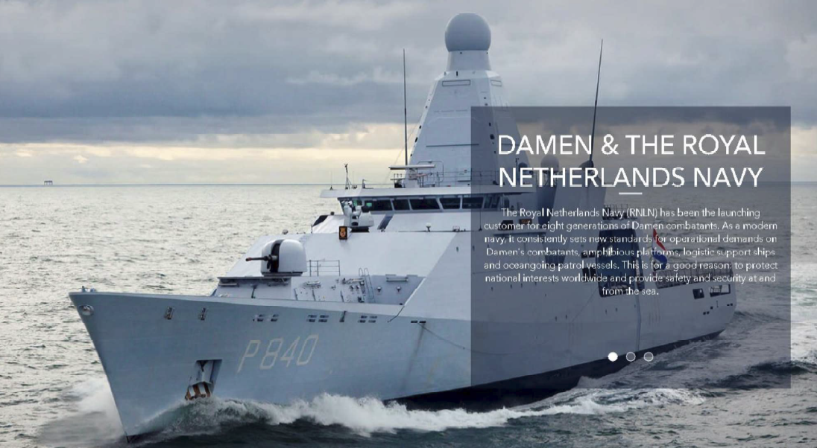
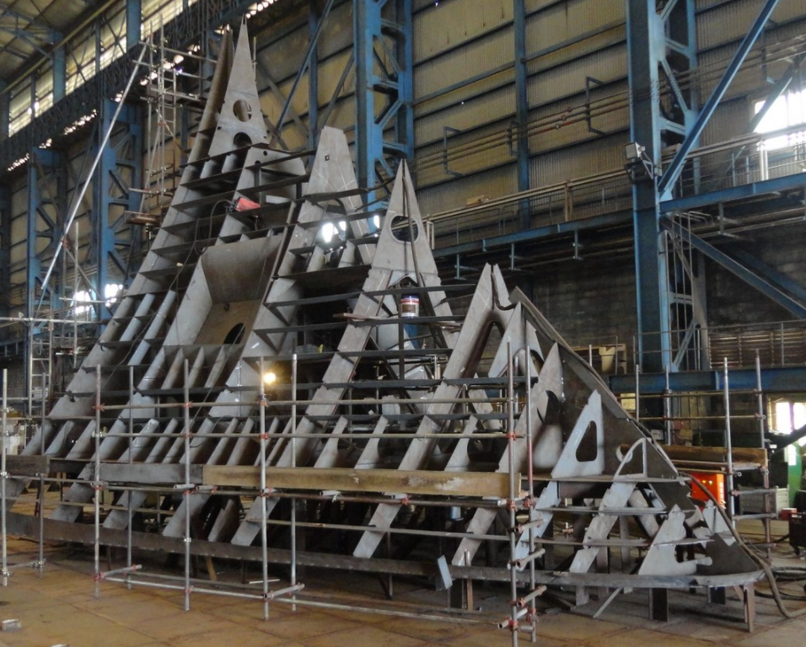
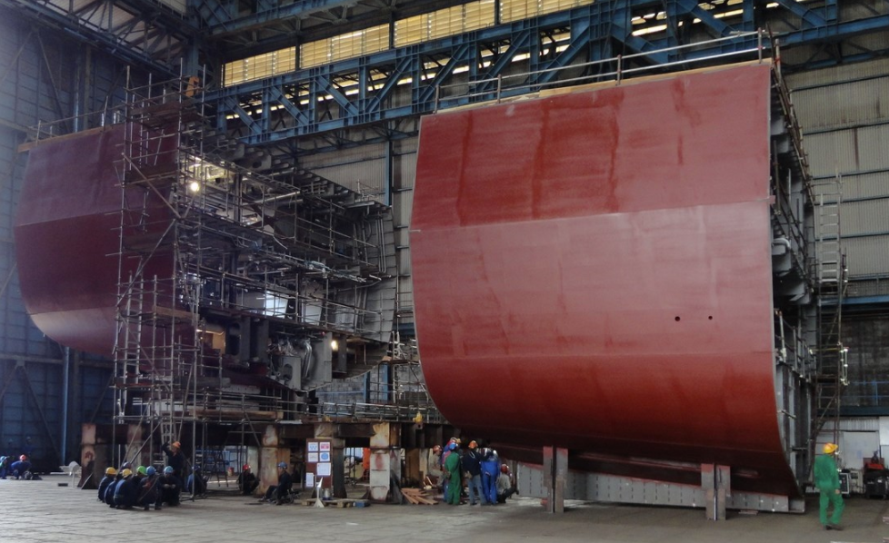
DAMEN NAVAL
Marine Shipbuilding in Spain
SA and ATS600

Slide 12
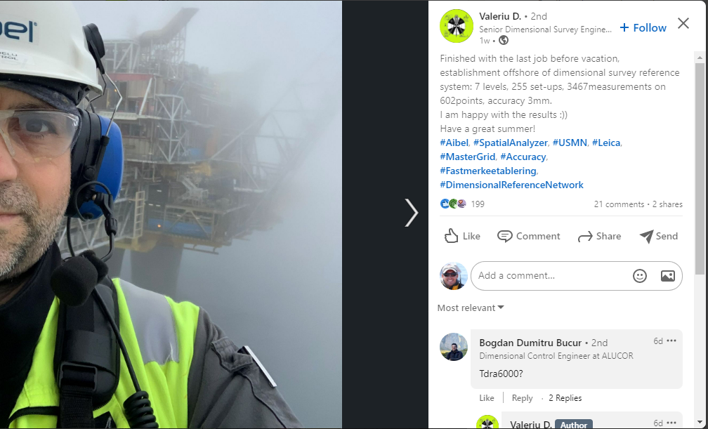
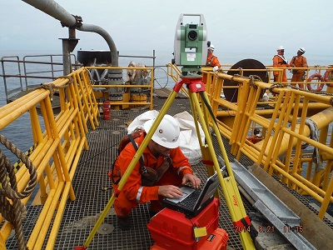
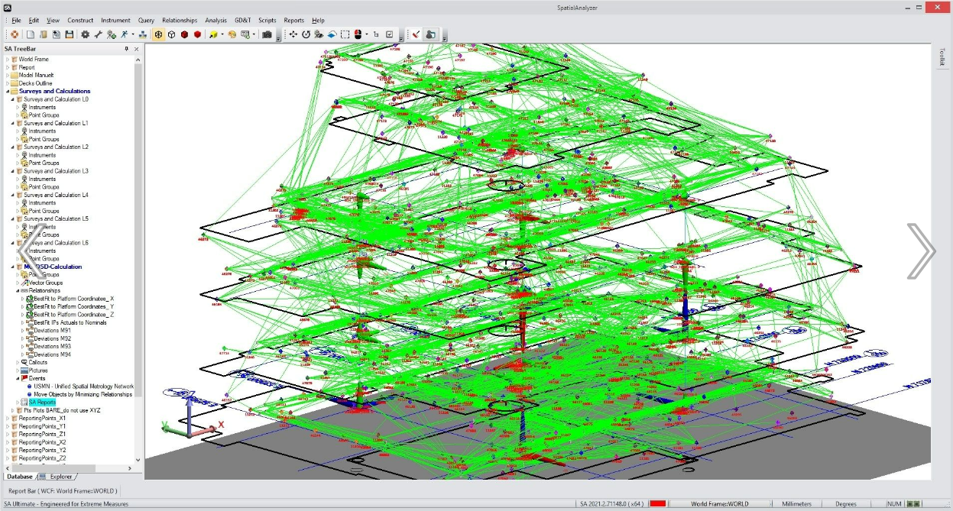
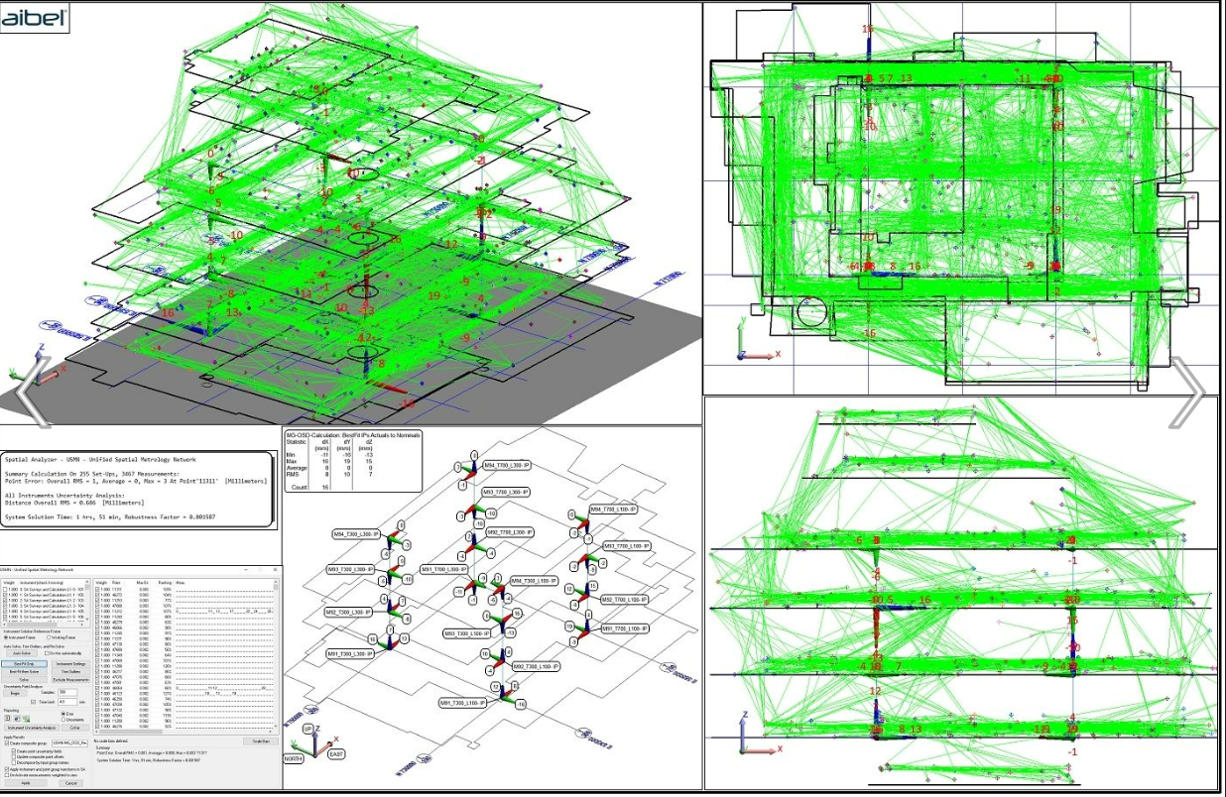

Slide 13
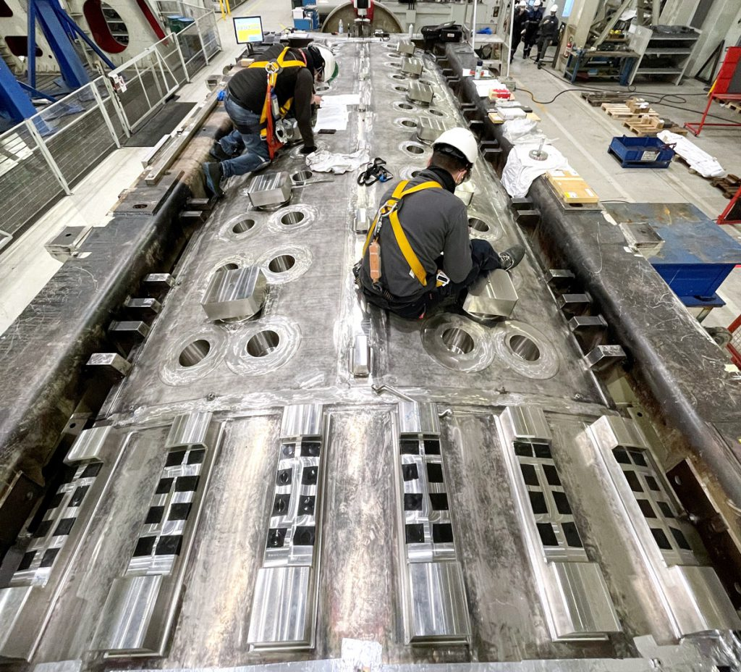
Dear NRK colleagues,
Thanks to your software and your effort, F4E is now capable to minimize the risk in one of the most challenge assembly, the Vacuum Vessel sector. It’s a team work.
https://www.iter.org/newsline/-/3611?utm_campaign=whatsnew_weekly&utm_medium=email&utm_source=10%20May%202021&utm_content=featured
It’s a team work!
Believed or not the idea to start this methodology on the Vacuum Vessel sector begun in April 2017 during the lunch at the SA user event, after bombarding with questions Scott, Zach and Nicolas about the use of the SA module Pipe fitting.
In 2018 I make the first VF test on two components and now F4E and AMW are capable to manage a file of 1 GB with more than 1 million of points and several interfaces.
Cheers
P.S. there is also a link at the F4E news
https://fusionforenergy.europa.eu/news/how-to-join-the-pieces-of-iter-components/
Alessandro Lo Bue
Metrology Team TSS/ ITER department 2/24

Slide 14
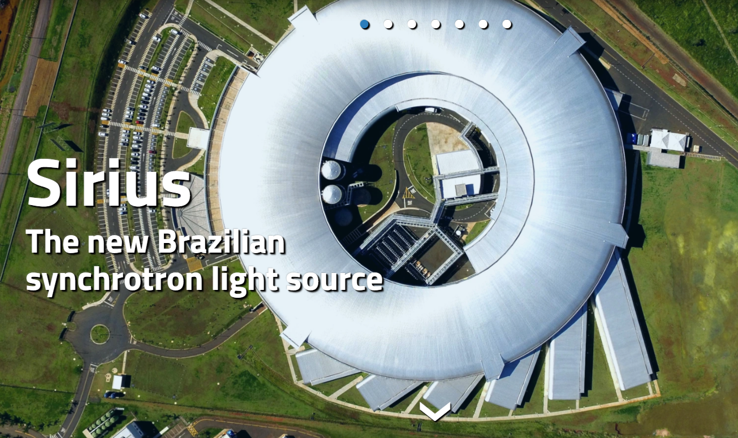
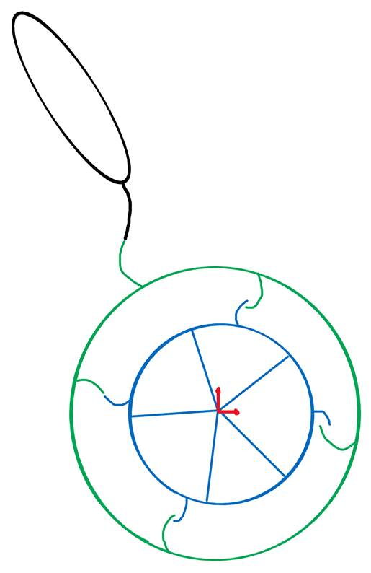
“I appreciate your comments. We are using the CUDA core processing, indeed, and it is amazing how it allowed our calculations to be performed in days rather than weeks!”
Rodrigo Junqueira Leão
Alignment & Metrology Group Brazilian Synchrotron Light Laboratory
https://www.3dmc.events/
I hope you find the presentations interesting. We present how we connected the secondary network to the primary one (LNLS 2/4 - via reciprocally oriented laser trackers), give an alternative solution (LNLS 3/4) and present a proposal to a new approach to reconstruct the alignment profile of our ring (LNLS 4/4).

