Slide 1
Using the Ultimate of SA
Steve Seiler Ashley DeKerlegand
Project Engineer Director of Training

Slide 2
Who We Are
Steve Seiler
Ashley DeKerlegand
PROJECT ENGINEER
DIRECTOR OF TRAINING
Purdue University ‘09
Brookhaven National Lab
Started at NRK March 2013
University of Virginia ‘07
Newport News Shipbuilding
Started at NRK February 2013

Slide 3
Topics
Automation
Advanced
Fitting
USMN
Scanning
Uncertainty

Slide 4
Measurement Uncertainty

Slide 5
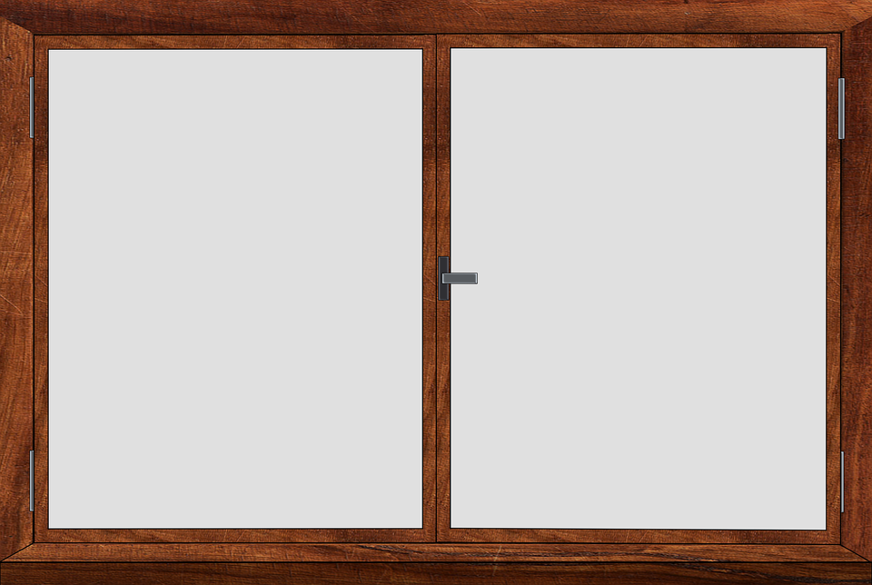
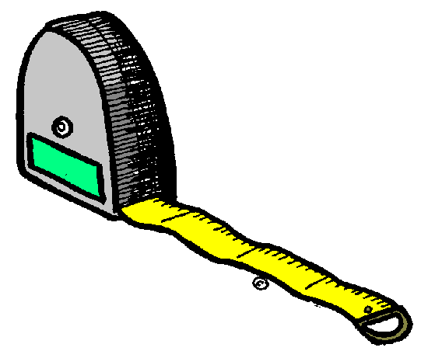
What is Measurement Uncertainty?
40” ± 0.500”
40” ± 0.050”
40” ± 0.005”
40”
Notes:
What exactly does “measurement uncertainty” mean? Let’s say that you are measuring a window using measuring tape.
[CLICK] The window, including the pane, measures at what looks like to be exactly 40”.
[CLICK] We can definitely say with certainty that we sure the window is 40” to within a .5”
[CLICK] But can we say for certain if the window is 40” to within .05” ? Maybe.
[CLICK] We definitely would not be able to determine whether or not it is within +/- .005”.

Slide 6
Standards for Uncertainty
NIST
ISO
ANSI
“A measurement result is complete only when accompanied by a quantitative statement of its uncertainty.”
- NIST-
Notes:
Being able to determine measurement uncertainty is extremely important. So important, in fact, that many organizations (NIST, ISO, ANSI, etc.) have standards requiring that measurement’s uncertainty.

Slide 7
Types of Uncertainty Calculations
Points
Instruments
Point to Point Distances
Geometry Fits
Instrument Network
Notes:
Here are the examples of uncertainty calculations that SA performs that we are going to discuss.

Slide 8
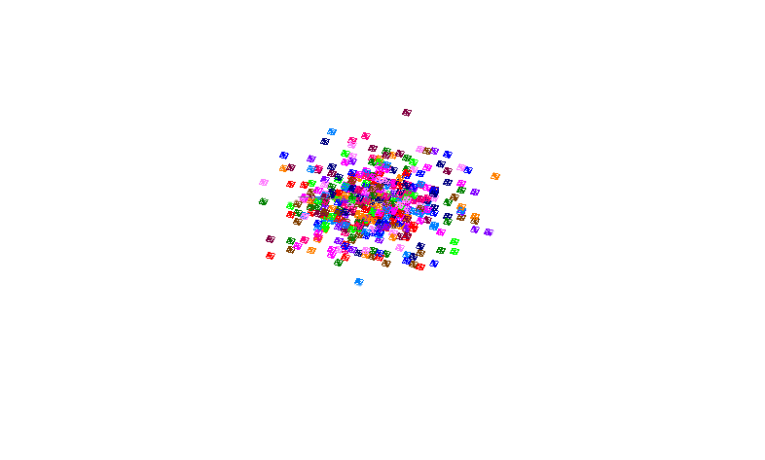
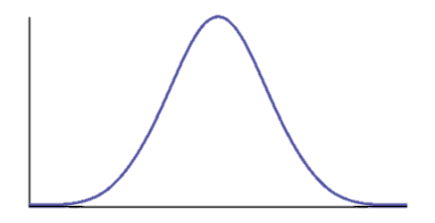
Uncertainty Visualization
2σ
σ
x
σ
2σ
Notes:
The best way to determine uncertainty in the measurements from your instrument in your environment is to measure a point many times under those conditions. Here is an example of what your graphical view would look like in SA if you measured a point 300 times. You would end up with a group of points all with slight deviations from each other.
There would be a greater number of points near the center of the group and fewer as you looked outward from that center location.
[CLICK] In other words, you would have a Normal or Gaussian distribution with x representing the mean of the distribution.
[CLICK] About 68% of the points would lie within this one sigma range.
[CLICK] And approximately 95% of the points would like within the 2 sigma range.
[CLICK] Unfortunately, most of us do not have enough time on our hands to measure each point several hundred times.

Slide 9
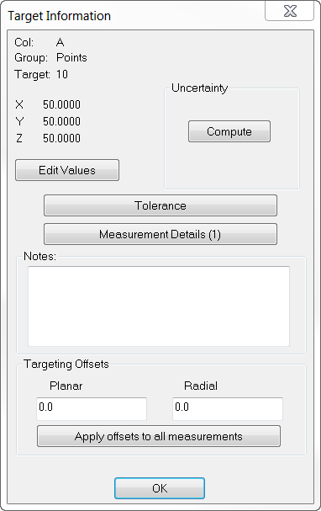
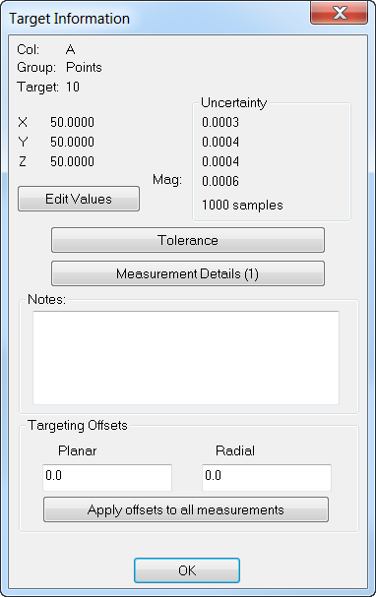
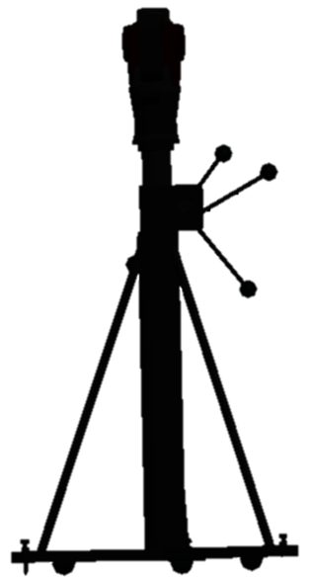
Point Uncertainty
Notes:
So there is a way we can actually simulate these measurements without actually measuring the same point over and over again.
[CLICK] Let’s say that an instrument measures a point and that point is recorded in X, Y and Z at 50,50,50. Although this is the reported number, we cannot be 100% sure that this is the exact location since this is not a perfect world.
[CLICK] Therefore, each measurement in SA has an uncertainty that can be computed. When we compute uncertainties of a point, we call it an uncertainty or a sensitivity cloud. This particular cloud has 1000 samples, meaning that it is produced as if you had taken 1000 measurements of this target.

Slide 10
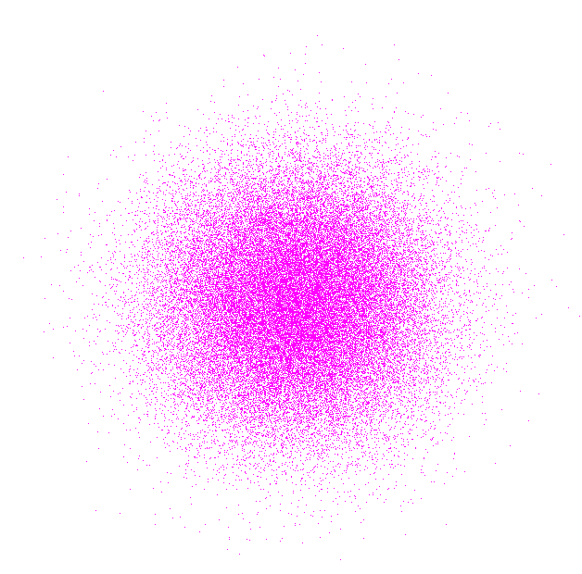
Uncertainty Cloud Visualization
2σ
σ
x
σ
2σ
Notes:
Mathematically, SA utilizes a Gaussian random number generator to build this cloud. Considering that real world processes tend to have a Gaussian distribution, this is a logical choice to model the expected distribution. It builds uncertainty clouds in three dimensions based upon the number of uncertainty values of the instrument and a user specified number of samples.

Slide 11
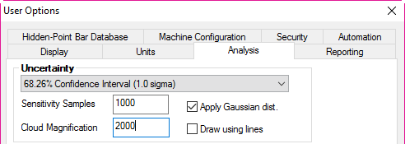
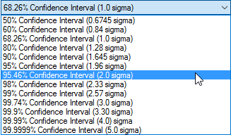
Confidence Intervals
68.26%
95.46%
Notes:
You can even specify the confidence interval that you would like to report to in the global user options under the analysis tab. We default to one sigma (or 68.26%) but you may change this as you see fit.

Slide 12
Confidence Intervals
Based on 1000 samples, I am 68.26 % confident that:
X = 50.0000” ± .0003”
Y = 50.0000” ± .0004”
Z = 50.0000” ± .0004”
Mag ± 0.006”
Notes:
Changing the confidence interval, changes the uncertainties that are reported.
For this example, I would report that based on 1000 samples, I am 68.26% confident that this point coordinate is located within +/- 0.006” of the measurement taken.

Slide 13
Determining Shape and Size of Cloud
Notes:
If you measure several points and compute the uncertainty clouds of those points, you will notice that each cloud looks different. The change may be slight, like the bottom two clouds shown here, or they may look very different, such as the top one.
So how is the shape and size of the cloud determined?

Slide 14
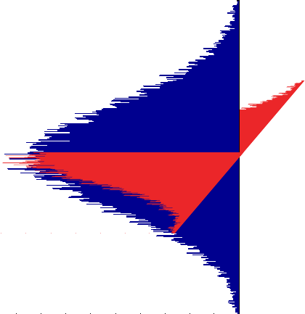
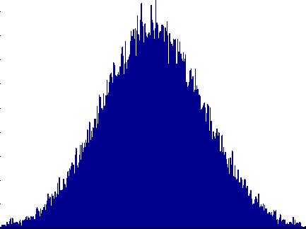
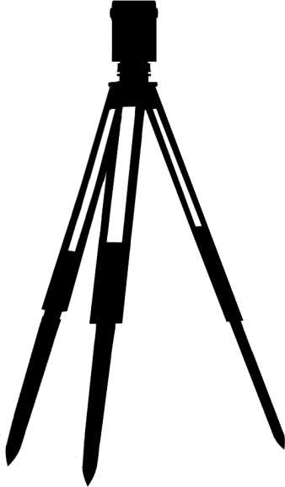
Instrument Uncertainty
ɸ
d
ɸ
d
ɸ
θ
θ
Notes:
The most important part of calculating the uncertainty of a measurement is actually by perturbing the instrument’s measurement components based on the uncertainty characteristics. In the case of a laser tracker, these components include horizontal angle, vertical angle, and distance. We then observe how those perturbations affect the resulting target, and place an uncertainty cloud point there. We do this many times over, placing uncertainty cloud points after each iteration. Soon, we have enough data to extract statistical information about the shape and size of the uncertainty cloud.

Slide 15
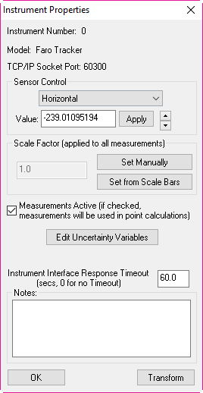
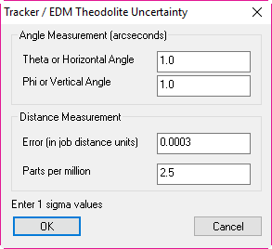
Instrument Uncertainty Variables
Instrument Properties Dialog
Types of Error:
Horizontal Angle θ
Vertical Angle ɸ
Distance Error
V
Notes:
By going to an instrument’s properties dialog, you can open up the uncertainty variables for that particular instrument.
[CLICK] Here is an example of a tracker’s uncertainty variables, which contain both angular (horizontal and vertical) as well as distance errors.

Slide 16
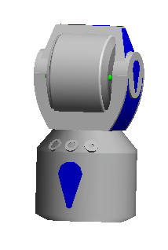
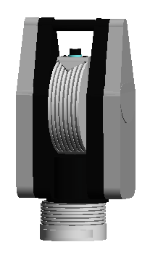
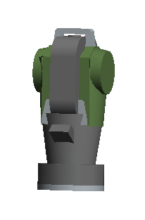
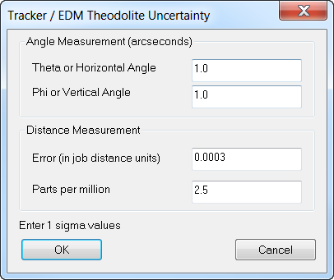
Different Manufacturer, Same Uncertainties
Would require constant updating
No two instruments alike
Real World Contributors
Notes:
If you take a look at the uncertainty variables for each manufacturer of the laser tracker (API, FARO and Leica), you will notice the variables are all the same. Also note that these variables are fairly conservative and most trackers perform with less error than what is listed here. But why is this so?
[CLICK] One reason is that these numbers would require constant updating….do to age, model, etc.
[CLICK] Another reason is that no two instruments are alike. Two instruments could come off the assembly line, one right after the other, and they would have different errors.
[CLICK] And finally, there are so many real world contributors that affect your tracker’s performance that we are unable to determine for you.

Slide 17
Real World Contributors
Instrument
Targeting
Environment
Operator
Geometry
Fixturing
Scale
Notes:
What exactly do we mean by “Real World” contributors?
[CLICK]The most obvious contributor is the instrument itself. Things like the instrument technology, calibration, mounting, compensation, and noise.
[CLICK]Targeting also contributes. For example, with a laser tracker, both the SMR and nest have centering and sphericity imperfections that contribute.
[CLICK]The measurement environment contributes as well. Is it dusty or clean? Are there temperature fluctuations?
[CLICK]Operator technique affects uncertainty as well. For example, ability to sight on a target, whether an SMR is placed in a nest in the same orientation each time, etc.
[CLICK]The geometry of the measurement has an effect. Depending on the type of instrument, distance of the measured target from the instrument or its orientation to the instrument can affect uncertainty.
[CLICK]Fixturing is important as well. How is the part secured. Is it fastened securely?
[CLICK]And then there’s scale. For instance, the tooling itself expands and contracts with temperature fluctuations, which are typically not compensated for. One could argue that the inability to accurately characterize the thermal distortion, expansion, and contraction of measured parts contributes to overall uncertainty as well.

Slide 18
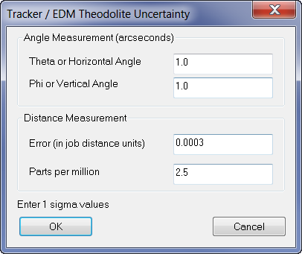
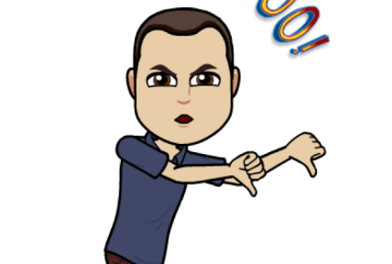
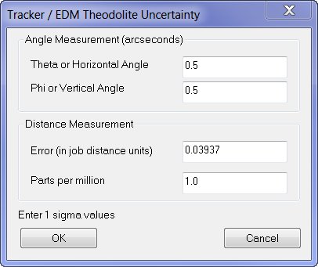
Different Type, Different Uncertainties
Distance
Angle
Notes:
So we know that instruments of the same type have the same uncertainty variables, but what about different types of instruments?
Let’s take a look at the uncertainty variables of a laser tracker and compare them to a total station.
[CLICK] Looking

Slide 19
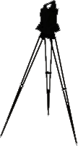
Total Station vs. Laser Tracker
Notes:
To visually represent these errors, let’s take a tracker and a total station and measure the same point from the exact same distance and angle.
[CLICK]
[CLICK] Now if we generate a point cloud for each of those measurements, you will two vastly different clouds created. The laser tracker, is represented by the orange cloud, which looks more like a pancake shape while the total station in green, is more of a cigar shape due to its uncertainty with regard to distance.

Slide 20
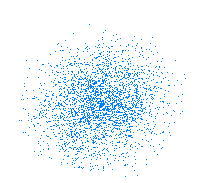
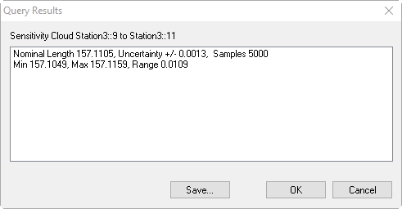
Point to Point Distance Uncertainty
Query > Sensitivity Cloud to > Sensitivity Cloud
157.1105”
Notes:
Aside from simply computing the uncertainty of a point, we are also able to calculate the geometric uncertainty of the distance between two points.
[CLICK] Here are two measured points with a measured distance of 157.1”.
[CLICK] After computing uncertainty clouds for these points, you can navigate to Query > Sensitivity Cloud to > Sensitivity Cloud and select the two points.
[CLICK] The nominal length is listed as the measured length between the two points, and the uncertainty, in this case, is +/- 0.0013. We even list the min and max lengths for you so you do not have to calculate these by hand.

Slide 21
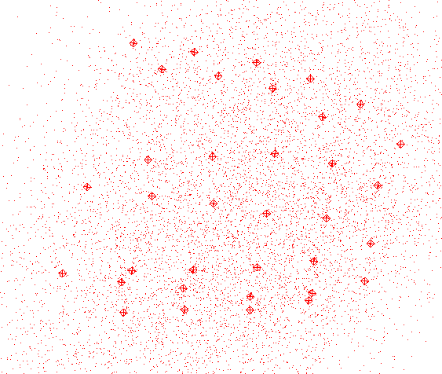
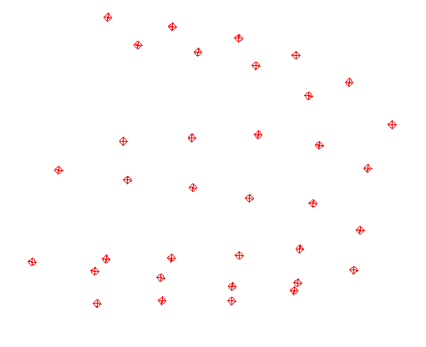
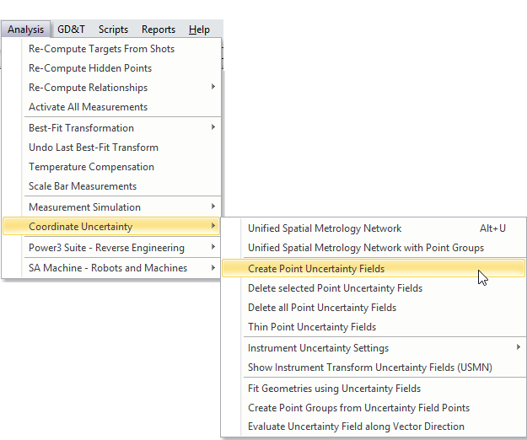
Multiple Point Uncertainty
Notes:
So up until now, we’ve been computing the uncertainty clouds for one or two points at a time. But what about a case like this where we need to report the uncertainties for several points? You certainly would not want to click on each point individually.
[CLICK] Fortunately, we have a command in the Analysis menu that allows you to select multiple points….
[CLICK] and generate their uncertainty fields simultaneously.

Slide 22
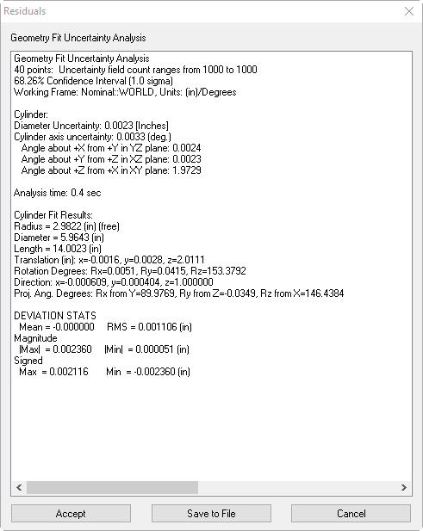
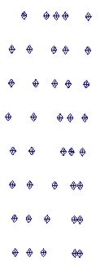
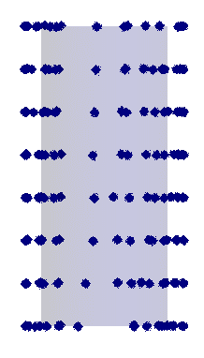
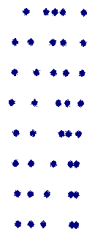
Geometry Fit Uncertainty
Analysis > Coordinate Uncertainty > Fit Geometries Using Uncertainty Fields
Less Coverage
More Coverage
 | Less Coverage | More Coverage
U Axis | 0.0033° | 0.0012°
U Diameter | 0.0023" | 0.0001"
# of Points | 40 | 158
Notes:
Rather than just computing and reporting out the uncertainties of multiple points, let’s take this a step further and use those points to fit to a geometrical shape and calculate the uncertainty of that shape.
Take, for instance, a cylinder. If we compute clouds for all the points measured on a cylindrical part, and then select the Geometry fit uncertainty icon in the toolkit or navigate to Analysis >Coordinate Uncertainty > Fit Geometries Using Uncertainty Fields….
[CLICK] then we are given a Residuals dialog containing an abundance of information, one being the diameter uncertainty which is .002”
[CLICK] A great reason to use this feature is to see how much coverage is needed on a geometric shape. The measurements on the right contain much more coverage than the measurements on the left, so let’s see what the difference is between the two.
[CLICK] By measuring 158 points as opposed to just 40 and covering more surface area, we were able to reduce the diameter uncertainty by over .002 of an inch. Notice the axis uncertainty is even reported and has been diminished by more than half.

Slide 23
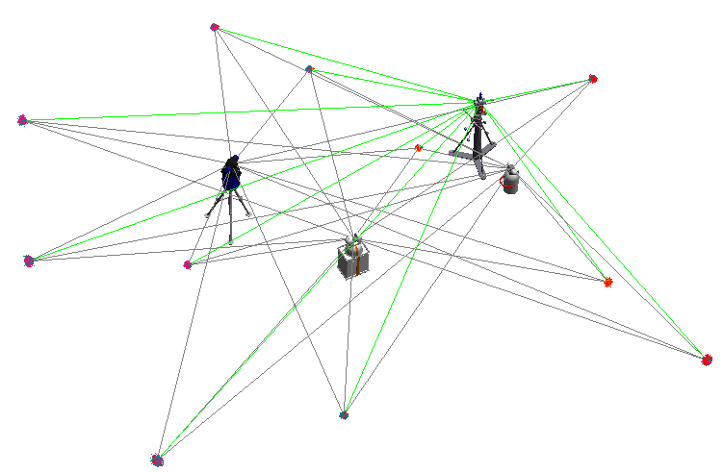
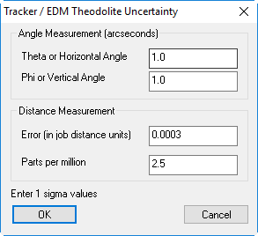
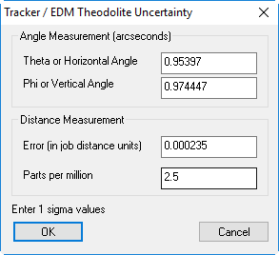
Instrument Network Uncertainty
Notes:
When a group of instruments are aligned together, an Instrument Uncertainty Analysis may be performed to determine the uncertainties in angular error and distance error of each instrument. We even report out what the actual uncertainties are for your instrument and allow you to edit these variables for more accurate uncertainty calculations.
But in order to arrive at this analysis, you must perform a USMN.

Slide 24
Unified Spatial Metrology Network
USMN
Notes:
USMN stands for Unified Spatial Metrology Network.

Slide 25
What is USMN?
An advanced bundling technique that optimizes instrument and target positions by way of measurement uncertainty weighting.
Unified
Spatial
Metrology
Network
Notes:
It is defined as an advanced bundling technique that optimizes instrument and target positions by way of measurement uncertainty weighting.

Slide 26
Uses for USMN
Characterizing measurement systems and their uncertainty.
Optimizing instrument networks.
Determining network uncertainty.
Notes:
There are three main uses for USMN:
First, is to characterize measurement systems and their uncertainties.
[CLICK] Second is to optimize an instrument network.
[CLICK] And finally, to determine network uncertainty.

Slide 27
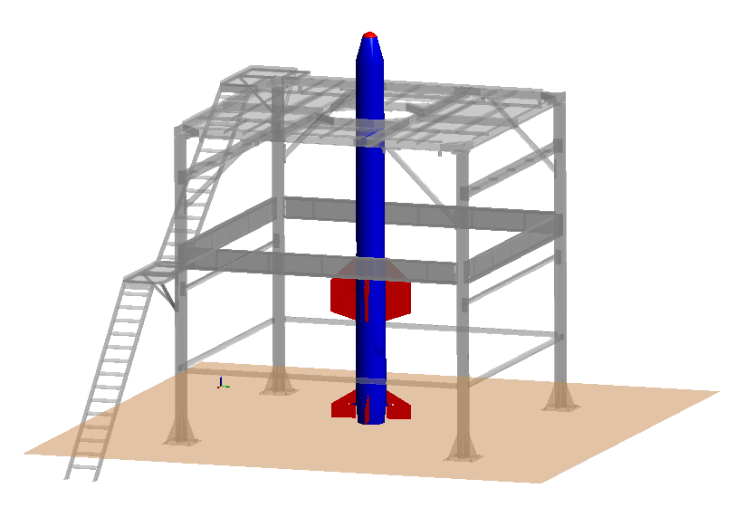
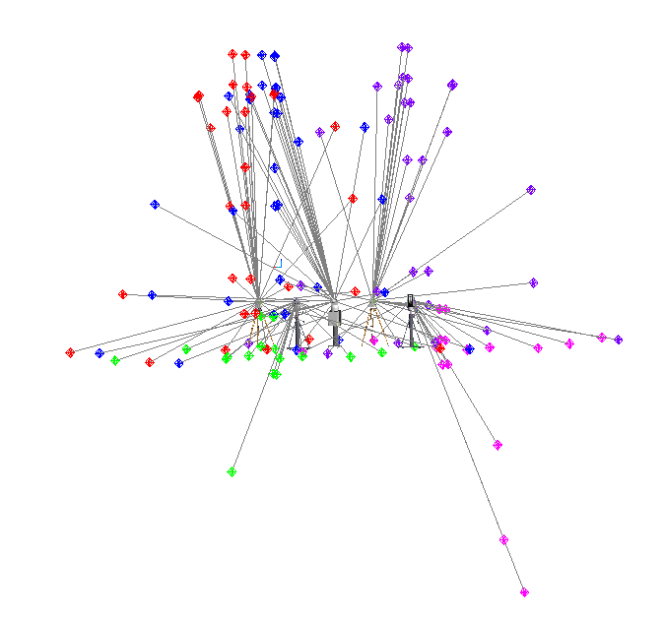
Notes:
USMN allows us to take two or more instruments (in this case five), which all shoot common targets around the room or on a part and fixture.

Slide 28
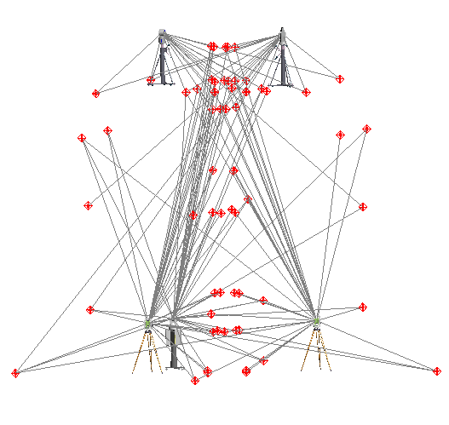
Notes:
And align all of those instruments simultaneously to form a network.

Slide 29
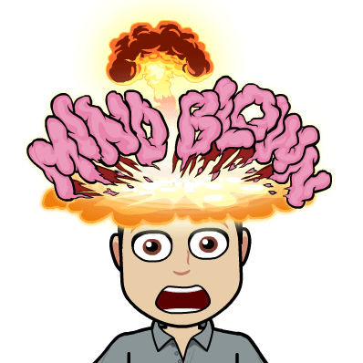
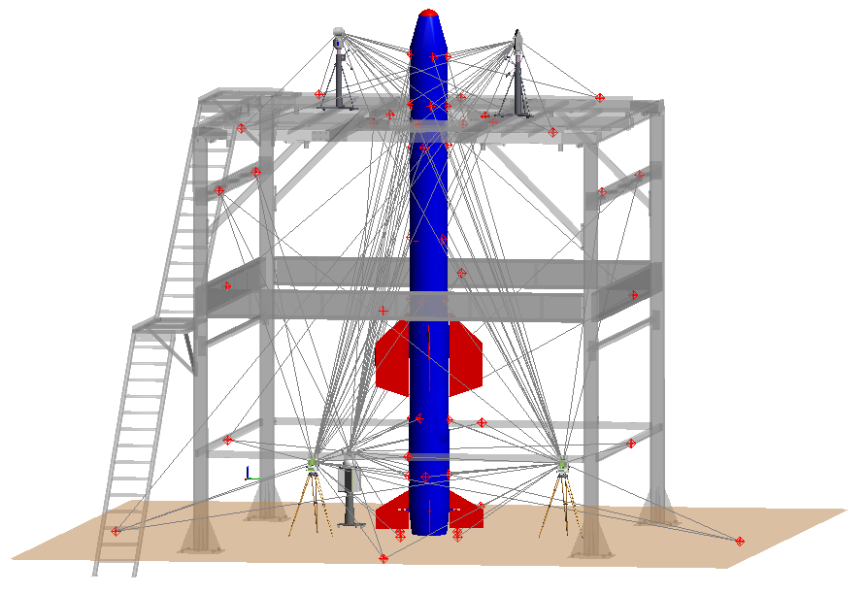
Notes:
Which gives us the ability to align all of these instruments to the CAD model.

Slide 30
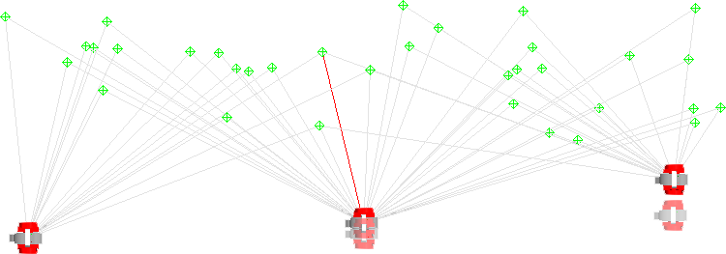
Prevents Stack-Up Error
Fit
location
Fit
location
C
True
location
B
A
True
location
Notes:
Aside from being able to align the instruments simultaneously rather than one at a time like Best-Fit requires…what are some of the other benefits to using UsMN?
Since only pairs of instruments can be fit at a time, instrument stations tend to be leapfrogged. Instrument B is fit to instrument A, then Instrument C is fit to Instrument B, and so on. When doing this, as is commonly done with large or long survey jobs, error stacks up rapidly.

Slide 31
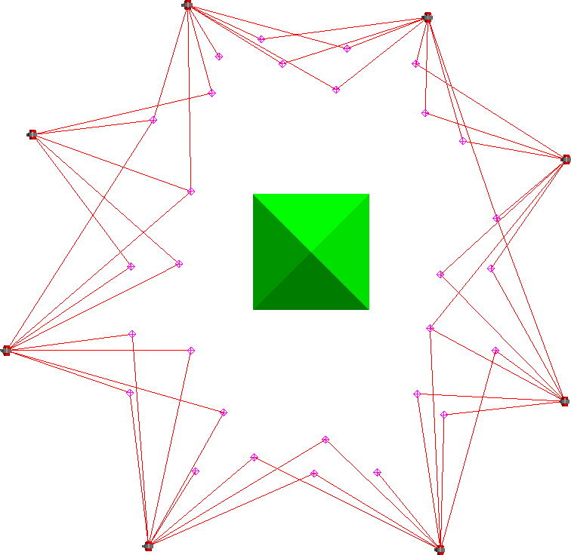
Closes Measurement Loops
G
F
H
E
A
D
B
C
Notes:
Again, since only two instrument stations can be fit at a time, if toward the end of a chain of instruments I can tie back into my first instrument, that will improve my overall fit. This can’t be done using Best-Fit, because it only optimizes one instrument position at a time.

Slide 32
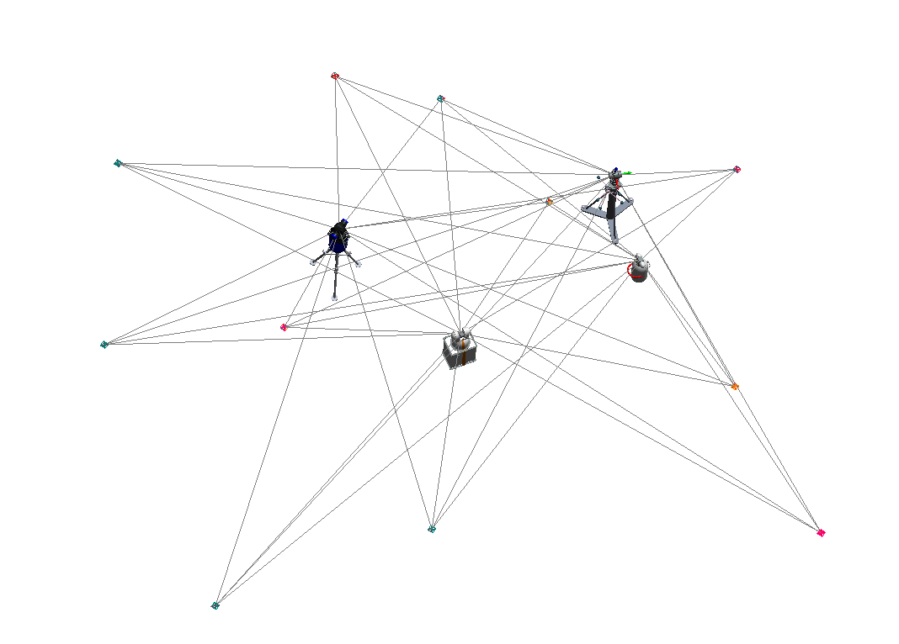
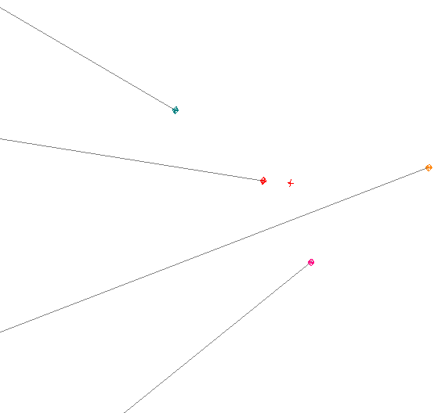
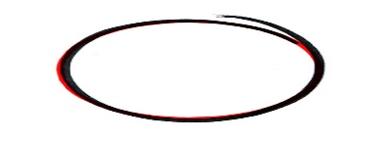
Composite Group
Notes:
It yields an entirely new group, called a composite group, which represents the most likely location of that point based on the weighted average of each shot that was taken from each station.

Slide 33
“Weighted” Average
2’
4’
6’
8’
Notes:
What I mean by weighted average is that while best-fit assumes that every measurement taken was perfect, USMN does not. Best-fit gives you no measurement uncertainty information. You end up with a network at the end, but how good is the network? How good are your other measurements, which are likely the real points of interest?
[CLICK] USMN uses the angular and distance errors associated with that particular instrument to compute a weighted average when generating the composite point. The points measured by a station that have high angular and/or distance error will have less influence.

Slide 34
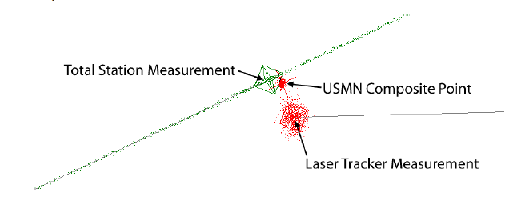
Composite Point Uncertainty
Notes:
Not only can USMN calculate the most likely position of the real target based on instrument characteristics, but it can also calculate the uncertainty of that composite point.
In this figure, that composite point is closer to the total station’s line-of-sight position (due to lower angular uncertainties of the total station), but is also much closer to the tracker’s distance measurement). The uncertainty of the composite point itself has less uncertainty than either of the instrument observations, because much of the total station’s uncertainty along the line of sight is rendered extremely unlikely based on the laser tracker’s measurement.

Slide 35
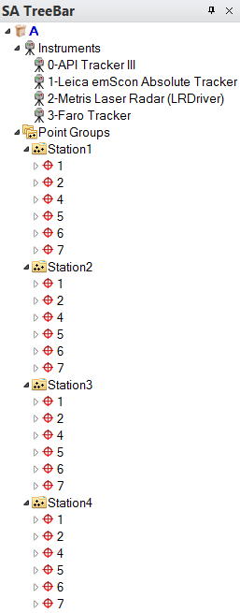
Prerequisites
Common Targets from more than one instrument network
Same point names
Observations from only one instrument for each point in a point group
Notes:
When setting up a network for analysis with USMN, there are several organizational requirement for instruments, measurements, point groups and points names. These are relatively simple in construction as they follow the process commonly used to locate an instrument.

Slide 36
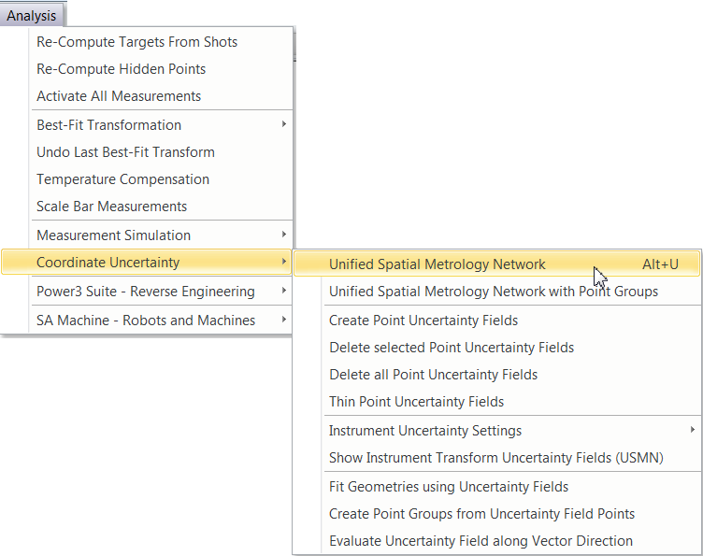
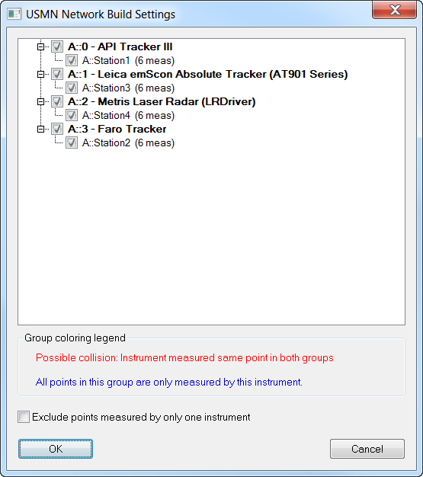
Alt + U
Notes:
To run a USMN, go to Analysis>Coordinate Uncertainty>Unified Spatial Metrology Network and select your instruments when prompted.
[CLICK] After selecting your instruments, the USMN Network Build Settings will appear. This dialog allows you to remove entire instruments or groups from the USMN process.
The dialog will highlight red any pairs of point groups that have one or more measured points with the same name and are measured by the same instrument (to aid in detecting point collisions). An example of this is if you were measuring a common target as a drift point as well.
Any point groups that contain point names that are not repeated in any other point groups will be highlighted blue, to indicate that the groups may not be involved in the USMN network and that you may not want to include them in the USMN solution (of course, those points will still be transformed along with the instrument).

Slide 37
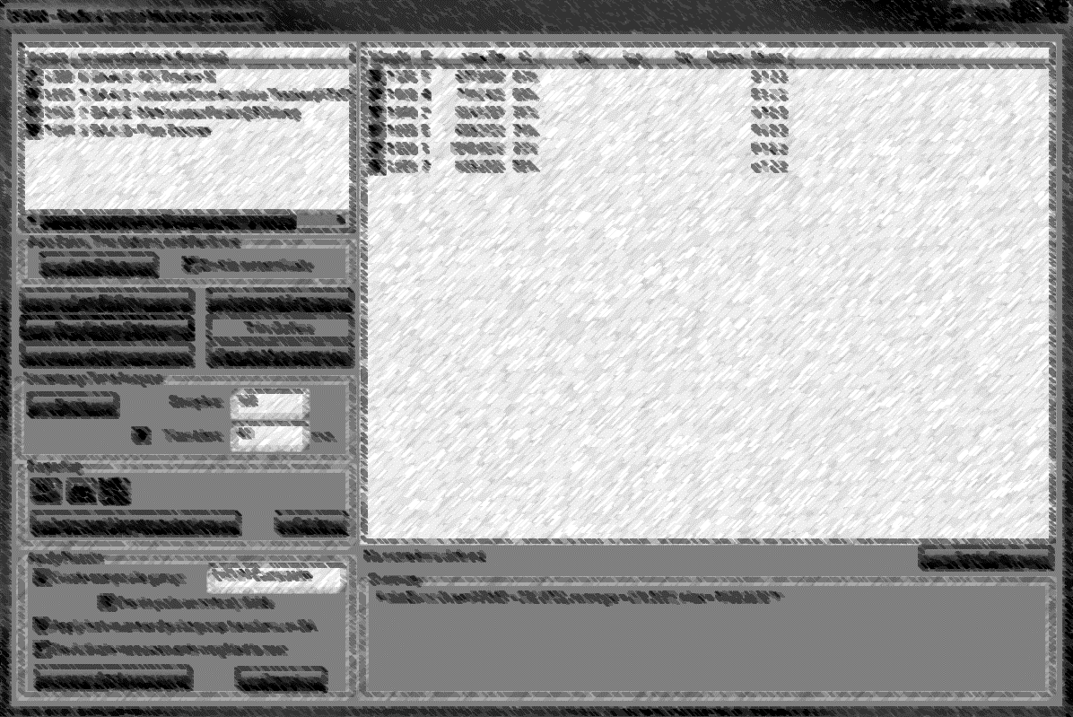
USMN Dialog
Notes:
The primary purpose of the USMN dialog is to help you optimize the network confidently and get the best Composite Point Group possible from the instrument stations and measurements. The window is composed of seven main parts.
[CLICK] This is the instrument section: It lists the instruments whose measurements are included in the USMN network solution. Instruments have a default weight of one. Each instrument has a checkbox indicating whether that instrument is allowed to move during the calculation. A USMN bundle (or any bundle) is a relative solution. That is, the solution can be reached relative to any instrument. Standard practice is to check all but one instrument to move all readings to that single location.
Double- click an instrument to access that instrument’s properties. For example you can adjust an instrument’s degrees of freedom.
[CLICK] The Measurement Section shows measurement specific information and has a number of columns.
[CLICK] Solve Section – This section contains the parameters and controls for actually calculating the USMN solution.
[CLICK] Uncertainty Field Analysis Section – USMN does not by default calculate the uncertainties of the resulting optimal (USMN Composite) points, because this calculation can take a fair amount of time. As a result, you must initiate this calculation yourself.
[CLICK] Provides methods for reporting results.
[CLICK] Apply Results – This section controls how the calculated results are applied to the job file.
[CLICK] This section lists a general summary of the USMN calculation, including values such as Overall RMS, average point error, uncertainty average, and other statistical information.

Slide 38
Best-Fit then Solve
Notes:
Let’s run through a basic USMN process. Once you arrive at the USMN dialog, you would ensure that the instrument settings are correct.
[Click] Best-Fit Then Solve. Some users choose to run a Best-Fit Only and then Solve but most simply use a Best-Fit then Solve.
[CLICK] Once it solves, two key columns to look at are Max Error and Ranking.

Slide 39
Max Error
13
Max Error
(spread of measurements)
13
13
13
Notes:
Max error is the largest error between all observations to a common target. It is an indicator of the maximum spread among observations.

Slide 40
Ranking
Notes:
And you can think of Ranking as a golf score, the lower the better. It is an indication of the uncertainty of the point error in the network and displayed as a percentage. It is an efficient method of determining which points may have measurement outliers.
[CLICK] Typically, points over 100% ranking are removed from the solution.
[CLICK] The ranking value for a given point is the largest ranking of all observations of that point. If you double-click on that point’s row, the point properties dialog will appear and you will be able to see the rankings of each instrument’s shot and tells you which observation had the highest error.

Slide 41
Ranking
0%
100%
Notes:
An observation with a ranking of at least 100% is consuming the entire 3-sigma envelope. Points with smaller rankings are more tightly clustered around the optimal value (the composite point).

Slide 42
Trim Outliers
Notes:
The way to remove these points is by selecting Trim Outliers.
[click] Once this is selected, the USMN Outlier Trimming dialog will be displayed. There are two sections: The ranking threshold is by default set at 100%. You then have the option to trim individual measurements that exceed the threshold or trim all observations of a point entirely if one observation exceeds that threshold. We recommend the former of the two.
As for the type of trimming, the default is to weight these measurements to 0. You also have the option to remove outlier measurements from the USMN entirely.
[click] Once you click Trim Outliers, the Residuals dialog appears telling you which observations from which points will be trimmed. Click OK.

Slide 43
Solve
RMS = 0.0015”
Notes:
The way to remove these points is by selecting Trim Outliers.
[click] Once this is selected, the USMN Outlier Trimming dialog will be displayed. There are two sections: The ranking threshold is by default set at 100%. You then have the option to trim individual measurements that exceed the threshold or trim all observations of a point entirely if one observation exceeds that threshold. We recommend the former of the two.
As for the type of trimming, the default is to weight these measurements to 0. You also have the option to remove outlier measurements from the USMN entirely.
[click] Once you click Trim Outliers, the Residuals dialog appears telling you which observations from which points will be trimmed. Click OK.

Slide 44
Uncertainty Field Analysis
Notes:
When you are ready to initiate the Uncertainty Field Analysis, [CLICK] click begin. The time this process takes to complete depends on the number of samples that you specify. 300 is the default. This number was chosen because it has been statistically determined that 300 or more samples will provide results within the 5% of the “statistically true” value.
[CLICK] Once the analysis is completed, you will see the Ux, Uy, Uz and Umag displayed in the Measurements section as well as in the Summary section.

Slide 45
Instrument Uncertainty Analysis
Notes:
Another type of analysis to run is that of the instrument.
[CLICK] Once Instrument Uncertainty Analysis is selected, you will see a display of the horizontal, vertical and distance errors for each instrument in this network. This allows you to edit each instrument’s uncertainties yourself and run the USMN with these new values for an even more accurate solution.

Slide 46
Point Clouds and Scanning

Slide 47
Point Cloud Formats
Point
Clouds
Scan Stripe
Clouds
Most generic
Needed for fine meshing
XYZ position and an index
Transform representing probing direction is saved per stripe
Targeting offsets
Visual Controls
Can be converted to point clouds
Notes:
Point Clouds are unique from Points and Point Groups because they are optimized for data storage and minimum memory usage. All cloud points are treated as a rigid body so point offsets and meta data are only recorded on the cloud level not with the individual points. Point Clouds are therefore ideal for large amounts of data, such as data measured with a laser room scanner or arm scanner, but can also be used to reduce the size of scanned measurements from a laser tracker with offsets.
POINT CLOUDS: The standard point cloud format is the simplest and most generic for-mat of point clouds. Each cloud point consists of nothing more than and XYZ position and an index. The cloud contains targeting offsets (applied to all included cloud points) and visual controls.
[CLICK] SCAN STRIPE CLOUDS: Scan Stripe Clouds were added to provide a missing piece of information necessary for meshing. In this format a transform representing the instrument probing direction is saved per scan stripe. Scan Stripe Clouds therefore contain slightly more information but are otherwise the same as Standard Clouds. For this reason Scan Stripe Clouds can be converted to Standard Clouds but Standard Clouds cannot be con-verted to Scan Stripe Clouds.

Slide 48
Properties Dialog
Notes:
Here is the properties dialog for a point cloud and a scan stripe cloud.
[CLICK] There are certain visualization settings you may want to change, such as thinning the cloud or changing the size of the cloud points, making them easier to see.
[CLICK] You can change the display options for all of the clouds in a file by selecting this box and changing the thinning and size of points.

Slide 49
Cloud Display Control
View > Cloud Display Control (or CTRL + T)
Notes:
Here is an example of thinning the points how you can use the scrolling bars to thin number or cloud points or resize the cloud points.
You will notice that when you rotate or translate a point cloud, the display resolution in the graphical view will reduce automatically and will be restored once the movement is stopped. Control over the extent of this additional thinning is also provided as part of the cloud display settings.

Slide 50
Properties Dialog
CONSTRUCT >
POINT CLOUDS >
EMPTY SCAN STRIPE CLOUD
Notes:
Clipping planes are a very important characteristic of a point cloud when you are trying to get rid of the excess scans that you may have from the table or other obstruction.
This may be defined in advance by creating an empty scan stripe cloud through the construct menu, changing the properties, and then scanning into that cloud, or it may be configured after the cloud has been scanned.
[CLICK] Simply measure a plane or construct one, select Configure Clipping Planes in the properties dialog, click add and then select the plane.
[CLICK] By default the XY plane of an object’s base frame defines the clipping plane used. Therefore, if you choose a plane directly it will be used as expected. However, you can choose any object as the reference object to define this plane.

Slide 51
Properties Dialog
Axis Aligned
Minimum Oriented
Notes:
In order to more readily visualize the extents of a cloud a bounding box can be displayed by checking the option in the cloud properties dialog. This option provides the minimum volume box that contains all the points in the cloud. This box can be quite helpful in visualizing a cloud when you have less points displayed or in detecting outliers in a cloud.
The AXIS ALIGNED box option defines a box that is oriented with the World coordinate system in a job file. It’s the default because it requires little initial computation.
[CLICK] The Minimum Oriented Box defines the minimum volume necessary to contain the data.

Slide 52
Meshing Formats
Polygonized Surfaces
Built from triangles
Imported or built from CAD
Simplified reference surfaces
Proxy for true curvature
Graphical Entities
Result of colorized graphical mesh
Visual representation only
Scan Stripe Mesh
Built from scan stripe cloud
Probing transforms provide direction vectors for real-time meshing
Coarse and Fine Meshing
Notes:
There are three types of meshing formats in SA:
POLYGONIZED SURFACES: these are approximated surfaces built from triangles (or polygons). These surfaces can be either imported or built directly from cloud data. They can be used for a wide range of purposes including simplified reference surfaces that can be used as a proxy for a surface’s true curvature. The vertex points used to define the triangles provide the only accurate information which the connecting lines are for visualization purposes.
[CLICK] GRAPHICAL ENTITIES: When a colorized graphical mesh is generated from the proximity of points or point clouds to a surface, the resulting feature in the tree is a graphical entity.
[CLICK] SCAN STRIPE MESHES: only built directly from a specific scan stripe cloud, much like auto vectors built from a relationship. The probing transforms embedded within a scan stripe cloud provides the direction vectors which are necessary to make real-time meshing possible. It also provides the ability to build finely detailed meshes from cloud data.

Slide 53
Scan Stripe Cloud
Visualization
Coarse
Mesh
Fine
Mesh
Notes:
Here is what a scan stripe cloud looks like in SA.
[CLICK] From this cloud, you can create a Coarse Mesh either by enabling auto-meshing in the properties dialog of the cloud or by right-clicking on the cloud and selecting Generate Coarse Mesh.
[CLICK] A Fine Mesh can be created after the Coarse Mesh. Simply right-click on the mesh and select the Fine Mesh command.

Slide 54
Mesh Parameters
Coarse Mesh Controls
Fine Mesh Controls
Pre-Filtering Options
Iterative Processing
Finalization Options
Notes:
There are several mesh parameters that can be changed for both coarse and fine meshing through the Scan Stripe Mesh Properties
[CLICK] The top section contains the coarse mesh controls for real-time scanning. You can change the number of points per scan line, the tolerance set for point exclusion, the max size allowed for triangles within the mesh.
[CLICK] The rest of the controls are utilized for fine meshing. The second section contains pre-filtering options such as the exclusion of points recorded at a sharp angle to the instrument and the allowable scan angle.
[CLICK] The next section is for the iterative processing of the mesh whereby you set the controls regarding the tolerances to reduce the deviation on the first and second passes.
[CLICK] And lastly, we have the parameters used for finalizing the mesh.

Slide 55
Align Cloud to CAD/Mesh
Notes:
SA provides a selection of alignment tools that can be used to align clouds and meshes as needed within your job.
[CLICK] Once you scan a cloud, you can simply right click on it and select “Align to CAD (or mesh)”
[CLICK] Once a transformation is performed, a results dialog will appear and ask if you’d like to apply. If you click no….
[CLICK] Then another dialog will appear asking if you would like to try with a finer alignment mesh, which will take longer but will typically give you a better result.
[CLICK] such as with this example, which returned a slightly lower RMS.

Slide 56
Align N Points to Objects
Notes:
In many cases a simple one click solution is not adaptive enough and a better starting condition is needed. For this purpose we have the Align N Points to Objects command which may also be found by right clicking on the cloud or mesh.
This alignment tool provides the ability to choose starting points for the alignment which are used for a best fit prior to the final optimization.
As you can see here, we have a blue cloud that we are going to first align to the orange mesh and then we will align the pink cloud to the blue cloud.
[CLICK] We begin by right-clicking on the blue cloud and selecting align N Points to Objects and then select reference mesh. Both a properties dialog and a second graphical window will open to help you select corresponding points on both the moving feature and the feature to align to.
Begin by selecting the control points on the mesh. You only need a minimum of three. Then select ROUGH ALIGN POINTS and choose the corresponding points on the blue cloud. Notice the reference points on the mesh highlight to red so that you know in which order to select the points. You can delete the last selected points location with the delete key.
When satisfied with the selected points press the PERFORM ALIGNMENT button and verify the alignment. You can do so both graphically and by checking the resulting RMS. At any time the applied alignment can be edited until you exit the dialog.
Then we do the same with the pink point cloud except we select reference cloud this time instead of reference mesh.

Slide 57
Filter Clouds to Vectors
Notes:
We also have several filtering options in SA whereby you can filter a cloud to certain objects. I will just show you a few of the options here and the others you can find in our User Manual.
For instance, vector filtering. If you scan a part and need to only extract points within a certain proximity to a vector, you may do so by using this command.

Slide 58
Filter Clouds to Plane
Notes:
We also have several filtering options in SA whereby you can filter a cloud to certain objects. I will just show you a few of the options here and the others you can find in our User Manual. If you go to the Construct menu and select Points>From Cloud Points>Filter Clouds to Plane
[CLICK] you can select the offset the direction and the output type (points or cloud points) and then filter clouds to a plane.
But in the Beta we released on Friday, we have a new way to filter clouds to multiple planes or cross sections.

Slide 59
Cross Section Clouds
Notes:
Cross Section Clouds were added as a convenient way to process a cloud or a groups of clouds in cross sections. It provides access to a set of filtering controls and the cloud visualization tools for cross sections.
The three pink squares here denotes the icon that represents these clouds in the treebar.

Slide 60
Building Cross Sections
Construct > Point Clouds > Auto-Filter to Cross-Sections

Slide 61
Cross Section Cloud Properties

Slide 62
Auto Filter to Surfaces/Faces
Construct > Point Clouds > Auto-Filter to Faces > Select Surfaces (Faces)
Notes:
With the Auto Filter to Surfaces feature, you can quickly filter a composite scan into individual point clouds for each face on the surface. Just select Construct > Point Clouds > Auto-Filter to Faces > Select Surfaces (or surface faces), configure your settings and then click okay.

Slide 63
Nominal Geometry Relationships
Notes:
The Auto Filter to Surfaces feature has been in SA for some time now, and we’ve decided to make it even more functional by filtering these clouds to geometry relationships.
Simply create Nominal Geometry Relationships as you would with a probing inspection. For instance, I’ve extracted a cylindrical feature from this CAD model to create a Nominal Geometry Relationship.

Slide 64
Auto Filter to Nominal
Notes:
Once you finish planning your job by creating a nominal geometry relationship for each feature, then…
[CLICK] Scan your part and rough align to cad by simply right-clicking on it and selecting “ALIGN TO CAD” as I showed you earlier.
[CLICK] Then navigate to the relationships menu, geometry comparison and then Auto Filter to Nominal.

Slide 65
Auto Filter to Nominal
Notes:
This Auto Filter dialog will appear.
[CLICK] Select Add relationships which will pull up your relationships whereby you can pick and choose which ones you like the clouds to be filtered. They will then populate in the top section.
[CLICK] Then select the Add Input Clouds option and choose the cloud or clouds to filter.
[CLICK] There are a number of options that you can change in the Auto Filter Proximity Settings, such as the proximity of the cloud points to the edge of the surface faces to include.
[CLICK] Then select Auto Filter.

Slide 66
Auto Filter to Nominal
Notes:
[CLICK] The cloud will then explode until multiples and by going to the properties of a relationship
[CLICK] You can now see the measured data as compared to the nominal. From here, point properties such as sub sampling options may be adjusted.

Slide 67
Advanced Relationship Fitting

Slide 68
Building Relationships
Notes:
You probably already know that several types of relationships can be built between measured data and design in order and used to align the two.
Relationships can be built before or after you make your measurements. Using the Relationships tab in the Toolkit bar, you can quickly build a relationship,
[CLICK] and then trap measurements by double-clicking on the relationship in the inspection tab.
Alternatively, you can right-click on the relationship in the tree and select Associate Data, and then select the points or groups you want to use in the relationship.

Slide 69
Minimize Relationships
Notes:
Once these relationships are built and measurements are associated with each, you can then located the instrument by selecting the minimize relationships option in the locate instrument dialog.

Slide 70
Advanced Properties
Auto Vectors
Outlier Rejection
Fit Weight
Degrees of Freedom
Fit Constraints
Notes:
But there are several advanced properties that you may not be aware of that can be used to help optimize your fit.

Slide 71
Auto Vectors
Points/Groups to Objects relationships
Dynamic
Magnified visual indicator
Notes:
If you have either a points or groups-to-objects relationship, you can right-click on the relationship in the tree, go to the relationship properties, and turn on Automatic Vector Group.
This vector group will update continuously as you move your instrument or take additional measurements, and it will give you a magnified visual indicator of the distance each measured point is from the part.

Slide 72
Outlier Rejection
Notes:
Stray points such as accidental measurements can cause your deviations to be considerably higher than normal.
[Click] Under the fit setting for the relationship, there is an option to turn on Outlier Rejection, which automatically removes outliers from your data set.
[CLICK] Once activated, points that are beyond a predefined high and low tolerance will be excluded from the fit solution so they don’t throw off your fit. [CLICK]

Slide 73
Weight Normalization
Hole Centers
8 points
Bottom Face
24 points
Weight = 1.0
Weight = 1.0
(Triple the total weight)
Notes:
With SA Ultimate, you have even more options at your disposal for relationship fitting. [CLICK] You can build multiple relationships and evaluate them all at the same time. SA provides a number of useful ways to determine which relationships have the most influence on the resulting fit.
[CLICK] Many people assume that a fit weight of 1 for each relationship means that each relationship has equal influence. However, this is not true. This actually means that each point in the relationship has a weight of one, causing relationships with a higher number of points to have more influence.
[CLICK] Let’s take this part as an example that has eight points measured on these hole centers and we are attempting to align those to centerlines.
[CLICK] We create another relationship to align the Bottom Face points to the surface. The bottom face has 24 points in it.
[CLICK] What this means is that the Bottom Face will have triple the weight as the hole centers since it has triple the amount of points.

Slide 74
Weight Normalization
Notes:
In order to equalize these relationships, we’ve given you a few options. By selecting Normalize Weighting….
[CLICK] You can select one of five modes. We recommend using either the first option, which is the number of points divided by the respective relationship count (EVERY POINT IS EQUAL)
[CLICK] or the fourth option, which is the number of points divided by the square root of the respective relationship count. (EVERY RELATIONSHIP IS EQUAL)

Slide 75
Fit Weighting
Notes:
You can see the advantage here to be able to use SA Ultimate in order to normalize weighting and run all of the relationships simultaneously. Many people change the weighting themselves, and while that is certainly an option as well, this takes out some critical thinking for you.

Slide 76
Tolerances
Notes:
One of the most useful settings we have in the relationship settings is the ability to add a tolerance which can be used to solve for the best fit.
[CLICK] Let’s say that we know the tolerance for a particular feature is +/- .02”. Simply type that in and
[CLICK] then go back to the normalize weighting dialog where you have two more options at your disposal which incorporate not only the number of points in a relationship but also the tolerance. Features that have higher tolerances than others will have less influence and be allowed to float around more than the critical features. This has been shown to actually pass parts that would have otherwise failed.

Slide 77
Degrees of Freedom
Key Fit-Up Features
Hinge Points
Top of Door
Jamb Face
Notes:
Relationships, by their very nature, automatically take care of constraints when they are created. Different geometric setups will result in different constraints.
[CLICK] By fitting a door up to a door frame we can create three separate relationships using key features and minimize each separately to demonstrate the ability relationships have to set up constraints “naturally” without explicitly defining further constraint parameters.

Slide 78
Degrees of Freedom
X
Y
Z
Rx
Ry
Rz
Notes:
Once you create these three relationships, and arrive at the minimize relationships dialog, you will see three relationships.
[CLICK] The hinge would most likely be the most critical fit-up of the three, so let’s fit this up first. There are many ways to run relationships, some of them may be through trial and error. Uncheck the top and face relationships and uncheck the Z and Rotation in Z degrees of freedom, see we will you those with the other two relationships.
[CLICK] Select Run Optimization and here is our result. The door is fit to the hinge, but clearly needs to move down in Z and rotate in Z as well.
[CLICK] Since the Top and Face both require movement in Z and Rz, let’s run all three together, with just Z and Rz checked, since we are already in position and orientation for X and Y.
[CLICK] Once you run the optimization again, you will see that the three relationships are fit.
[click] Since the bottom of the door was not measured, however, it’s obvious that there is a rather large gap there.

Slide 79
Apply Transform and Continue
Notes:
We’ve added a new option that you can select between each iteration when you are changing degrees of freedom. This will allow the apply the last solution and allow you to make changes to the degrees of freedom so that is the new starting point when running the next optimization.

Slide 80
Fit Constraints
EXACTLY
0.25”
Notes:
This is where what we call Fit Constraints comes in to play. Let’s say that we need a quarter of an inch clearance between the top of the door and its frame. This means we need to move it down .25”.
[click] There are several options here, one of these being setting a high constraint of -.25” and leaving the low limit unchecked. This means that the door will move down at least .25”…but maybe more. The highest point in that data set will be at the high limit.
[click] Another option is to move this door down exactly .25”. So we can set the high and low limits at -.25”.
[click] Once we do this, you will see that the max and RMS have added on an extra .25”.

Slide 81
Fit Constraints
Notes:
[CLICK] Once we run the optimization with these new fit constraints in place, you will see the door move down .25” and the new RMS and MAX deviation should read as zero if the solution worked.

Slide 82
Fit Constraints (Dead Zone)
-0.25
-0.50
Notes:
What this means is the high and low limits essentially serve as what we call a “dead zone”. For instance, if the high limit was set at -.25 and the low at -.5. the RMS will be displayed as what they truly are from the limit.
[click] once the points are within the limits, they will be displayed as 0 and have no influence in the fit whatsoever.

Slide 83
Fit Constraints (Positive)
+ 0.25in
+ 0.50in
FIXED
PART TO BE ASSEMBLED (ALIGNED)
SHIM (GAP MANAGEMENT)

Slide 84
Fit Constraints (Negative)
-0.50in
-0.25in
FIXED
PART TO BE ASSEMBLED (ALIGNED)
TO BE TRIMMED (CLASH MANAGEMENT)

Slide 85
Run Optimization
Newton – Raphson Method
Assembles matrix
6(unknowns) X
N (# of points)
Inverts Matrix
Determines move directions
Notes:
SA makes small progressive movements of the instrument and associated points until the average is reduced as much as possible. Run Optimization is the default mode of operation and it is based on the Newton-Raphson Method. The optimization method performs a version of the steepest-descent algorithm on the system. This means it assembles a matrix that is 6 (unknowns) X N ( number of points), inverts it and determines move directions.

Slide 86
Direct Search Optimization
Hooke & Jeeves
Step, Evaluate, Repeat
Tolerancing &
Fit Constraints
Can deal with large point sets
Notes:
Many SA users know that there is a run optimization option and a run direct search optimization and they run both of them without knowing the difference between the two.
What a Direct Search does is it provides a powerful method for searching the solution space. It is also required when using the tolerance-best fitting options since they introduce non-linearities into the solution space.

Slide 87
Automation
Notes:
And finally we have our last section on Automation.

Slide 88
Why Automate?
Perform repetitive or complex tasks quickly
Remove potential for human error
Standardize processes
Reduce effort for established processes
Incorporate custom logic
Reduced turnaround time

Slide 89
Measurement Plans (MPs)
Uses graphical user interface (GUI) for editing (not text-based)
Similar to macros with respect to repeating a series of steps for a user
Supports traditional language constructs:
Conditionals
Loops
Variables
Subroutines
Arrays

Slide 90
MP Editor
Command List
Step List
Variable/Connections
View

Slide 91
Simple Script
0 – Add an instrument
1 – Connect to SA – Simulation Mode
2 – Auto Measure Points
3 – Construct Line
4 – Make Frame on Line
5 – Make Working Frame
6 – Report Point Coordinates on Line

Slide 92
Adding Commands

Slide 93
Types of Arguments
Input
Return

Slide 94
Argument Entry Types
Dialog Entry
Enter Value
Reference
Variable
Hard Coded by typing directly into field
Value fed from another command
Retrieved from a variable of a compatible data type

Slide 95
Arguments
OR

Slide 96
Editing Arguments

Slide 97
MP Types
Embedded
Stored in the SA job file and listed in the tree
External
Separate .mp file
Independent of any job file

Slide 98
Running an Embedded Script
Locate script in measurement plans category in tree
Right-click and select RUN
Script loads into MP Bar

Slide 99
Running an External Script
Select Scripts > Run Measurement Plan
Select desired .mp file
Script loads into MP Bar

Slide 100
Running the Script

Slide 101
MP Command Reference Manual

Slide 102
Debugging

Slide 103
MP Watcher
Scripts > MP Watcher

Slide 104
MP Capabilities
Make Calculations
Branch to different behavior based on decisions
Gather user input
Read and write to files
Execute custom code

Slide 105
SA SDK
Write custom applications utilizing MP functionality
C++, VB.NET, or other ActiveX controls
Offers full power from these languages
Simplifies complex math operations and data manipulation
Compiled and distributed as true application

Slide 106
SDK Code Viewer

Slide 107
Setting Up an SDK Project
Visual Basic
C++

Slide 108
Sending Commands to SA
Connect
Declare

Slide 109
Sending Commands to SA
Set Argument
Execute

Slide 110
Tank Cross Section Demo

