Slide 1
Re-Intro to SA
By. Jay Urquhart and Richard Nelson

Slide 2
Working With Instruments

Slide 3
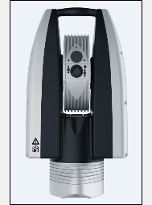
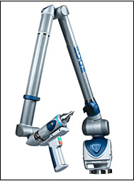
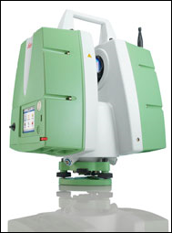
Instruments
Laser Tracker
PCMM (Probe/Line Scanner
Room Scanner
Notes:
There are three main ways to measure data to analyze within SA.
Laser tracker
PCMM
Room Scanner
First we will discuss utilizing a laser tracker.

Slide 4
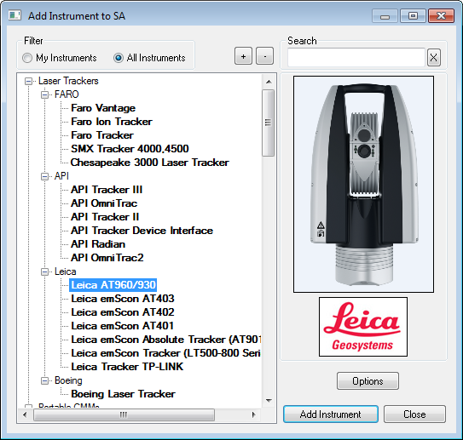
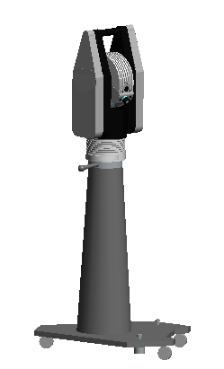
Instrument Add and Connection
Add Instrument
Notes:
[CLICK] To add a laser tracker to the job file, select the Add Instrument icon from the menu bar.
[CLICK] The dialog listing all of the available instruments will be shown.
(If the intended instrument is not listed make sure your filter is set to “All Instruments” then proceed to find the instrument you are looking.)
[CLICK] Once you have found the instrument you are looking for select “Add Instrument”

Slide 5
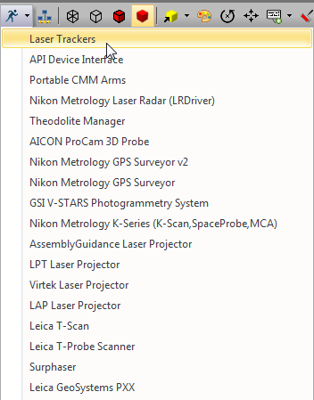
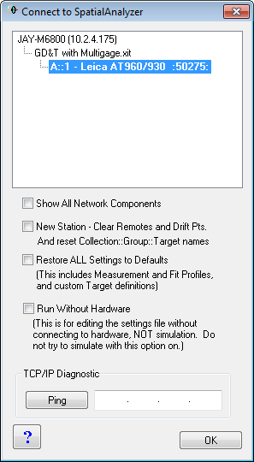
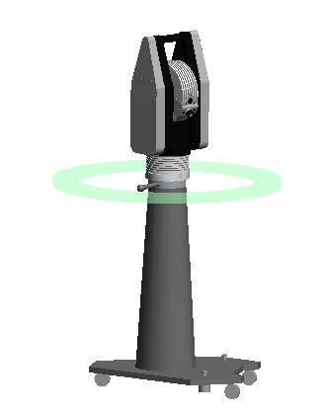
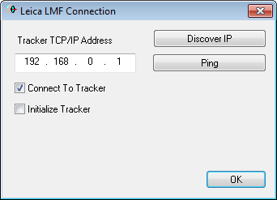
Instrument Add and Connection
Select Dropdown Menu
Notes:
Now with the instrument successfully added to the job file we can now connect. Ensure that all drivers, if necessary, and IP configuration has been installed and established.
[CLICK] Next to the add instrument icon there is an icon that allows you to begin the connection process, the “Run Instrument Interface” icon, or better known as the “Blue Running Man”. We will be selecting the dropdown next to that icon. This will show a list of instrument connection options. Select Laser Trackers.
[CLICK] Once you have done that in the next dialog you will now need to select your instrument and then click OK.
[CLICK] Next the connection dialog will appear. Here you may want to check the IP address and ensure that its correct (A ping can help with that). Then select OK.
[CLICK] A successful instrument will be displayed my a ring around the instrument in the graphical view as well as the instrument interface opening.

Slide 6
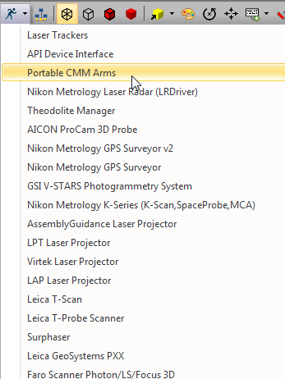
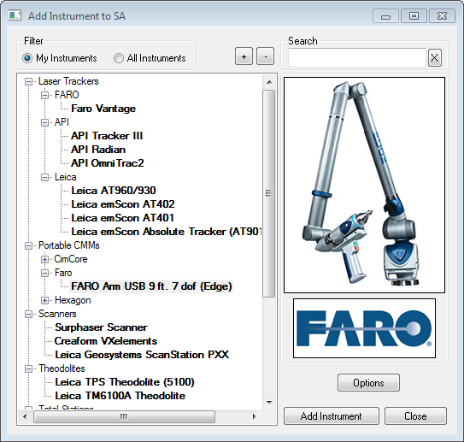
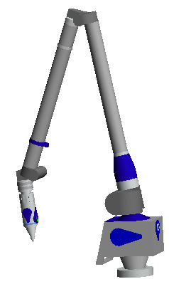
Instrument Add and Connection – PCMM Arm
Notes:
In the case of an Arm, the process is essentially the same..
[CLICK] but instead of selecting Laser Trackers we will select “Portable CMM Arms”. [CLICK]

Slide 7
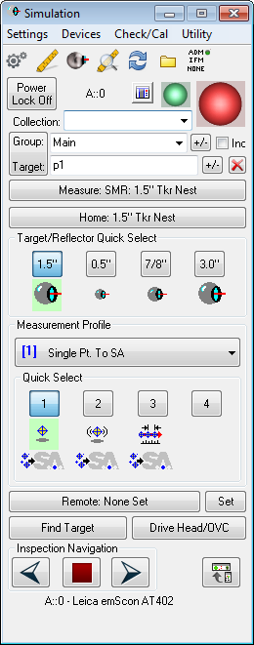
Instrument Toolbar
Toolkit
Tracker Toolbar
Arm Toolbar
Instrument Interface (PCMM Arm)
Full instrument control.
Instrument Interface (Tracker)
Full instrument control.
Notes:
There are two ways to interface with most instruments in SA. The first is to use the instrument interface. As you can see the interface for the PCMM Arm is more simpler visually than the tracker interface. The instrument interface has additional complexity, but provides more full-featured control over measurement parameters.
[CLICK] The more streamlined interface is the instrument toolbar, which is easier to use but slightly less flexible. Also the use of the instrument toolbar more visually appealing when utilizing the toolkit at the same time.
We are going to focus on the instrument toolbar and utilizing the SA Toolkit.

Slide 8
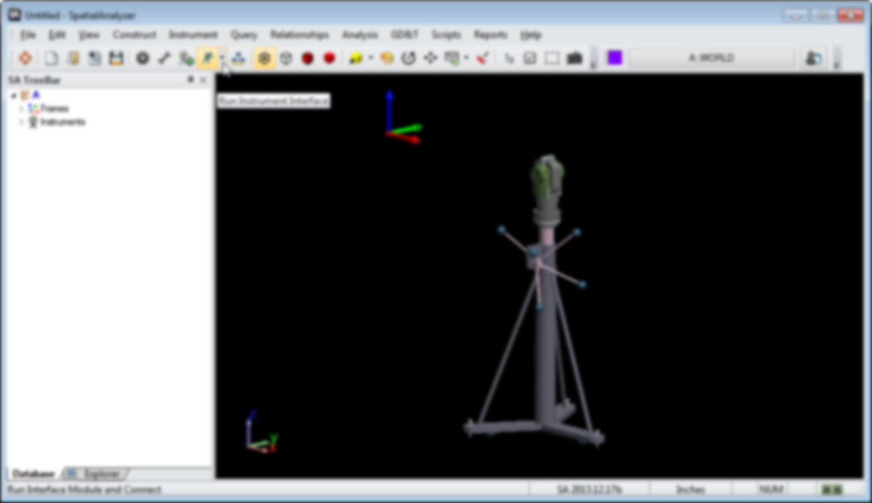
Instrument Toolbar
Home
Target Name
Beam Status
Tooling Quick-select
Current offset(s)
Measurement Profiles
Notes:
So here’s what the instrument toolbar looks like for a laser tracker.
Beam Status Indicator provides information on whether you have a lock, whether you’re measuring, whether the tracker’s waiting for the probe to move or become stable, and more. You can click the beam status indicator to initiate a search and try to lock on a target.
[CLICK] Home icon allows you home that tracker if it has a home nest.
The toolbar includes many of the normal operations that are included in the traditional instrument interface.
Target Name text field will be used for collection, group, and point naming.
Tooling Quick Select allows you to quickly switch back and forth from up to four designated toolings The four icons below the target name allow you to quickly switch between four different tooling combinations. By right-clicking each of these icons, you can assign different tooling to them.
The Current tooling offset is listed next to the quick-select. It will show the probe diameter (if using just a probe), or the planar and radial offsets (if using other tooling).
The next 8 icons are measurement profiles—that is, different measurement modes.
The first 4 preset measurement modes correspond and 4 user-definable modes – you can assign your own measurement profiles to those slots.

Slide 9
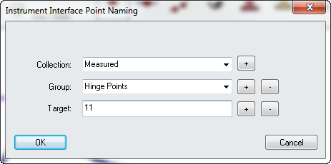
Instrument Toolbar
Target Name
Notes:
[CLICK] In an effort to make this toolbar more intuitive a simple left click on the Target Name text field will allow you to change the collection, group, and target for the measured point. The target name will automatically increment by one for each measurement.
[CLICK] This will open the point naming dialog where you can specify the collection, group, and target names. The target name will automatically increment by one for each measurement.

Slide 10
Instrument Toolbar
Tooling
Selection
Current offset(s)
Notes:
The four icons below the target name allow you to quickly switch between four different tooling combinations. By right-clicking each of these icons, you can assign different tooling to them.
[CLICK] The current tooling offset is listed next to the quick-select. It will show the probe diameter (if using just a probe), or the planar and radial offsets (if using other tooling).

Slide 11
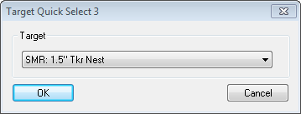
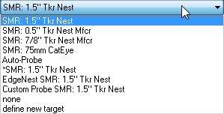
Instrument Toolbar
Notes:
The toolbar makes it easy to change quick selects and to define new tooling.
[CLICK] You can right-click each target slot and select a preferred tooling type to add in that quick select menu.
[CLICK] If you do not see the necessary tooling in the list, you can always “Define New Target” to build it.

Slide 12
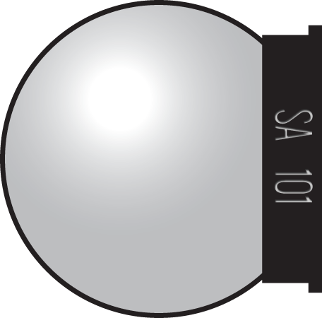
Recorded Measurements
Recorded Point
SA always records the center of the probe when a point is measure.
Offsets
Probe offsets are stored with every measured point.
Notes:
When you measure a point, the position of the center of the probe is what gets recorded.
[CLICK] SA also records probe offsets for every measured point, so it can calculate where the point of contact is located.
These offsets are also used when analyzing each measurement.

Slide 13
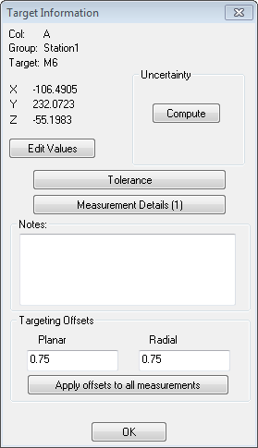
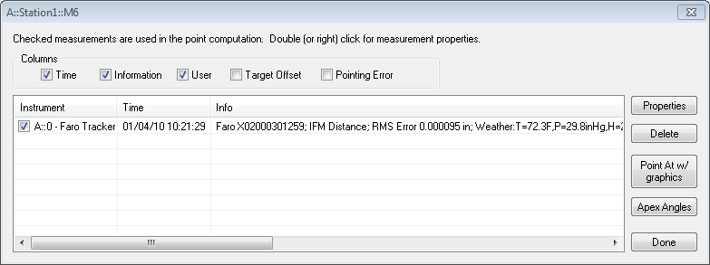
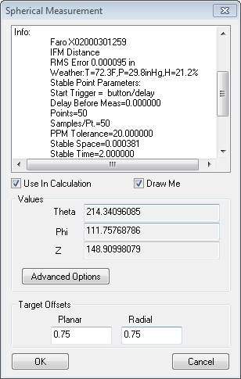
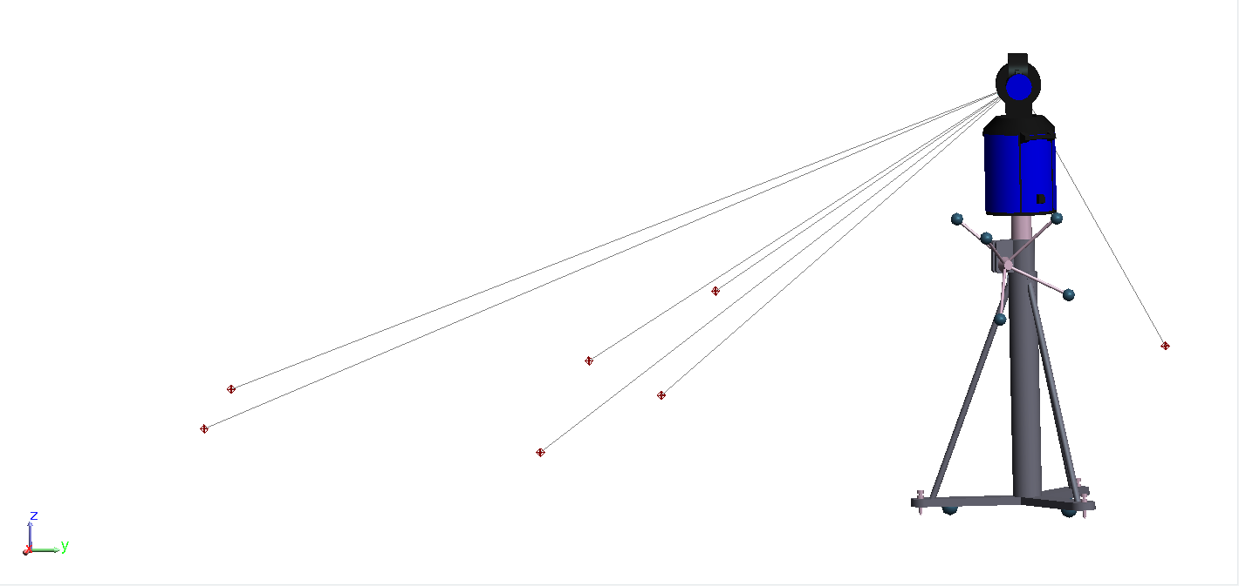
Point Traceability
Notes:
Traceability, is a cornerstone principle that allows the adjustment and reevaluation of data without concern compromising its integrity.
[CLICK] Select a point graphically or in the tree.
[CLICK] A Double-click it, or the use of the right-click menu to open its properties. Select the Measurement Details to see information about that point.
[CLICK] You will see pertinent information that is associated with that point such as weather and timestamps. If there is more than one single observation for a single point you may want to look closer at the individual observation.
[CLICK] Highlight the desired observation and click properties.

Slide 14
Instrument Toolbar
Measurement Profiles
Notes:
Looking back at the instrument toolbar, the 8 icons on the right side represent the measurement profiles, which are different measurement modes. Click any measurement mode to start it, and click it again to abort or stop it (if applicable).
[CLICK] The first 4 measurement modes correspond to Single Point (which records a single measurement when clicked), stable point (which records measurements when the probe becomes stable), spatial scan (which records sequential measurements as the probe moves through space), and tooling ball (which permits scanning of a tooling ball followed by an automatic sphere fit and sphere center creation).
[CLICK] The last 4 modes are user-definable—you can assign your own measurement profiles to those slots.

Slide 15
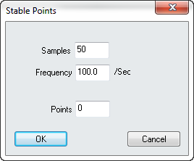
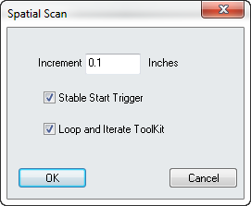
Instrument Toolbar
Notes:
Some of the modes have a few settings that can be adjusted by right-clicking on the icon.
[CLICK] For the spatial scan measurement profile you can set a stable start trigger along with the loop and iterate toolkit function. This control is helpful for scanning around a hole with a pin nets. It recognizes that a loop is closed and iterates to the next feature for you automatically when measurement counts can’t be used.

Slide 16
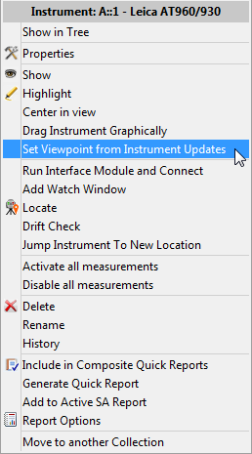
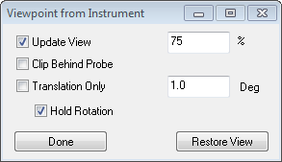
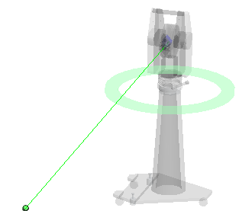
View Control
Notes:
View control can now be set from the instrument right-click menu for any instrument (that returns either 3D or 6D probe updates).
CLICK Panning can be configured to only occur when the probe moves within a proximity of the edge of the view.
Full rotation can also be limited by angular motion and can continue while constraining roll to align with
the instrument orientation.

Slide 17
Best-Fit Alignment
Notes:
Next we will talk about best fit alignment.

Slide 18
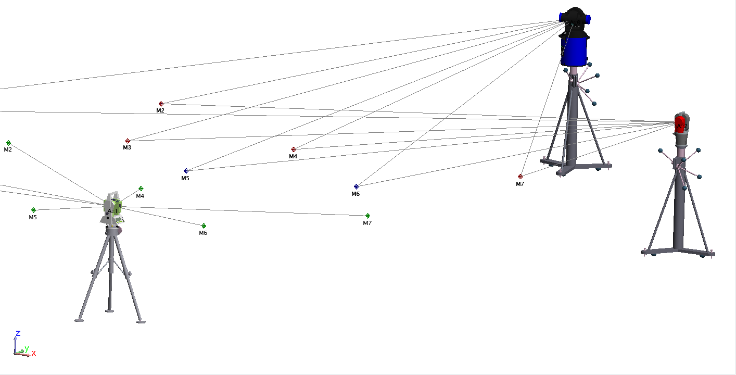
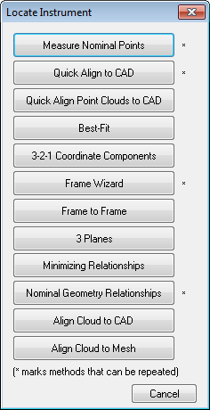
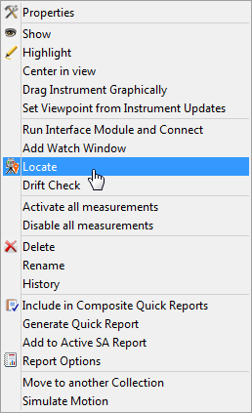
Best-Fit Alignment
Measured points are tied to the
Instrument that measured them
Instruments can be moved as needed
without losing measurement integrity
Notes:
A Best-Fit transformation solves for the difference between a group of points and the expected (or reference) coordinates for those points.
[CLICK] To perform this alignment you can right-click an instrument and select Locate.
[CLICK] In the next dialog select “Best Fit” as the alignment method. With multiple instrument stations a best fit can be used to align them to a nominal set of points based on the points each has measured. Each instrument and its measurements will move as a rigid body.

Slide 19
Best-Fit
Notes:
[CLICK] You first will measure the reference points,….[CLICK]

Slide 20
Best-Fit
Notes:
…then transform the instrument so that the measurements best fit the reference points.
[CLICK]

Slide 21
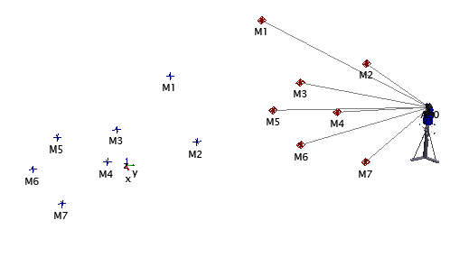
Best-Fit – Auto Vectors
Notes:
Possibly you would like to visually show the deviations of your best fit…
[CLICK] When using a Best fit to align an instrument you can create auto vectors to visually display the deviations in the fit. [CLICK]

Slide 22
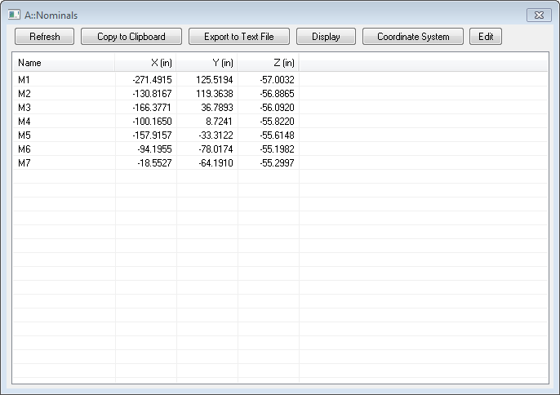
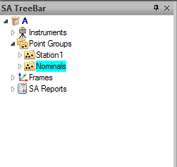
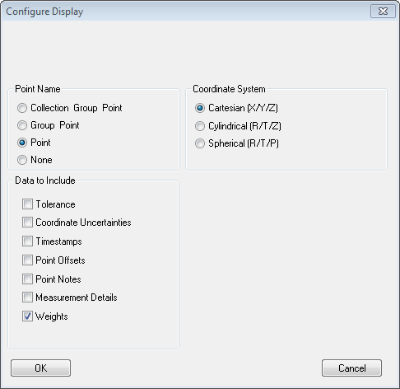
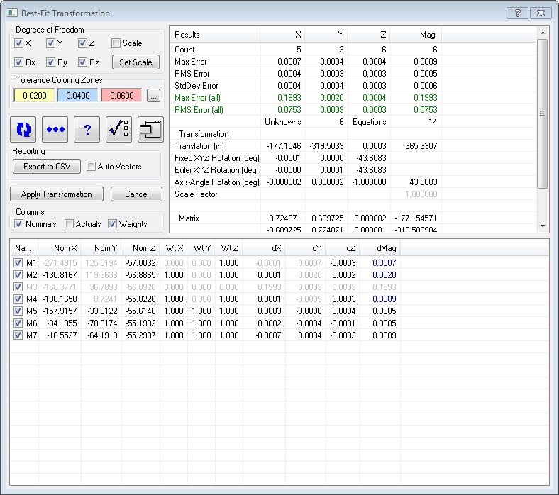
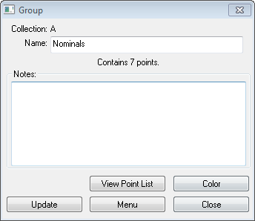
Best-Fit
View Point List Control
Notes:
The View Point list can be the doorway to controlling all point settings.
[CLICK] First open the point group properties and select the View Point List.
[CLICK] The point list will open and selecting Edit will allow you to change weights, tolerances, etc.
[CLICK] Once the changes are made select Display to allow you to configure what properties are displayed for each point.
[CLICK] Once the data to include has been added it will be reflected in the best-fit transformation.

Slide 23
Toolkit Relationships

Slide 24
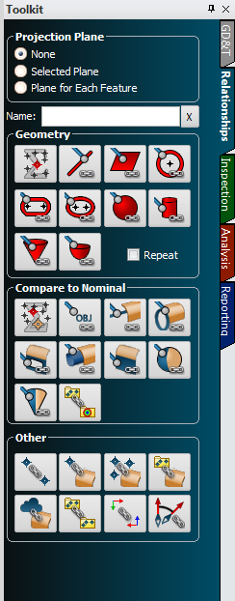
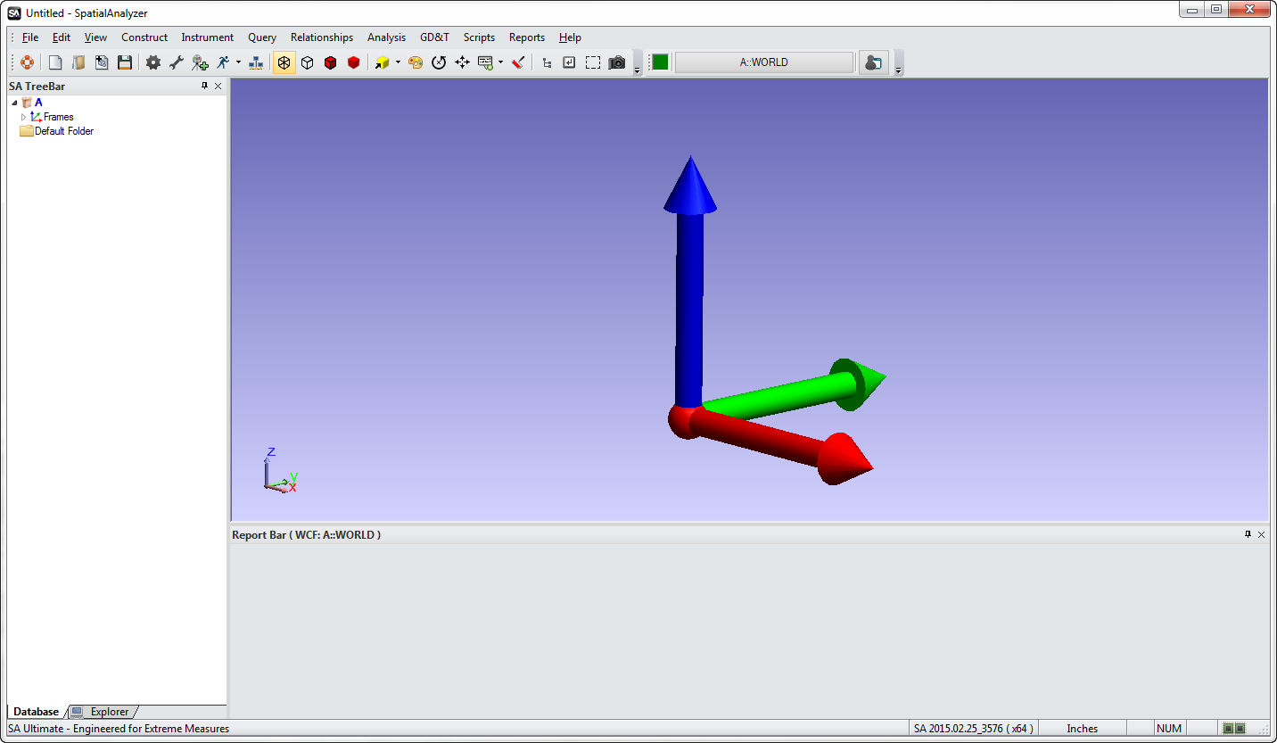
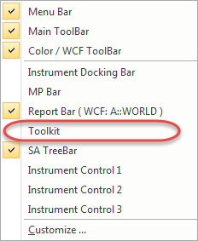
Toolkit Relationships
Notes:
If not visible the toolkit can be opened by right-clicking in the gray space on the right side of the main menu then selecting it from the dropdown.
The toolkit will dock itself on the right side of the graphical view.

Slide 25
SA Toolkit
GD&T
Relationships
Inspection
Analysis
Reporting
Notes:
The SA Toolkit contains five tabs that provide convenient access to a number of useful SA tools. These tabs include:
GD&T contains tools for creating GD&T checks from CAD surfaces, primitive objects, or directly from points.
Relationships tab contains tools for quickly creating various types of relationships.
Inspection tab allows you access to a list of inspection-ready items with buttons for advancing through the inspection.
Analysis allows one-click access to many analysis tools.
Reporting contains buttons for creating reports, dimensions, and callouts.
We will be focusing on the Relationships and Inspection tab.

Slide 26
Geometry Relationships
Projection Plane
Define/select projection planes
Geometry Name
Control of relationship name
Build Geometry
Dynamic geometry fitting
Compare to Nominal
Quick link to CAD feature Comparison
Other Relationships
Comparison and alignment relationships
Notes:
The relationships tab enables one-click definition of features (defined by CAD or using primitive geometry) primed for easy inspection using geometry relationships, with or without projection planes. Other relationships can be easily defined as well.
The relationships tab is divided into five sections:
[CLICK] Projection Plane: define/select projection planes.
[CLICK] Name: Control name of relationship.
[CLICK] Geometry: dynamic geometry fitting.
[CLICK] Compare to Nominal: fit and compare geometry to a specified nominal geometry.
[CLICK] Other: All other relationship types.

Slide 27
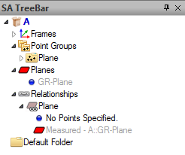
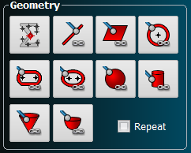
Geometry Relationships
Plane Geometry Relationship
Notes:
[CLICK] After naming the geometry relationship and selecting the type of relationship you would like to create, a “phantom” relationship and feature will populate in the tree.
[CLICK] This will represent the resultant geometry and relationship that will be created once measurements are trapped in the inspection list or existing points are associated.

Slide 28
Geometry Relationships
Select radio button
-OR-
Hover and Right-Click
Notes:
Setting a Projection is fast and simple. There are two ways you can set projection planes for geometry relationships.
[CLICK] Select the radio button in the projection plane section which allows you to select a plane that is already created
OR
[CLICK] Hover over the plane geometry relationship icon then right-click. This creates a projection plane relationship that will be used as the projection plane for the next feature.
[CLICK] When a projection plane is set all features that cannot be projected to a plane will be grayed out only leaving the acceptable options.

Slide 29
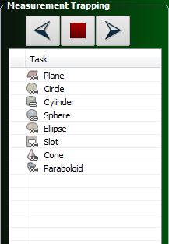
Toolkit Inspection Tab
Inspection List
Displays each of the measurable items defined in the tree
Measurement Trapping
Control over current active Item and order in the list
Notes:
[CLICK] The Inspection tab of the toolkit will display in a list all of the measureable relationships that are in the tree.
[CLICK] This allows you to implement the concept of measurement trapping. Each relationship can almost be considered a bucket that you can fill with measurements. To begin the trapping process, after you have connected to an instrument, simply double-click the desired feature in the list.

Slide 30
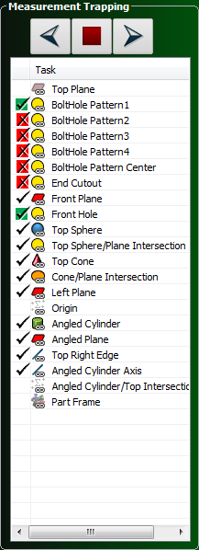
Inspection Tab Icon Status
No Points Associated
Points Associated with no Tolerance applied
Pass per Tolerance
Fail per Tolerance
Notes:
[CLICK] Relationship status icons have been added in the inspection tab as well as the tree.
[CLICK] The first status, faded icon, means that no points are associated with the relationship.
[CLICK] Just a single check mark indicates that the relationship has points associated.
[CLICK] Next is the Pass per the tolerance that was set for that relationship.
[CLICK] Lastly is the Fail per the tolerance that was set for that relationship.

Slide 31
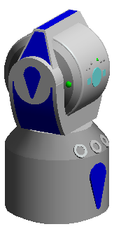
Inspection Measurement Trapping
Notes:
If you would like to measure the plane, use the inspection tab to trap measurements to that geometry relationship.
[CLICK] With SA connected to an instrument, double-click the desired relationship in the measurement trapping list and begin measuring points. As each point is measured the HUD will increment to display the number of points measured for that relationship.
[CLICK] Also notice that the geometry will recalculate as new measurements are taken.

Slide 32
Geometry Relationships
Plane
The Associated Data command through the right-click menu can be applied to existing points.
Notes:
If the measurements have already been taken, they can be associated to the relationship by using the right-click menu.
[CLICK to start video.]

Slide 33
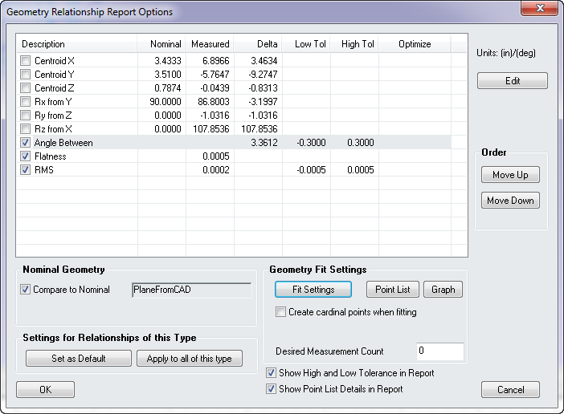
Geometry Relationships
Plane
0
Notes:
The report options for any desired geometry relationship can be selected via the right-click menu “Report Options”, or double-click the geometry relationship in the tree bar.
[CLICK] To compare the measured plane to a nominal feature select the “Compare to Nominal” box, then select the plane in which you would like to designate as the nominal plane. After this selection the nominal values and deltas will be populated.

Slide 34
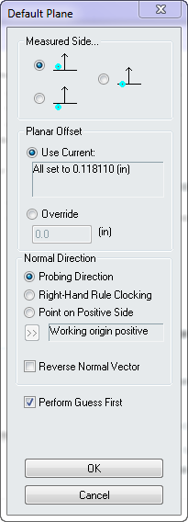
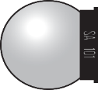
Geometry Relationships
Plane
Notes:
[CLICK] To change the resultant geometry select the fit settings option.
[CLICK] Here you can select which side of the geometry was measured. Remember. the initial geometry location is based on the line of sight for trackers and the angle of approach for a PCMM Arm.
[CLICK] The objects normal vector can also be reversed if you would like it to point in the opposite direction. [CLICK]

Slide 35
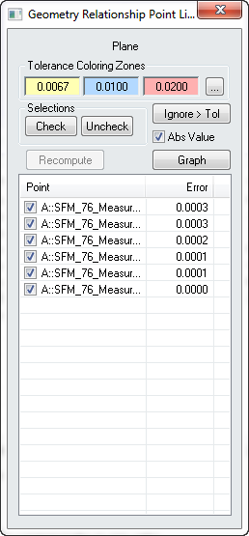
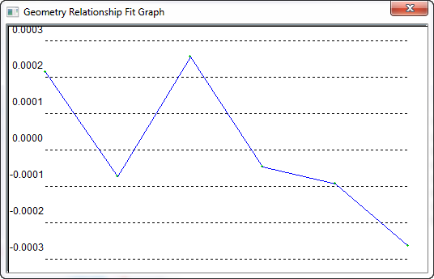
Geometry Relationships
Plane
Notes:
You can also take a look at the points list and graph for the fit geometry.
[CLICK] Here you can ignore points and recalculate the geometry.

Slide 36
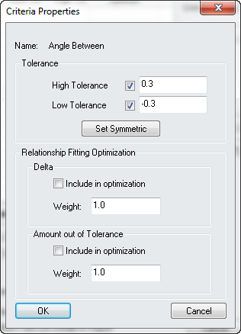
Geometry Relationships
Plane
Notes:
When setting tolerances for specific features highlight the name in the description column then select “Edit”.
[CLICK] The tolerance properties will open and there you can set your values.
[CLICK] You will be able to see the measured properties of the geometry and the specific features that will be reported are designated by the check box.

Slide 37
Auto Vector – Fit Geometry
AVF
Notes:
Users may now activate auto vectors to display the deviation of individual measurements to their fi t geometry.
CLICK The abbreviation AVF refers to Auto Vector Fit.

Slide 38
AVN – Cardinal Points
Notes:
Auto vectors may also be activated to display the deviation between cardinal points of the measured feature to the nominal:
AVN = Auto Vector Nominal

Slide 39
AVN – Input Points
Notes:
Auto vectors may also be activated to display the deviation between input points (compensated measurements) to the nominal geometry:

Slide 40
Dynamic Geometry Relationships
NEW DYNAMIC GEOMETRY
Notes:
The newly added dynamic geometry relationships allows features to be dependent upon other features for creation.
[CLICK] Dynamic Point Relationship
[CLICK] Dynamic Line Relationship
[CLICK] Dynamic Plane Relationship
[CLICK] Dynamic Circle Relationship
[CLICK] Dynamic Ellipse Relationship

Slide 41
Measure Geometry
Demo-
Building
Geometry
Notes:
Demo1_ Simple Relationships:
Build a groups to objects relationship
Show how the vectors update
Relationship alignment
Adjust the relationship properties
For tolerance
For visualization

Slide 42
Nominal Geometry Relationships
Notes:
[CLICK] The next section of the Relationships tab is the Compare to Nominal Section.
The main difference with these relationships is that they compare the measured data to a nominal cad face.
After selecting the desired Nominal geometry relationship you will be prompted to select a cad face that represents the nominal feature you would like to compare.
[CLICK] Notice that some of the relationships have right and left click options as well as a possible Alt-L selection.

Slide 43
CAD Import
Auto-Import
(by file extension)
Direct CAD Access
Standard Importer
Explicit Import Methods
Notes:
[CLICK] To import CAD, you can select File>Auto Import (by file extension) to automatically identify the format by file extension.
[CLICK] Or you can pick an explicit import method through the File>Import menu.
[CLICK] When importing, you can use a standard importer that will bring in STEP, IGES, VDA, and SAT files.
[CLICK] However, we generally recommend initially using the Direct CAD Access import capability.

Slide 44
Objects From CAD
Notes:
Some Construction icons you may find useful are:
[CLICK] The Frame Wizard allows you to create a frame from point and objects.
[CLICK] Constructing Objects from Surface Faces will allow you to create points offset from a surface or geometry from primitive cad models.
[CLICK] Creating Circle Centers is a great tool to quickly construct points at the center of circles in the job file.

Slide 45
SA Toolkit
Points to Objects
Groups to Objects
Clouds to Objects
Notes:
[CLICK] Using the “Other” section of the Relationship Tab of the SA Toolkit will allow you to create the standard relationships.
[CLICK] In the properties of the created relationship there are settings that can be changed to give you full control of that relationship.
[CLICK] Selecting the Projection Properties will allow you to ensure the deviation arrows are point in the correct direction.

Slide 46
Recorded Measurements
Create vector from nominal object to point of contact.
“Inspect” point of view
Notes:
[CLICK] One selection for the direction of the vector is starting from the nominal surface point in the direction of the contact point.
[CLICK] This is called the Inspect point of view and can be used when trying to figure out how far out the actual part is from the nominal.

Slide 47
Recorded Measurements
Create vector from point of contact to nominal object.
“Build” point of view
Notes:
[CLICK] Another selection for the direction of the vector is starting from the contact point and pointing towards the nominal surface.
[CLICK] This is called the Build point of view and can be used when trying to figure out the direction and distance you need to go to make the part better.
[CLICK] In the properties of the created relationship you can create dynamic auto vectors. These will update to display new deviations if the relationship changes in any way. A vector group will appear in the tree.

Slide 48
Vectors for Visualization
4 Vector Types / Magnification
– Arrows
– Blotches
– Tubes
– Arrows + Blotches
Notes:
Within the Vector Group Properties you can change the way they are displayed to help visualize the deviations.
[CLICK] The components used in the vector can be changed to reflect deviation along a certain axis.
[CLICK] The vector group statistics will display things such as the max and min deviations as well as the RMS.
[CLICK] The Draw As section lets you change the vector type and magnification. There are 4 types of vectors that can be created.
[CLICK] Arrows
[CLICK] Blotches
[CLICK] Tubes
[CLICK] Arrows + Blotches

Slide 49
Vectors for Visualization
Tolerances and Colorization
Tolerance Control
New Colorizer Tool
Show/Hide Color Bar
Notes:
Tolerances and Colorization
[CLICK] Tolerance control allows you to set asymmetrical and symmetrical tolerances for the vector group.
[CLICK] The new colorization tool allows for easier use of color bars and setting tolerances and limits.
[CLICK] If you would like to show the color bar graphically select “Show in View”.

Slide 50
New Colorizer – Discrete 4, 8, &12
Notes:
The New colorization tool now allows for the creation of a Discrete Color Bar.
You can select from 4, 8, or 12 Colors.
Also we have integrated three different color spectrums that can be utilized
Standard
Gray Scale
Deuteranopia (colorblind friendly)
Supports Continuous and Symmetric color distribution modes

Slide 51
New Colorization Options
Notes:
New Colorizer Options.
Using the new colorizer you can now set the default tolerance that will be used for all vectors that will be created in the job file.

Slide 52
Vectors in Report Bar
Tolerance and Colorization
Each have there own representation in vector table
Notes:
After the color bar is selected along with the selected tolerances…
[CLICK] The vector group statistics as well as a detailed table can be found in the report bar.
The Magnitude will display the Pass/Fail relative to the tolerance that was set.
The Colorization column will show the color of the vector based on the set.

Slide 53
Trapping Vectors
Notes:
A new function has been added to the Relationship Category in the tree that allows you to display the auto-vectors for any relationship currently set as the active trapping target. [CLICK]
A placeholder vector group will be built and updated with each relationship that is selected unless an auto-vector groups has already been built. In that case, the existing vector group will be displayed and then hidden when you move to the next relationship.

Slide 54
Nominal GR Alignment
Notes:
Nominal Geometry Relationship Alignment
Just as any other instrument alignment you can right-click the instrument and select Nominal Geometry as the alignment.
This will bring up the F2 dialog that shows all of the point reducible geometry relationships that you can use for alignment.
[CLICK] After your selection a best fit is performed between the center of the measured feature and the nominal geometry center.

Slide 55
Frame Wizard Relationship
Notes:
A Relationship type has been added to SA called a Frame to Nominal Frame relationship.
This function operates like a Geometry Relationship in that it provides a customized comparison report between the nominal and measured features. It also combines the best features of our Frame Wizard utility with the 6D dynamic comparison power of a Frame to Frame relationship. This powerful new tool allows you to build a dynamic frame from measured features and have it continually update as those features are recomputed or moved. It also provides a convenient way to perform a frame to frame alignment.

Slide 56
Vectors for Visualization and Alignment
Demo-
Building
Relationships
Notes:
Demo1_ Simple Relationships:
Build a groups to objects relationship
Show how the vectors update
Relationship alignment
Adjust the relationship properties
For tolerance
For visualization

Slide 57
Point Clouds in SA

Slide 58
Instruments
Arm Toolbar
Laser Tracker
PCMM (Probe/Line Scanner
Room Scanner
Notes:
There are three main ways to measure data to analyze within SA.
Laser tracker
PCMM
Room Scanner

Slide 59
PCMM Arm Scanning
Notes:
Scanning with a PCMM arm made easy
[CLICK] Once connected to the arm just select the Scanning icon to put the arm in scan mode, which allows you to scan and create a scan stripe cloud. “Pink Cloud”

Slide 60
Deleting Vectors/Cloud Point Pairs
Notes:
Two new functions have been added to the Edit menu that allow a user to select and delete both vectors and the corresponding points. Note that this only works with vectors created in this version and later.

Slide 61
Real Time Coarse Mesh
Notes:
New Scan Strip Mesh
A refined mesh can now be built from Scan Stripe Clouds with a significant amount of control. These settings are provided within the Mesh properties and the fine mesh can be re-generated as needed based upon changes made to the originating cloud.
[CLICK]
Real-Time Course Mesh
A course mesh can be built from cloud points as you scan. This makes it easier to see the extent of data coverage during a scanning operation. This can be turned on through the cloud’s properties and set as default if you want a course mesh generated for all clouds.

Slide 62
Colorized Mesh
Notes:
Colorized Mesh from Point Clouds
While SA could build a colorized mesh to display point deviations in the prior version, this function has now been expanded to be used with point clouds. It provides a means to display a colorized surface displaying deviations as transitions between colors. Colors can be configured using the same parameters used for vector groups.

Slide 63
Large Volume Scanning
Room Scanner
Notes:
Large volume scanners can record an immense amount of data, which SA has enhanced.

Slide 64
Room Meshing
Notes:
We can now mesh large volume scans.

Slide 65
Dimensions and Callouts

Slide 66
Reporting Tab
Reports
Build and access SA Reports
Dimensions
Quick format control for linear and angular dimensions.
Callouts
Links to building and annotating Callout Views
Notes:
The Reporting tab in the toolkit gives quick access to building and viewing reports.
[CLICK] Reports section allows you to create new reports and choose which report to view from the drop down selection.
[CLICK] Dimensions section will create dynamic dimensions using points and objects.
[CLICK] The Callous section will essentially allow you to create screenshots that can be used in reports as a visual aid.

Slide 67
Dimensions and Callouts
Dimensions-
Part Centric
3D Annotations
Callouts-
Screen Centric
2D Annotations
DYNAMIC
Notes:
Though callouts and dimensions can be used to help display the results of data analysis, they are different.
Callouts are positioned based on the screen in a 2D layer. This means that they do not change in size with the cad model when zooming.
[CLICK] In opposition dimensions are oriented to the part or features that drive it. This means that they will remain relative to the size of the part when zooming in and out.
[CLICK] Either one you choose they both are dynamic and will update whenever the feature changes in any way.

Slide 68
Dimensions
Dimensioning in SA
3D / Object Oriented
Right-click formatting
Notes:
Creating a Dimension from the reporting tab of the toolkit is simple.
[CLICK] Select the type of dimension you would like to create: Point to Point, Point to Object Axis, or Object Axis to Object Axis.
[CLICK] Then select the features you would like to know the dimension for. Once created you can graphically right-click the dimension to open its properties.

Slide 69
Dimension Tolerance
Point to Point
Dimensions
Notes:
[CLICK] Lets create a point to point dimension.
[CLICK] To open the properties of that dimension you can right click it graphically or in the tree. Now we have the ability to add a tolerance to the dimension
[CLICK] You can specify a nominal value and add a tolerance based on that value. The nominal value and the tolerance will be reflected in the properties.
[CLICK] Now graphically we show the actual dimension and the amount the dimension exceeds the designated tolerance.

Slide 70
Dimension Tolerance
Notes:
When using dimension tolerances you can also set the high and low tolerance as a value larger and smaller than the measured value, which will result in a pass or fail.

Slide 71
Dimensions
Add Target Offset
Subtract Target Offset
Point to Object
Dimensions
Object Use: Origin
Notes:
To make a point to object dimension is just as easy.
[CLICK] In the properties you have the option to add or subtract the target offset, as well as changing how to use the object such as a dimension from the origin instead of the plane.
[CLICK] Here are examples of each of those scenarios.

Slide 72
Dimensions
Object to Object
Dimensions
Notes:
[CLICK] To create an Object to Object dimension you can select the last icon in the “Linear” section, which will give you a distance between one object axis to another. The other options in the Angular section will look at either the angles between an object axis and another object axis, the object plane and another object plane, or a combination.
[CLICK] Within the properties these can be treated the same as the others and angular tolerances can be set.

Slide 73
Callouts
– Screen Centric Annotations
Add a New Callout
Choose to add text, vectors or relationship info
Notes:
To make a callout from the Reporting tab of the toolkit…
[CLICK] Select the add new callout button.
[CLICK] Then choose the type of information you would like to add to your callout.

Slide 74
Image Callout
Notes:
This new callout type allows you to add an image as an overlay directly within the SA graphics.
This can be very useful in prompting operators during a measurement process with visual aids.

Slide 75
Callout Properties
Notes:
Once the callout is created you can open its properties using the right-click menu.
[CLICK] In the properties dialog you can lock the viewpoint, recall the working frame, and set the visibility.

Slide 76
Vector Callout (Max/Min)
Min/Max Vector Group Callout
Notes:
Max/Min Vector callouts added directly to auto-vectors now refresh dynamically as points are added to the relationship such that the highest and lowest vectors always have the callout labels attached.

Slide 77
Building a Report

Slide 78
Building a Report
SA Reports:
Drag and Drop
Quick Reports
PDF/Excel Export
Notes:
[CLICK] Building a Report in SA is simple and easy with its drag and drop option and quick formatting. Also Export to PDF in a snap.

Slide 79
Building a Report
Image Capture
Table Construction
Report Generation
Notes:
[CLICK] Some key features of SA reporting include capturing images/visualization, building tables, and actually generating the report.

Slide 80
Building a Report
Users Options:
Display Options
Unit Control
Notes:
The user options is a great tool which allows you to change some of the display options to help generate a clean and visually appealing and informative report.
[CLICK] When building a report that will utilize screenshots from the graphical view it may be important to show or hide the shot lines from the instrument(s).
[CLICK] Also ensuring that he decimal precision is shown correctly.
[CLICK] When looking at linear distances the length value should be changed to represent the desired decimal precision.
[CLICK] The values will then reflect the change.

Slide 81
Building a Report
Users Options:
Angular Units…
Notes:
[CLICK] in the Units tab of the user options the angular units can be specified as well.
[CLICK] Notice in a point group reported in Cylindrical Coordinates the theta angle reflects the unit setting.
[CLICK] The same applies for features that are constructed, such as points and frames.

Slide 82
Building a Report
Add new Report
Drag and Drop
Notes:
[CLICK] Select the button at the top of the report tab in the toolkit to make a new report.
[CLICK] To add things to the report its as simple as drag and drop from the tree.

Slide 83
Building a Report
Notes:
This is a short video showing the simplicity of dragging a dropping items into a report.
To add an item to a report, simply click on an item in the tree and drag it into the report designer. Once inside the report, items can be moved by dragging them.

Slide 84
Generate a Quick Report
Right-Click
Notes:
[CLICK] Use the Right-Click Menu to select any feature in the tree to create a report including only that information.
Once the report is created you still have the option to add more information to the report via drag and drop.

Slide 85
Dynamic Reporting
Dynamic Reporting with Geometry Relationships
Notes:
A report can be created in a way that it will update as measurements are being taken.
[CLICK] As measurements are added to the reported relationships they will update to show the current deviations.

Slide 86
Exporting a Report
Fundamentals
of an SA Reports
Notes:
Exporting to PDF and Excel may be essential functions of your reporting process.
[CLICK] An entire report can be exported to excel by clicking the excel button in the reporting menu.
[CLICK] Individual items can be exported to excel as well. To do this, right-click the item in the report that you would like to export and select “Export to Excel”.
[CLICK] The same process goes for exporting to PDF. Use the PDF option in the reporting menu.

Slide 87
Thank You
By: Jay Urquhart

Slide 88
Building a Report
Fundamentals of an SA Reports
Basic Layout Controls
Notes:
[CLICK] Within the Page Settings Dialog there are few settings that can help to format your report.

Slide 89
Building a Report
Notes:
Before creating a report, it is important to select the appropriate page layout. The layout may be changed during report design, however it could change the layout of some existing items. The Report Table Settings dialog is accessible by clicking the Table Styling Options.
[CLICK] Default Fonts: make changes to tabular or text styling.
[CLICK] Page Setup: allows you to change how the page setup to either landscape or portrait.
[CLICK] Table Styling Options: You can change the background and text color of the header title as well as other display options that may be easily selected or deselected.
[CLICK] Grid: These options allow you to display a grid to make it easy to align items in the report. As you drag an item in a report the “snap to grid” option will perform just as it states, snapping the item to each grid line.
[CLICK] Headers and Footers: more display options for the header and footer.
[CLICK] PDF Printing: you may turn image compression on or off when printing to a .pdf file.

Slide 90
Building a Report
Users Options:
Logo…
Byline…
Notes:
The contents of the report header can be formatted to include a logo image and a company byline. To include this information, navigate to Edit>User Options. Select the Reporting Tab.
[CLICK] The logo filename may be added by selecting the “Select” button and locating the picture on your computer.
[CLICK] You may also type in your company’s byline.

Slide 91
Building a Report
Render Modes
Translucency
Color Options
Background
Object colors
New Graphic Window….
Cropping
Formatting
Notes:
A few other settings that will aid in preparing for report creation are the background color, rendering mode/translucency, and color options.
[CLICK] These can be found in the menu bar.

Slide 92
Building a Report
Jump to Next Input Field
Save as PDF
Zoom Out
Excel Export
Refresh
Print Current Report
Help
Page Setup
Zoom In
Zoom 100%
Lock Report
Notes:
Report Toolbar
[CLICK] PRINT CURRENT REPORT: displays print dialog for the current SA report.
[CLICK] SAVE AS PDF: allows the current SA Report to be saved as a PDF document.
[CLICK] GLOBAL REPORTING OPTIONS/PAGE SETUP: displays SA Report Options such as page layout, default fonts and other options.
[CLICK] REPORT REFRESH: refreshes the SA report with the current values from the tree.
[CLICK] DOCUMENT ZOOM IN: increases the scale of the report.
[CLICK] DOCUMENT ZOOM OUT: decreases the scale of the report.
[CLICK] DOCUMENT ZOOM 100%: restores the report scale back to 100%.
[CLICK] EXPORT TO EXCEL: exports the current SA report to Excel.
[CLICK] LOCK REPORT: when clicked the SA Report becomes static and will no longer receive updates from the tree.
[CLICK] HELP: displays useful information regarding how to navigate and interact with the Report Designer.

Slide 93
Building a Report
Reporting Fields
Input & Export
Values and Tags
Required Fields
Notes:
[CLICK] To add a new field right-click anywhere on the canvas of the report.
Input fields are intended for the user to input information (which will be red if they are required).
Output fields have a gray background.
[CLICK]
A Value is used to populate the field. Field values are always displayed in the field itself, and are changed when a script or a user modifies the field.
A Tag could be something such as the Date/Time or filename.

Slide 94
Building a Report
Adding Report Shapes
Notes:
Shapes can be created within a report to add emphasis to specific details.
[CLICK] To add a new shape right-click anywhere on the canvas of the report.

Slide 95
Best-Fit – Point Weights
Fit Stats and Point Control
Fit Statistics
Point Control
Notes:
[CLICK] The Fit Statistics include items such as:
Count – Number of points in the fit.
Max Error – Maximum error between a pair of matching points.
Translation – The X,Y, and Z instrument translation needed for solution.
[CLICK] Point Control includes the list of point pairs being used in the transformation.
[CLICK] Points can be excluded by unchecking them in the point list
[CLICK] By Right-Clicking the desired point in the list you can change the weights of each component of each point.

Slide 96
Analysis Tab
VISUALIZATION
View Control Options
Construction
Construction Menu Options
Fitting
Quick link for geometry and relationship fitting.
Uncertainty
Calculate uncertainties and measurement simulation
Scaling
Comparison and alignment relationships
Notes:
The analysis tab is divided into five sections:
[CLICK] VISUALIZATION: commonly used commands you may find in the VIEW menu.
[CLICK] CONSTRUCTION: frequently used commands from the construct menu.
[CLICK] FITTING: commands for geometry and relationship fitting as well as two methods for instrument location.
[CLICK] UNCERTAINTY: calculating uncertainties and measurement simulation.
[CLICK] SCALING: temperature compensation and scaling methods.

Slide 97
Dimensions & Callouts
Dimensions:
Text orientation control (Screen / Along)
Dimension component control (Point to Point)
Text Placement control through offset along axis & radial
Notes:
To increase visibility for dimensions that would otherwise be hidden you can offset radially or along the axis.

Slide 98
Dimensions & Callouts
Text orientation control (Screen / Along)
Dimension component control (Point to Point)
Text Placement control through offset along axis
Dimension Report Tables
In-line Notes
Notes:
The dimensions can be easily added to a report and additional notes can be added to the graphical dimension to help with clarity.

Slide 99
Recorded Measurements
Notes:
If we delete some of the faces of this CAD surface, we can see that the model of this boat is really just a shell.
[CLICK] If we look at the surface normals for this boat model, they all point outward—away from what would be the material of the real object.
The colored side of the cad model indicates the positive side. The gray side indicates the negative side.

Slide 100
CAD Import – Verify Surface Normals
Notes:
It is good practice to change the color of a model so that it is not gray. This will help indicate which side of each face is positive and negative.
[CLICK] To change the color of the cad model to aid in verifying the surface normals you can select the Color Objects icon (Paint Roller). If the surface color remains gray after the selection then it represents the negative side.
[CLICK] If you notice that some outward faces are positive and some are negative, open the Direct CAD Access Settings and change the Surface Normals Mode. Then try and reimport the cad model.

Slide 101
CAD Import – Verify Surface Normals
Notes:
This way, you’ll end up with a clean model with a single surface in the tree, ready to work with.
Using the command Edit>Surface Normal Conditioning>Reverse Surface Normals may be necessary changing the Mode still leaves surface normals flipped.
It’s worth noting that usually you don’t need to groom a model like this—but it’s important to know how when the need does arise.

Slide 102
Recorded Measurements
Offsets -
Are applied automatically when a comparison is made
Notes:
Looking at these points that are clearly off of the surface of the part…
[CLICK] But remember the tooling offsets are saved with each measurement and used for analysis.
[CLICK] We will get the correct value once they are analyzed, due to the offset automatically being applied.
We’ll see later how SA handles this when it tries to determine the deviation between a measured surface and the design surface.

Slide 103
Recorded Measurements
Radius: 0.75” (Offset Value)
Design Surface
Measured Surface?
Notes:
Knowing the probe offset, and thinking of the problem in just two dimensions, we can draw a circle around the recorded point to represent the probe.
[CLICK] We now know that, assuming the probe was touching the measured surface as it should have been, the point of contact is touching that circle somewhere.
So when you take a measurement, all SA really sees is this: the location of the center of the probe, and an offset value. [CLICK]

Slide 104
Recorded Measurements
Radius: 0.75” (Offset Value)
Design Surface
Projected Point
Measured Surface?
Offset Point
Notes:
To find the point of contact, SA first finds the closest point on the design surface to the measured point. The“Projected Point”.
[CLICK] The measured point and the projected point can then be used to create a line. As it turns out, geometrically that line is perpendicular to the design surface, and no point on the design surface is closer to the recorded point than the projected point.
[CLICK] That being said, the contact point or “Offset Point” can be created along that line to represent the measured surface.

Slide 105
Recorded Measurements
Measured Surface?
Radius: 0.75”
Design Surface
Surface Normal
Notes:
The way that SA figures out which side is the inside of a surface is by looking at its surface normal direction. Every surface and geometric feature in SA has surface normals that indicate which side of the surface points toward the outside of the surface that it represents.
[CLICK] In this example the, if the surface normal is point outward, the actual projected point would be analyzed as follows.

Slide 106
Recorded Measurements
Notes:
In this example, because the normals are facing up,
[CLICK] SA assumes the point of contact to be on the bottom of the SMR, and determines the measured surface as being here.

Slide 107
Recorded Measurements
Notes:
If we were to make one minor change—that is,
[CLICK] To flip the normal directions from facing outward to facing into the material of the part, what would happen?
[CLICK] The point of contact would be assumed to be on the opposite side of the probe, and SA would then assume that the measured surface is up here instead. Obviously, this is not what we want.
Notice that the difference between this result and the previous result is exactly 1 probe diameter. This is something to look out for. If you see a value that seems off by about a probe diameter, this is a likely culprit. It also means that the smaller your probe, the harder it is to detect this problem by looking at the deviations alone.

Slide 108
Quick Align to CAD
BUT WAIT!
Notes:
When using CAD you can perform an alignment technique called the Quick Align to CAD.
But Wait….How did the CAD get there?

Slide 109
Quick Align to CAD

Slide 110
Quick Align to CAD
Single Click on CAD to Select Locations to Measure
Measure points on the real part that refer to the bullseye locations
Once Completed “Accept”

Slide 111
Dimensions & Callouts
Dimensions:
Text orientation control (Screen / Along)
Dimension component control (Point to Point)
Notes:
When constructing dimensions you can orient the to the screen or along the dimension to increase visibility.
Also when checking the dimension between two points you can designate a specific axis to assign that dimension.

