Slide 1
SA Robot Calibration Appliance Workshop
By: Sandwith

Slide 2
What can SARCA do?
Solve as-built kinematic model of a robot in cell
Solve robot base coordinate system
Solve for As-built TCP offset
Calibrate a robot in specific zones
Compensate for Robot deflection loads
Compensate for joint backlash
Compensate gravitational deflection
Used with native robot language

Slide 3
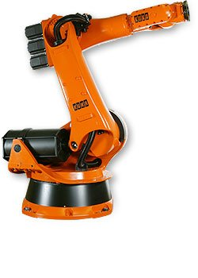
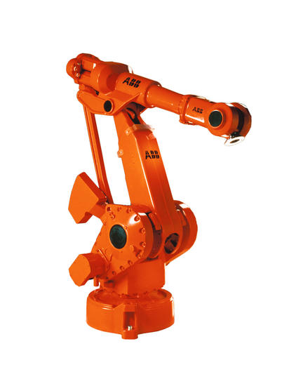
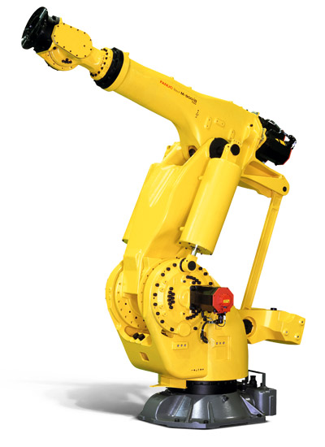
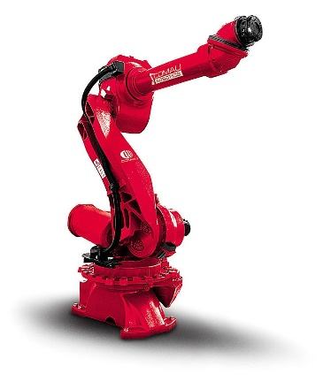
Advantages of SARCA
Supports Kuka, ABB, FANUC, Comau
Robot accuracy performance improvement
Enhanced robot kinematic model
Multiple Zone and Load Calibrations available at Run Time
Native Robot language access to SARCA calibration can be used to write motion programs
SARCA calibration do not require metrology in production
Metrology system could be used for several robots at the same time
3 Reflectors can be used for 6DoF measurements

Slide 4
Accurate SARCA Applications
Medical Patient Positioning
Accurate Determinate Assembly Drilling
Accurate Torch Cutting Paths

Slide 5
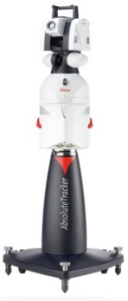
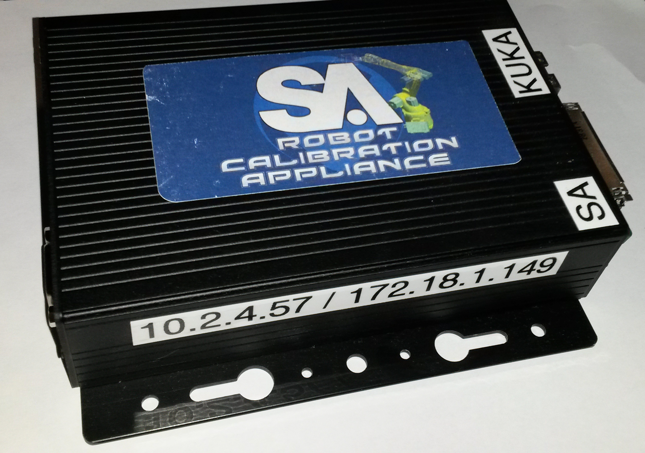
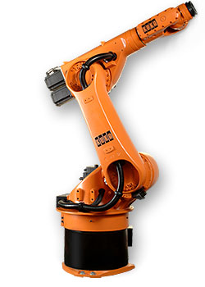
How does it work?
Robot
Controller
Laser Tracker Controller ATC
Embedded
SARCA
Controller
LAN (RJ45)
LAN (RJ45)
LAN (RJ45)
Application Computer
Running SA

Slide 6
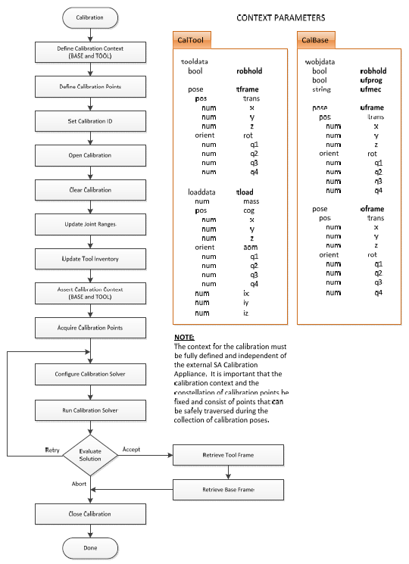
Calibration Appliance Process Flowchart
Inputs:
  Set CalibrationID
  Program Poses (Zone)
  Interface Metrology System
Run Robot Cal Program
Solve / Accept Cal
Output: As-Built Kinematic Models

Slide 7
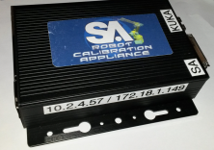
Architecture
Production Run Configuration Schematic

Slide 8
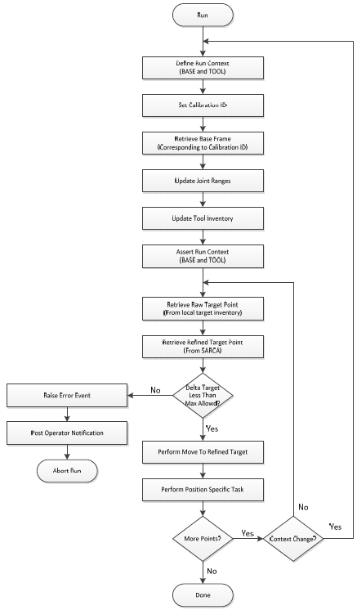
Calibrated Robot Production Run Flowchart
Program Robot (Native Language)
  Run – Select CalibrationID
  Retrieve Cal Base and Tool
  For each Point(i)
    Inverse Kinematics
    Compute Accurate Joint Angles
    Forward Kinematics
  Point(i’) [Calibrated]

Slide 9
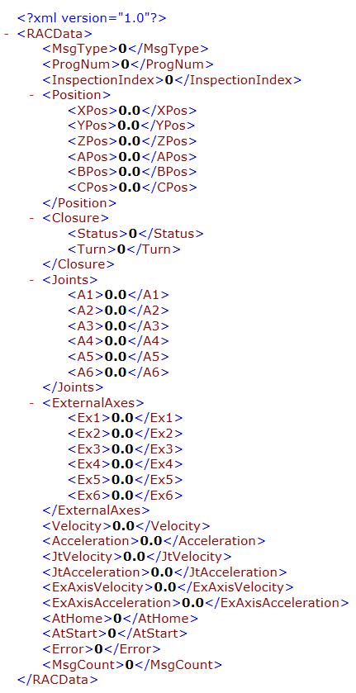

Calibration Appliance Communication

Slide 10
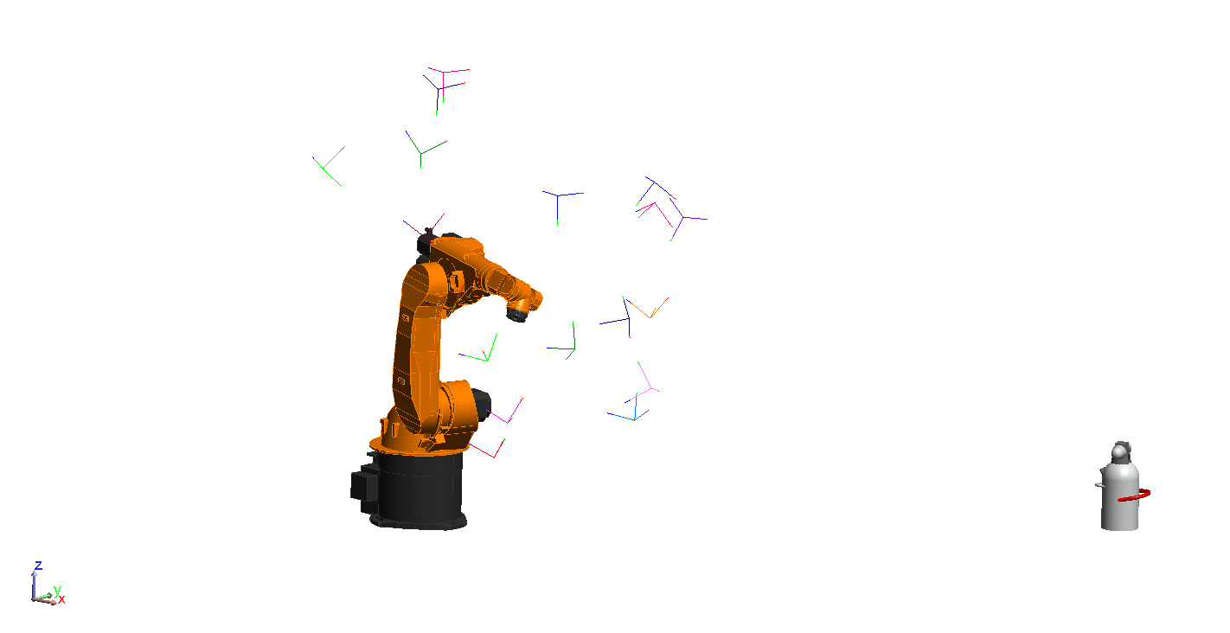
Calibration Process
Acquire measurement data
Measure n – 6DoF positions distributed over the work space of the robot..

Slide 11

Calibration Process – SA Machine

Slide 12
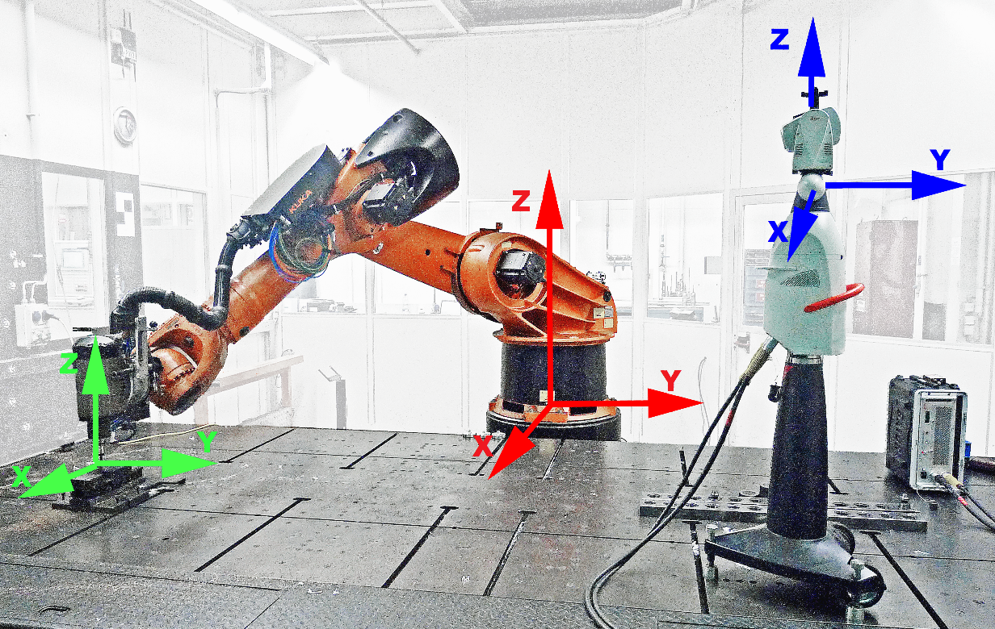
Extrinsic Calibration Cell Alignment
Notes:
Identify robot base coordinate system relative to tracker and tool system

Slide 13
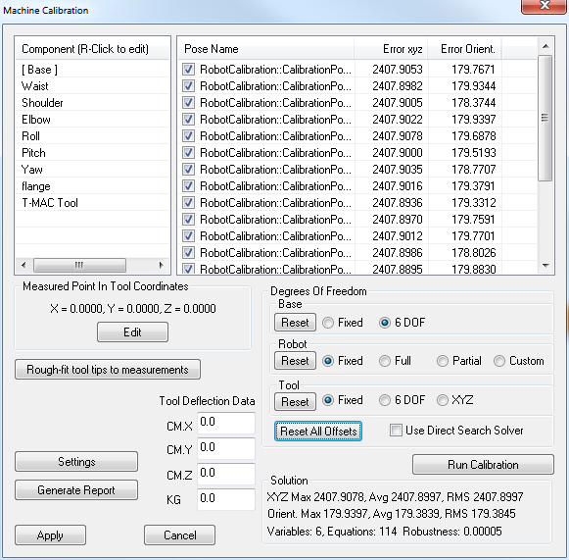
Extrinsic Calibration
Base Offset
Calculate base offset by fixing all other parameters

Slide 14
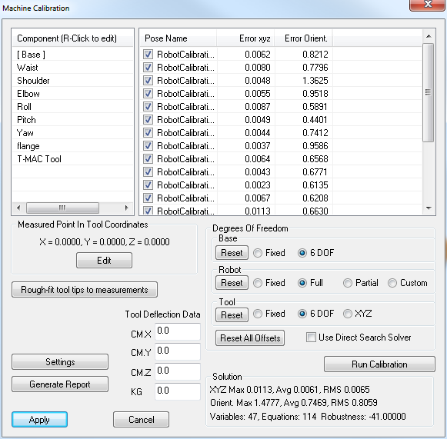
Intrinsic Calibration
Optimize Physical Parameters
Optimize geometric parameters (Denavitt Hartenberg parameters)
Notes:
Normally (DH-Parameter identification):
Newton-Gauss Algorithm
Levenberg-Marquardt Algorithm
We have our own specialized algorithms

Slide 15
Zone Specific Calibration
Zone 1
Zone 2
Zone 3
Notes:
Advantage of this method, zone specific calibration is very easy

Slide 16
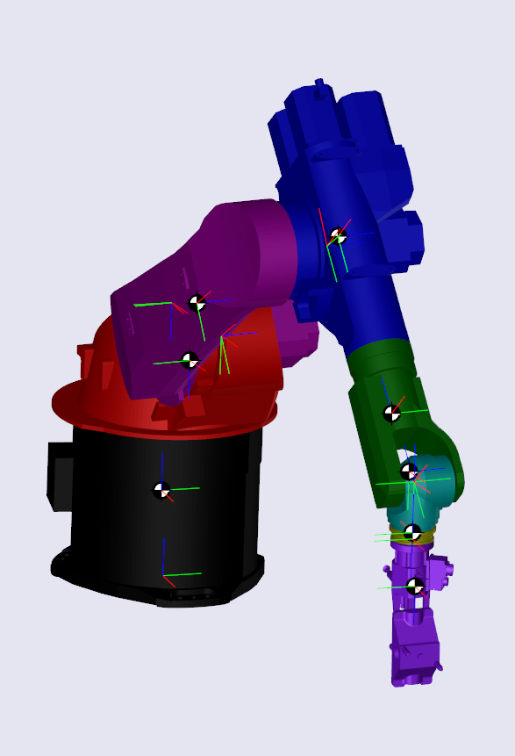
Elasticity Calibration
Compliance Model Identification
Extract weights and centers of gravity from CAD data

Slide 17
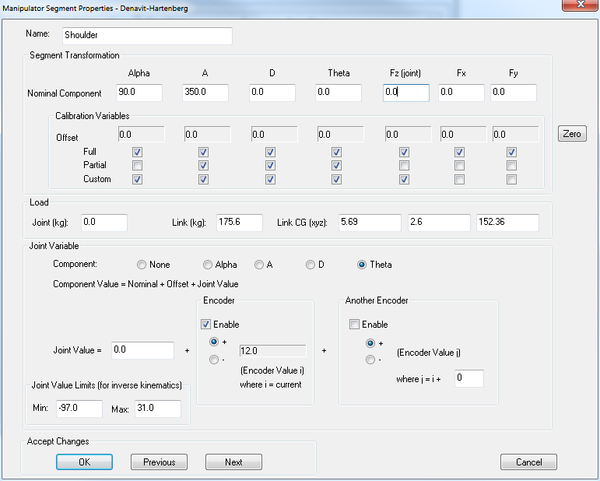
Elasticity Calibration
Compliance Model Identification
Extract weights and centers of gravity from CAD data

Slide 18
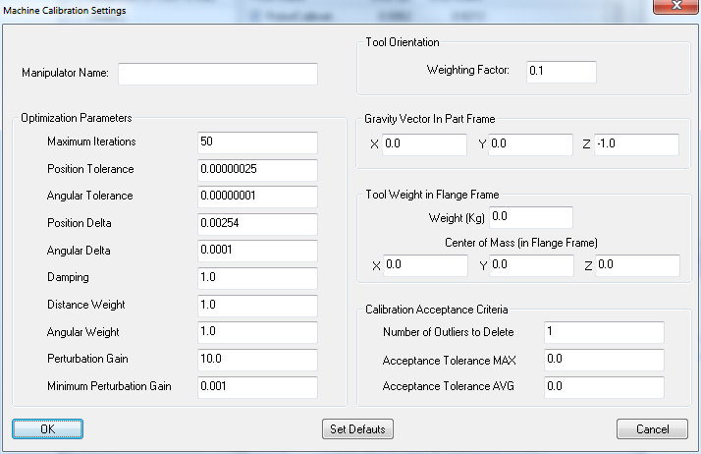
Elasticity Calibration
Gravitation Settings
Define gravity relative to active base frame

Slide 19
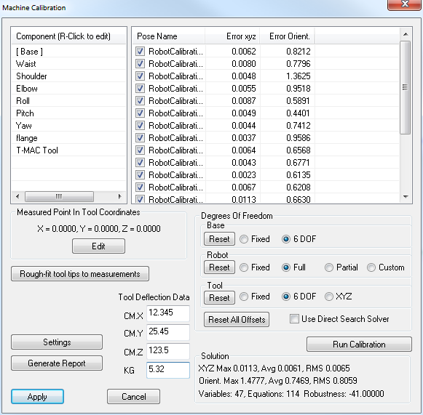
Tool Loads
Calibrate for Different Load Cases
Attach different tool loads and repeat the calibration process in order to obtain a compound calibration

Slide 20
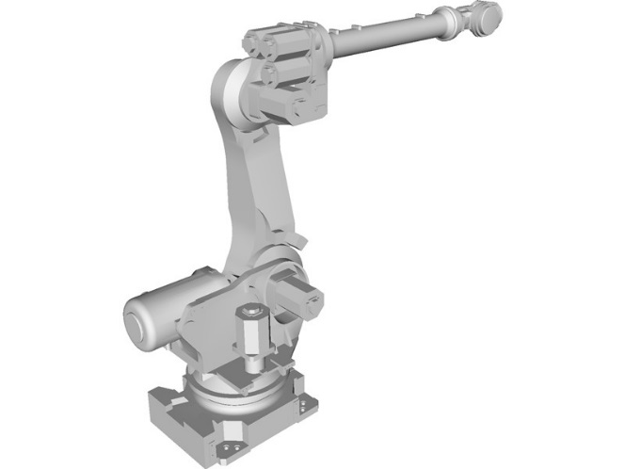
Tool Loads
5 kg
10 kg
20 kg

Slide 21
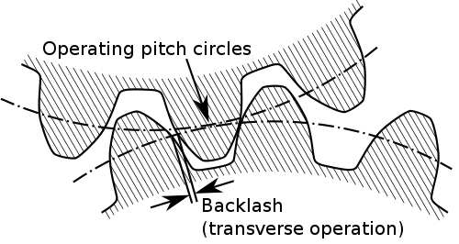
Backlash Compensation
Backlash Identification
Empirically determined by measurement or configured based on specifications

Slide 22
Solution RMS, Robustness
Evaluate Calibration Results
The nearer to zero the better

Slide 23
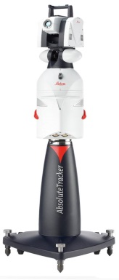

Calibration Appliance Communication
Robot
Controller
Laser Tracker Controller ATC
Embedded
SARCA
Controller
LAN (RJ45)
LAN (RJ45)
LAN (RJ45)
Application Computer
Running SA

Slide 24
Calibration Appliance Process Flowchart
Inputs:
  Set CalibrationID
  Program Poses (Zone)
  Interface Metrology System
Run Robot Cal Program
Solve / Accept Cal
Output: As-Built Kinematic Models

Slide 25
Architecture
Production Run Configuration Schematic

Slide 26
Calibrated Robot Production Run Flowchart
Program Robot (Native Language)
  Run – Select CalibrationID
  Retrieve Cal Base and Tool
  For each Point(i)
    Inverse Kinematics
    Compute Accurate Joint Angles
    Forward Kinematics
  Point(i’) [Calibrated]

Slide 27
Calibration Appliance Communication

Slide 28
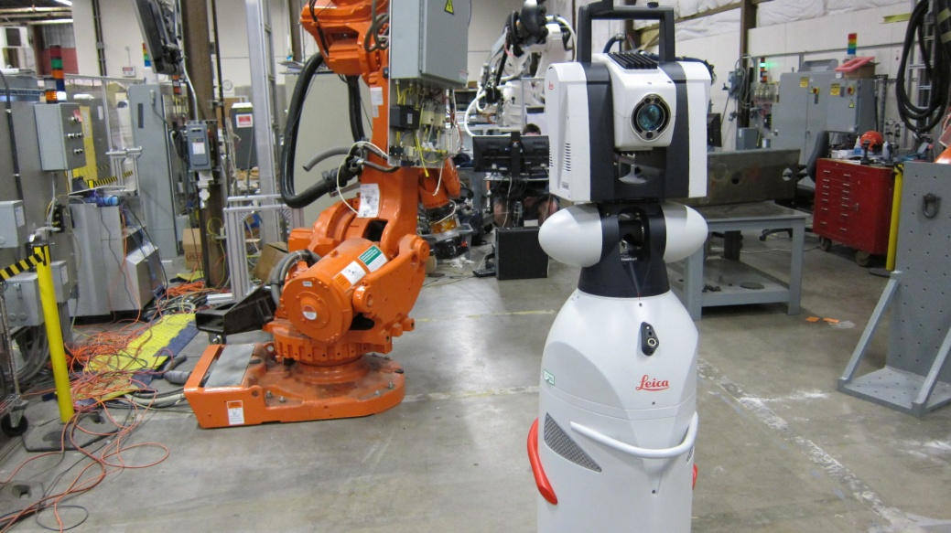
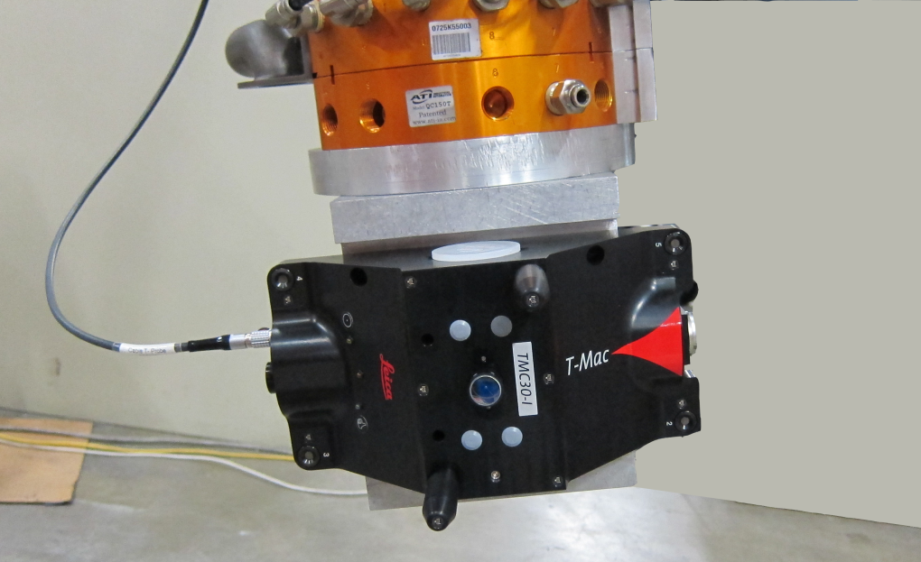
Test Setup
ABB 6640
Leica AT-901 + T-MAC
SARCA
Network Switch

Slide 29
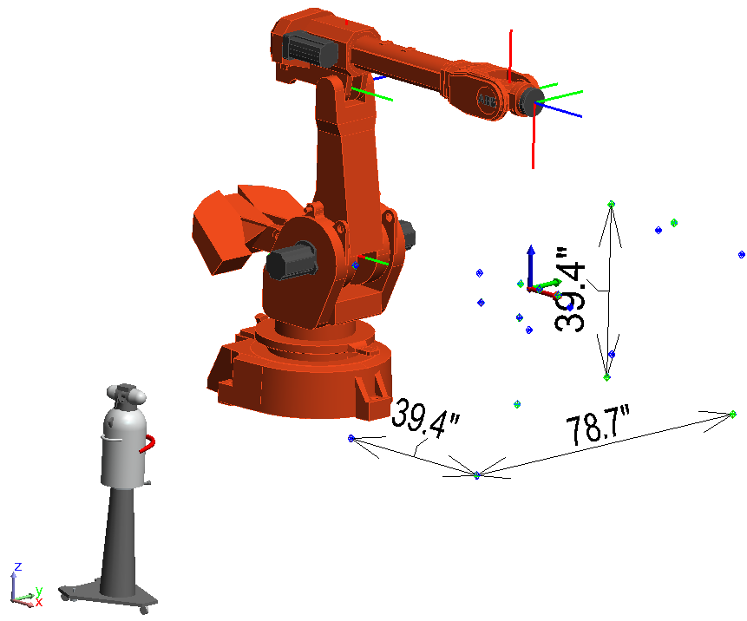
Test Setup
Test Volume: 80” x 40” x 40”

Slide 30
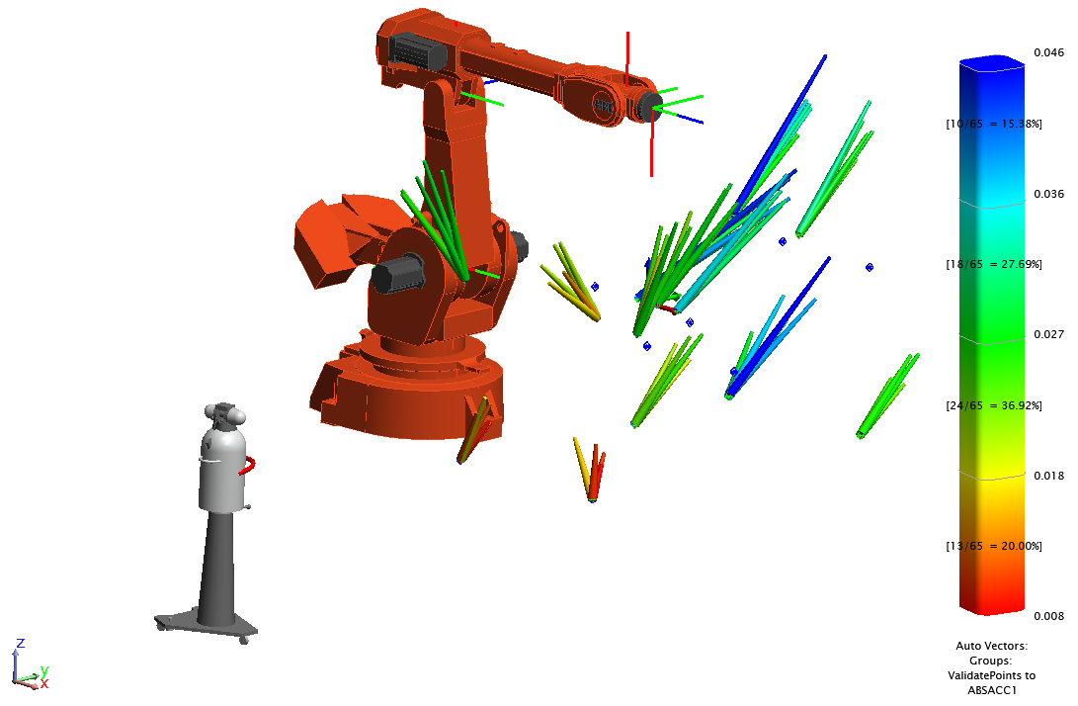
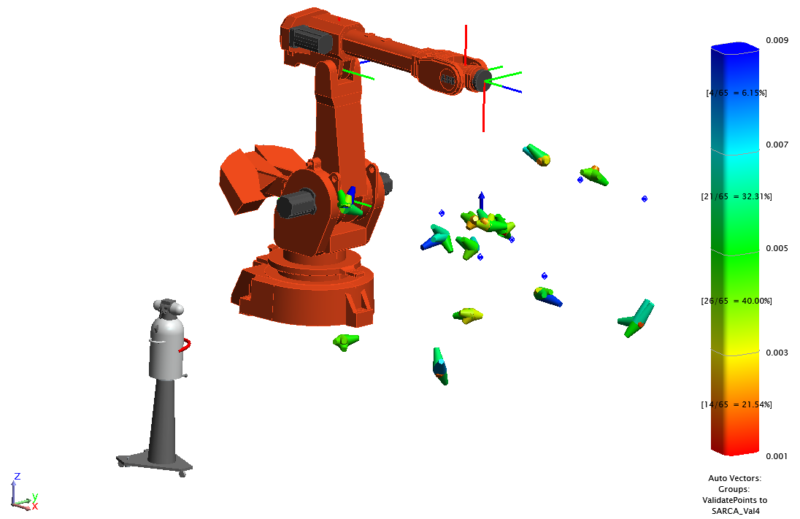
AbsAcc v. SARCA Validation Errors
AbsAcc Errors (x 1000)
SARCA Errors (x 1000)
Max: 0.046” Avg: 0.025
Max: 0.009” Avg: 0.005
Test Volume: 80” x 40” x 40”

Slide 31
Test Results
Analysis comparison (inches) programming to the work object (2 m x 1 m x 1 m).
 | SARCA | AbsAcc
Min | 0.001 | 0.008
Max | 0.009 | 0.046
Average | 0.005 | 0.025
StdDev from Avg | 0.002 | 0.009
StdDev from Zero | 0.005 | 0.027
RMS | 0.005 | 0.027

Slide 32
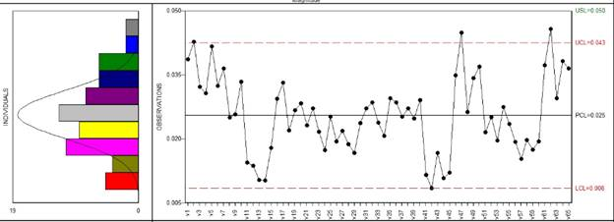
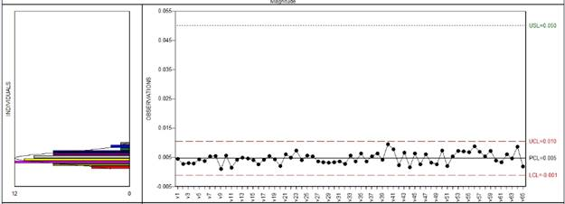
Test Results
AbsAcc Results
SARCA Results

