Slide 1
GD&T Inspection
Jeremy Winn
Support AE
Williamsburg, VA
Zach Rogers
Application Engineer
Germany

Slide 2
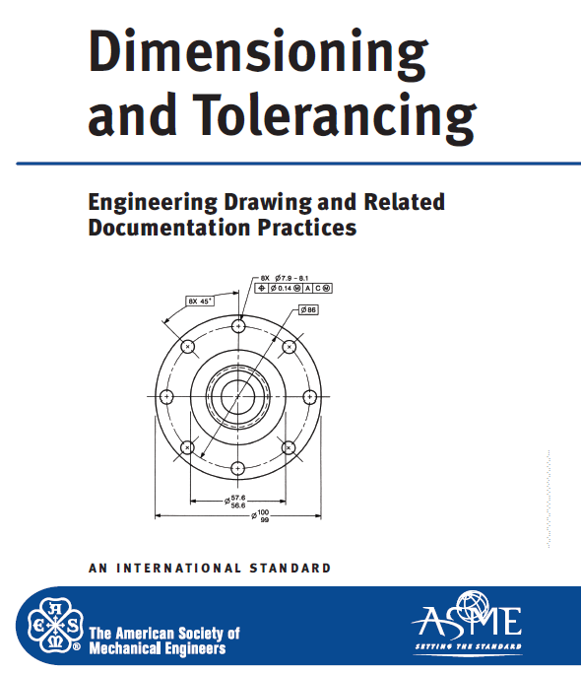
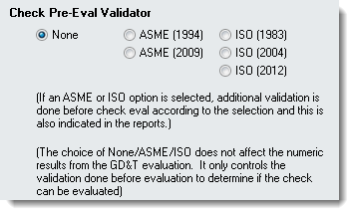
What is “GD&T” in the SA world?
Incorporating
Standardized Inspection within SpatialAnalyzer
ASME 1994 Foundation
ASME is a single standard with a thorough explanation and complimentary examples. It is also revised infrequently providing consistency.
Validation for both ASME and ISO is provided.

Slide 3
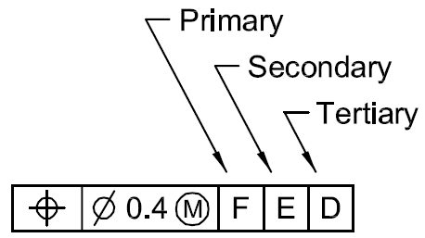
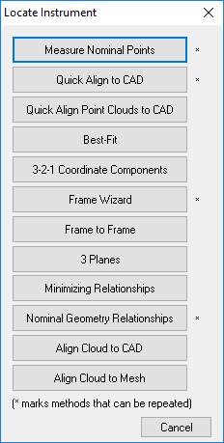
GD&T Inspection
GD&T
“Regular Inspection”
Alignments:
Datum Structure
User Choice…
Notes:
SA’s GD&T Inspection tools provides engineer’s the ability to perform standardized Geometric Dimensioning and Tolerancing
with complete confidence that their inspection is in accordance with the guidelines of the ASME or ISO standard.

Slide 4
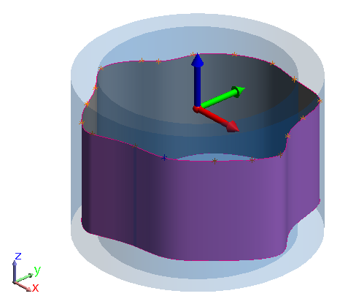
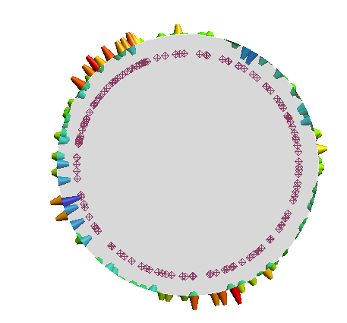
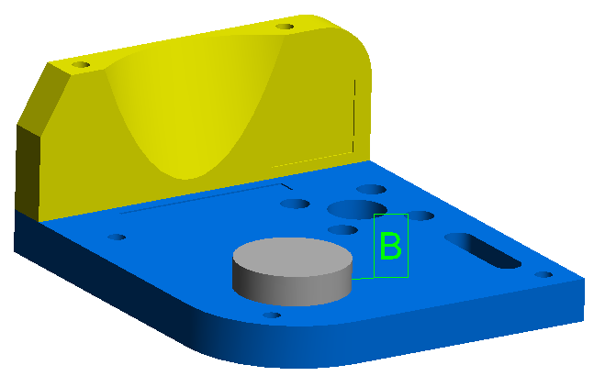
GD&T Inspection
GD&T
“Regular Inspection”
Alignments:
Datum Structure
User Choice…
Evaluation:
Bounding Condition***
RMS (root mean square)
Notes:
SA’s GD&T Inspection tools provides engineer’s the ability to perform standardized Geometric Dimensioning and Tolerancing
with complete confidence that their inspection is in accordance with the guidelines of the ASME or ISO standard.

Slide 5
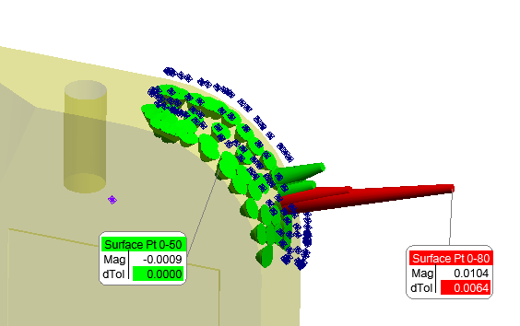
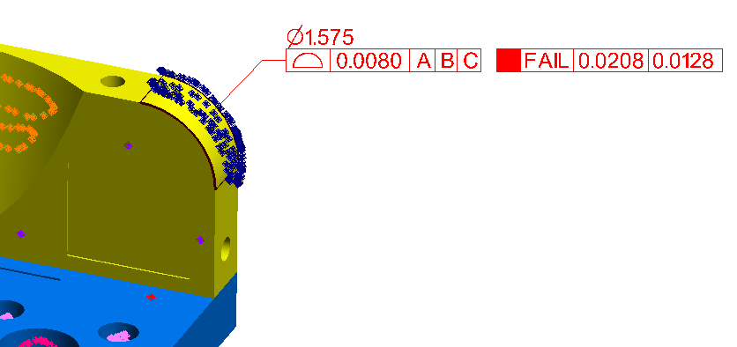
GD&T Inspection
GD&T
“Regular Inspection”
Alignments:
Datum Structure
User Choice…
Evaluation:
Bounding Condition***
RMS (root mean square)
Goal:
Pass / Fail Result
Understand Contributing errors
Notes:
SA’s GD&T Inspection tools provides engineer’s the ability to perform standardized Geometric Dimensioning and Tolerancing
with complete confidence that their inspection is in accordance with the guidelines of the ASME or ISO standard.

Slide 6
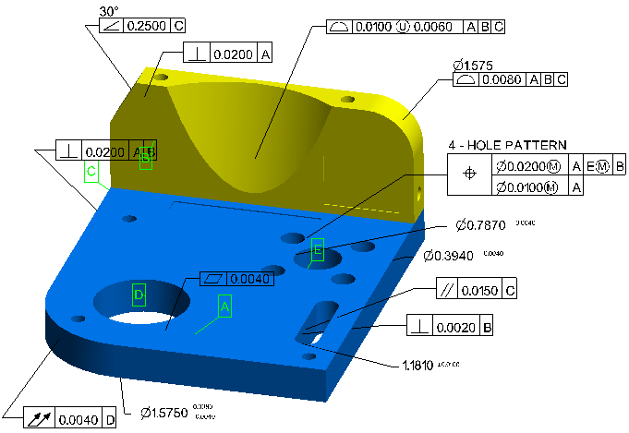
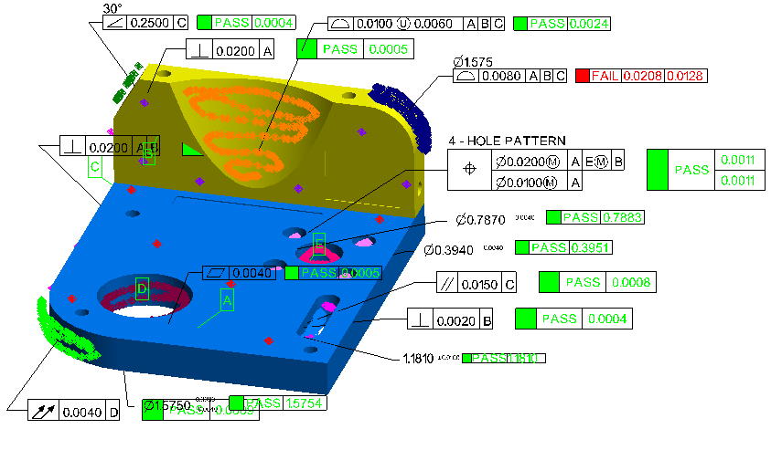
GD&T Inspection
GD&T Inspection - 2 Distinct Steps
1. Defining the Checks
Building Annotations
Tolerance Structure
Nominal designation
2. Measurement Process
Data Gathering & Association
Inspection/ inspect scripting
Toolkit or direction Association
or Measurement Plan (MP)

Slide 7
Building Annotations
The Definition and Details for a Check.

Slide 8
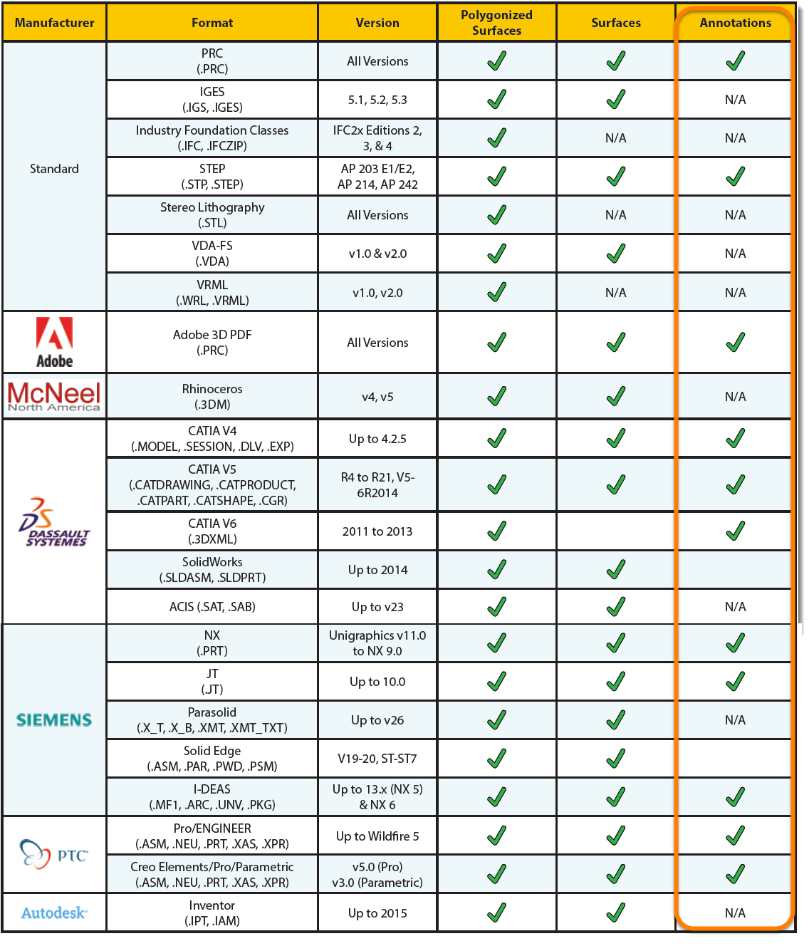
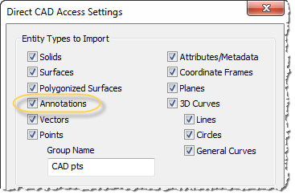
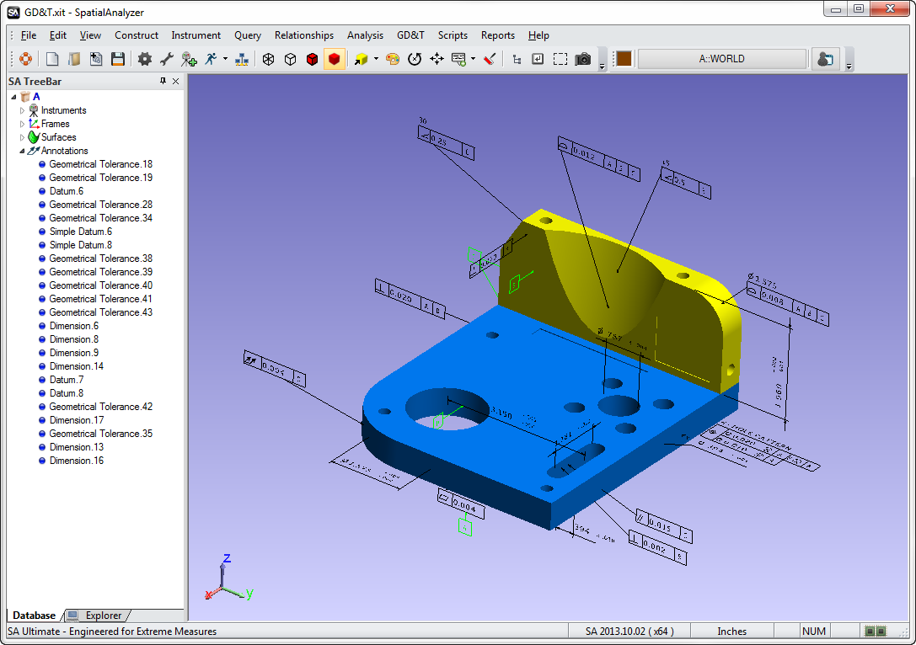
GD&T Annotations
First Option - Import
Importing from CAD:

Slide 9
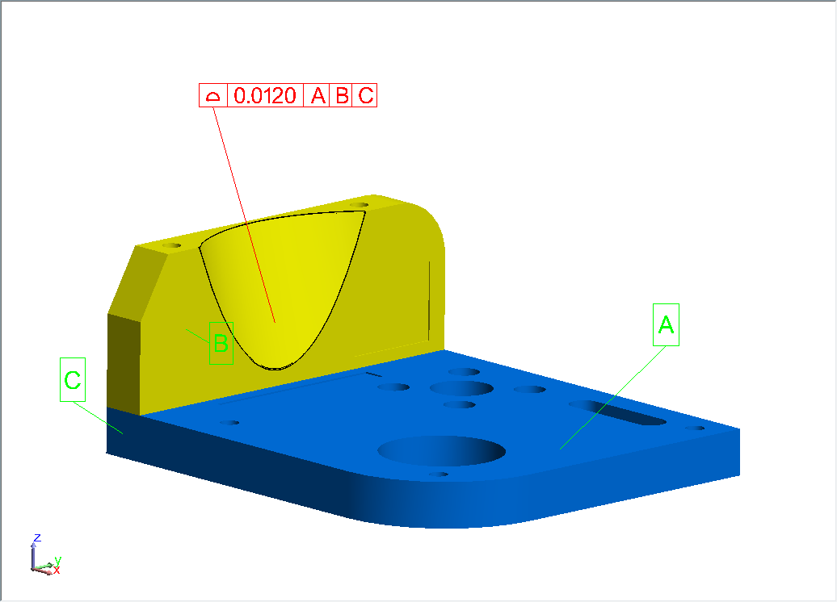
GD&T Annotations
Anatomy of an Annotation
Tolerance = 0.012
With an Alignment:
Primary Datum A
Secondary Datum B
Tertiary Datum C
Surface Profile

Slide 10
GD&T Annotations
Anatomy of an Annotation

Slide 11
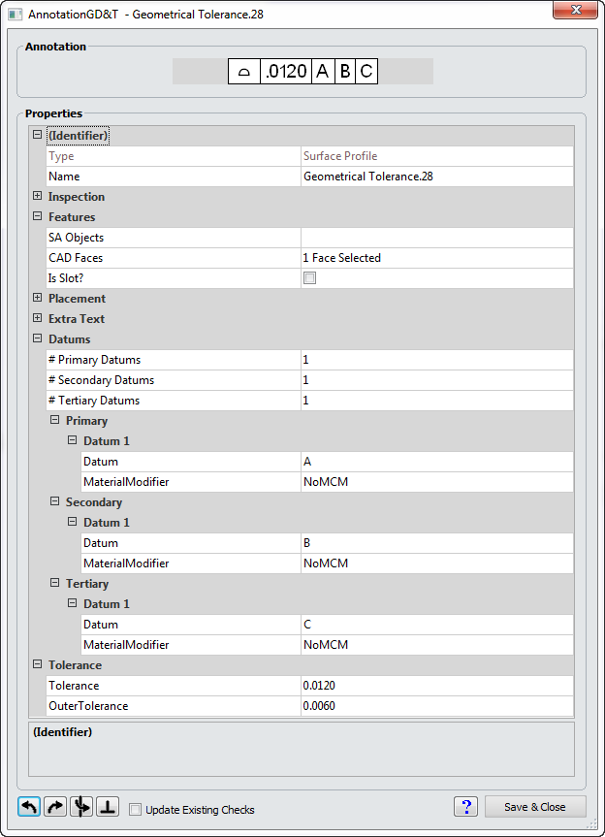
GD&T Annotations
Anatomy of an Annotation
SA Objects/CAD Face
Datum Assignment
Tolerance Definition

Slide 12
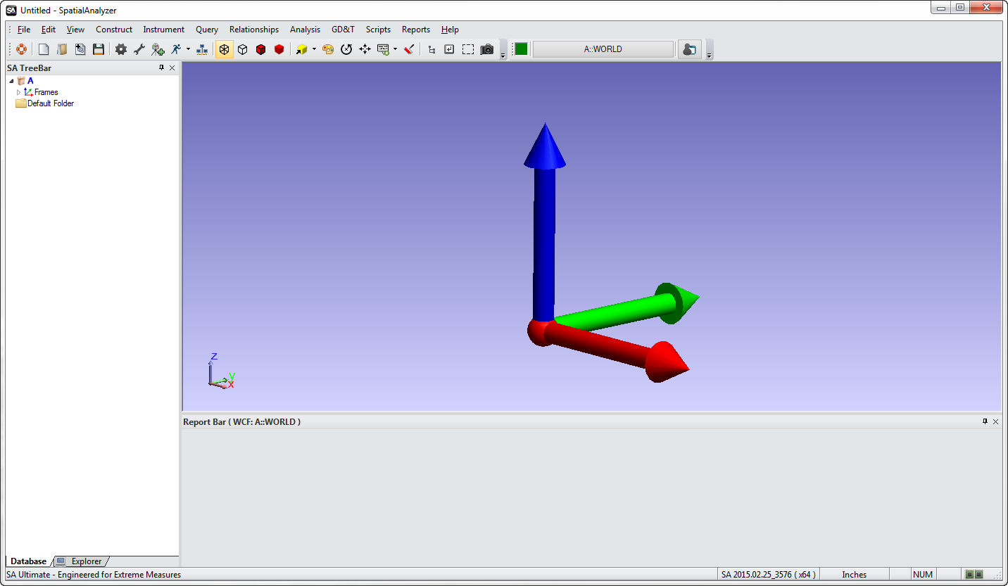
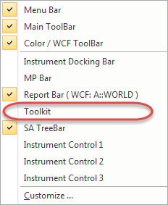
Building Annotations

Slide 13
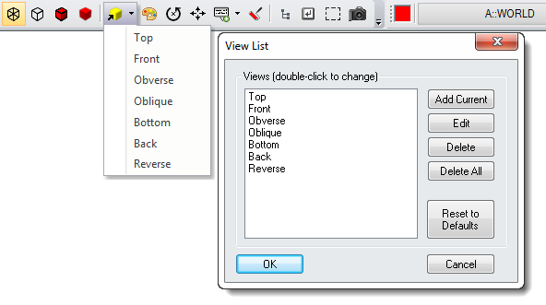
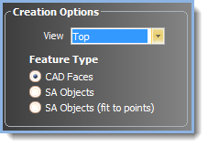
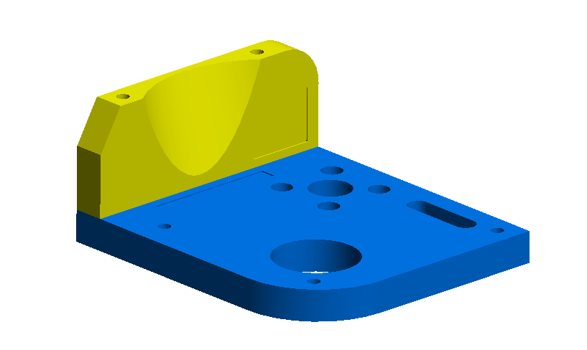
GD&T Annotations
Annotation View Orientation:

Slide 14
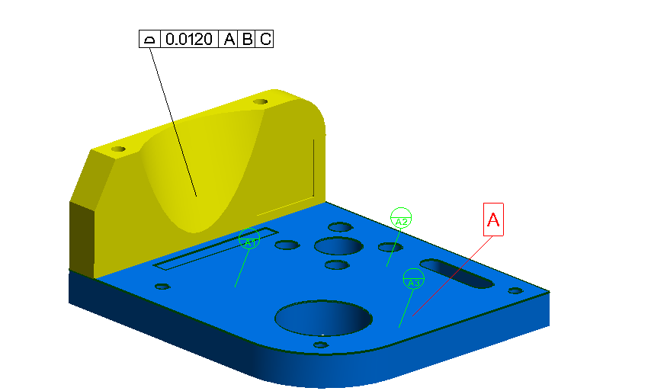
GD&T Annotations
Datum and Datum Target Designations
(Hold down A-Z to pick a letter)
Click-point defines leader line anchor point

Slide 15
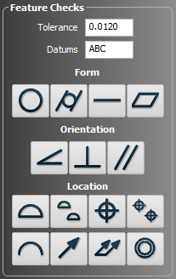
GD&T Annotations
Feature Checks Designation:
1.
3.
2.

Slide 16
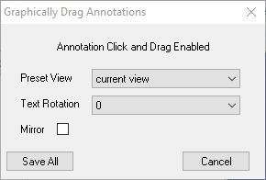
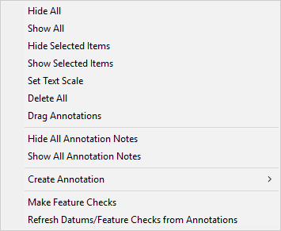
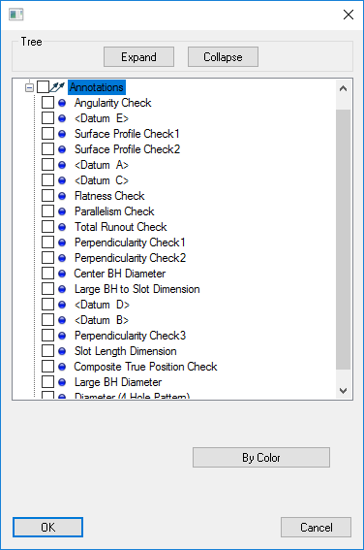
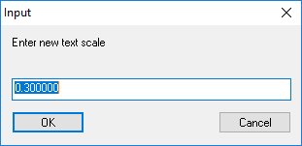
GD&T Annotations
Anatomy of an Annotation
New Right-Click Options:
Annotation Notes
Drag Annotations
Set Text Scale
Show/Hide Selected
Callout Views & Layers

Slide 17
GD&T Inspection
GD&T Inspection - 2 Distinct Steps
1. Defining the Checks
Building Annotations
Tolerance Structure
Nominal designation
2. Measurement Process
Data Gathering & Association
Inspection/ inspect scripting
Toolkit or direction Association
or Measurement Plan (MP)

Slide 18
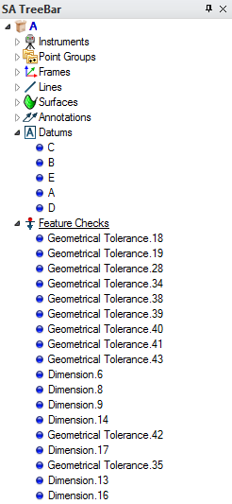
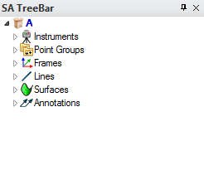
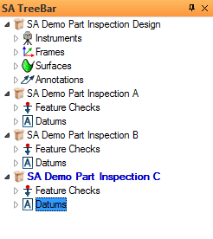
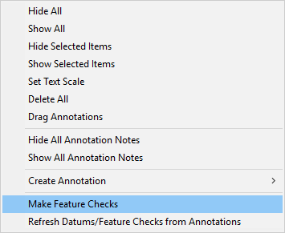
GD&T Inspection
Tree Structure
Annotations
Tolerance & check definition
Datums & Feature Checks
Link points to annotations
Point offset & evaluation control
Contain guided inspection controls
Inspections must be in the working collection and are collection specific.

Slide 19
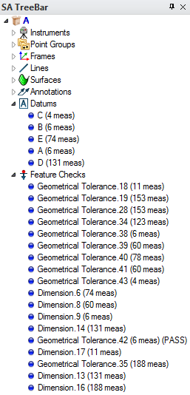
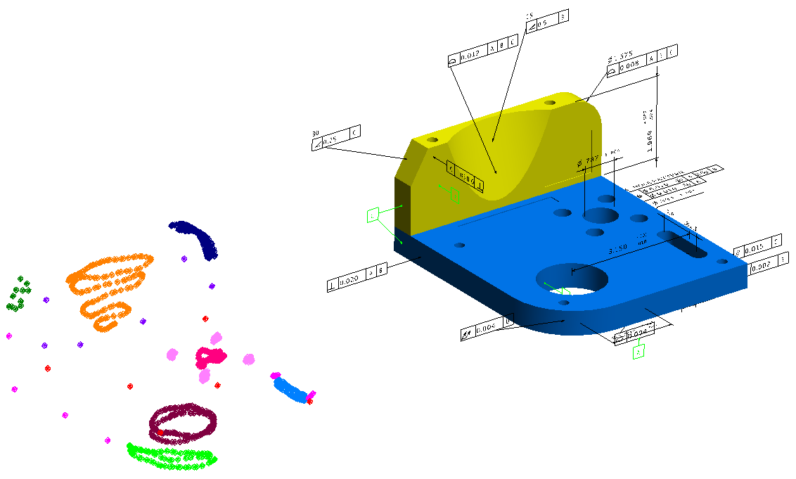
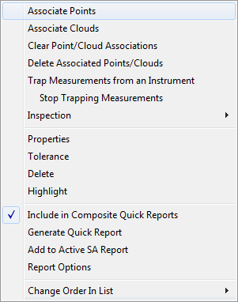
GD&T Inspection
Direct Point Association

Slide 20
GD&T Inspection
Trapping Measurements

Slide 21
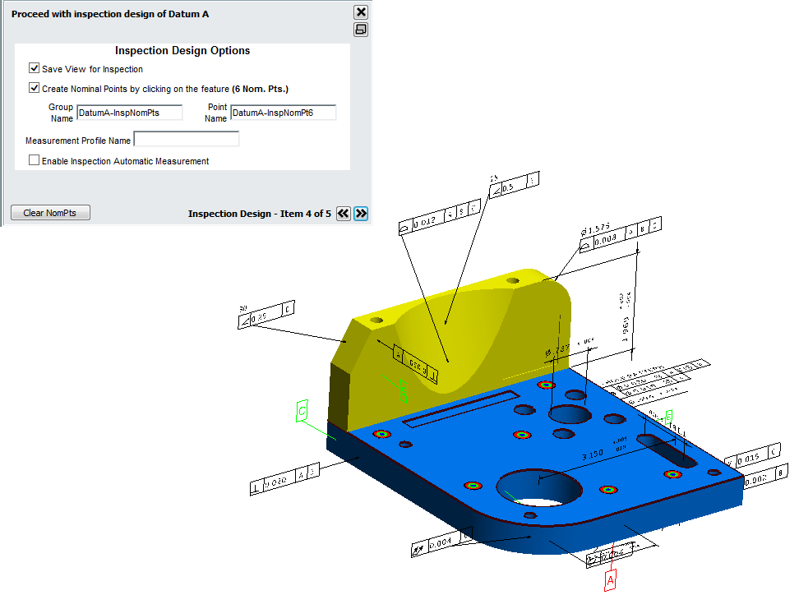
GD&T Inspection
Guided Inspection

Slide 22
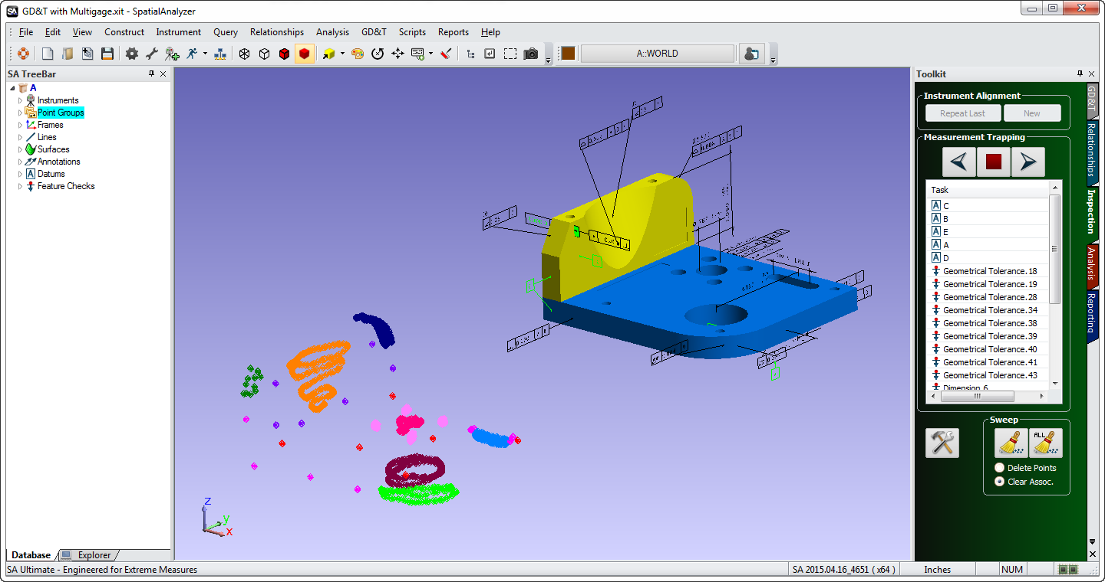
Demo – Basic Fit & Link Data

Slide 23
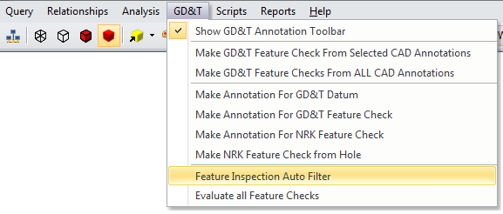
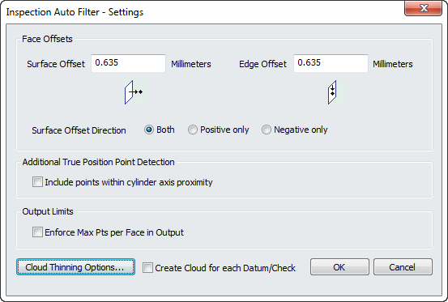
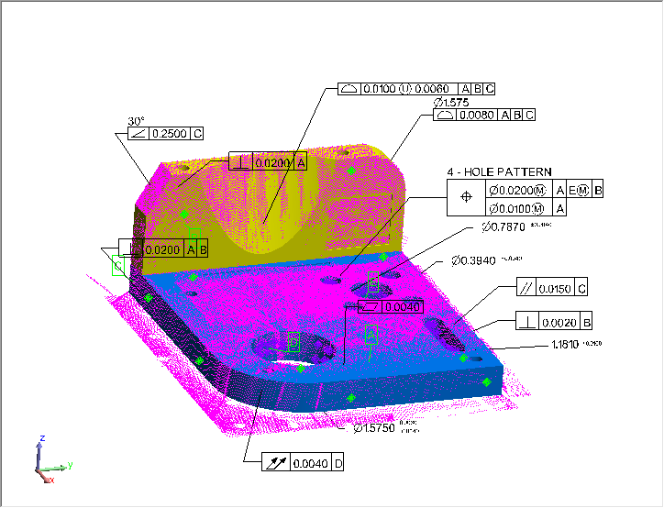
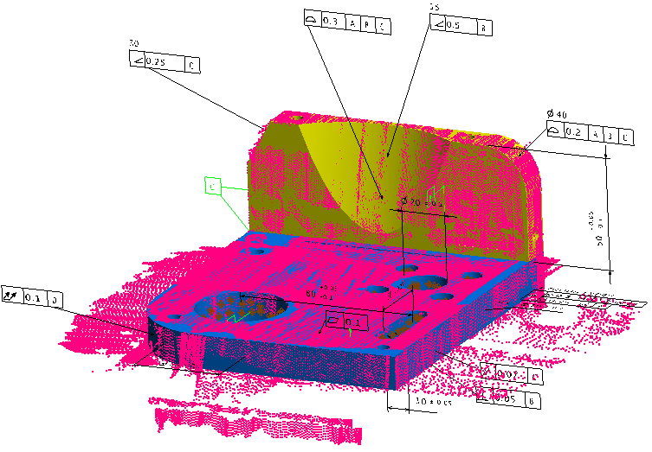
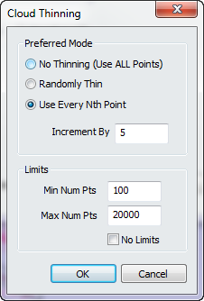
GD&T Inspection
Automatic Point Association
Things to remember:
Proximity Filter
Based on Initial
Alignment

Slide 24
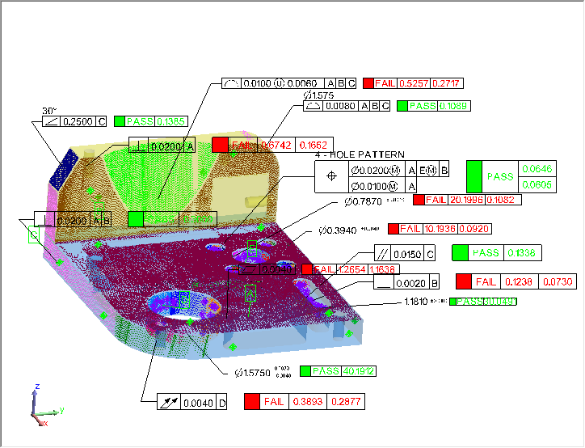
GD&T Inspection
Automatic Point Association

Slide 25
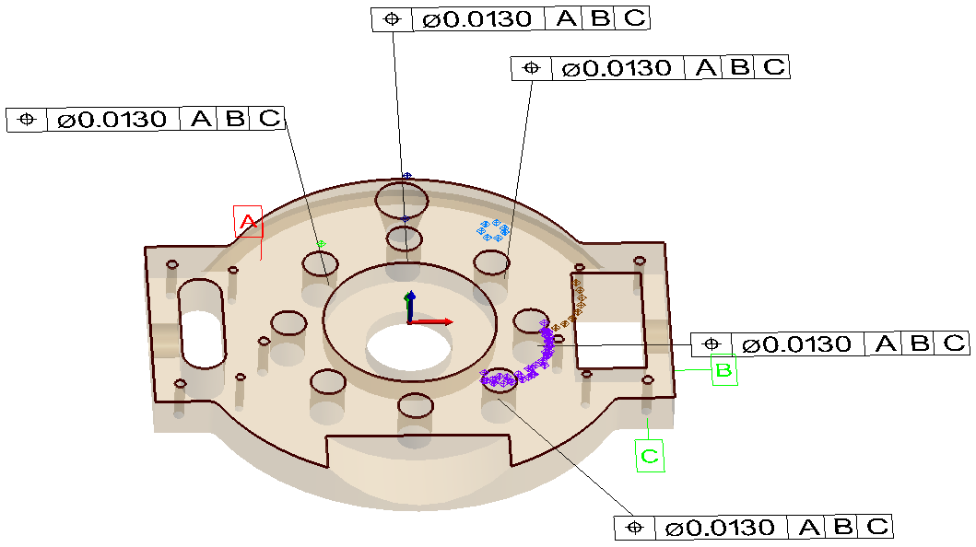
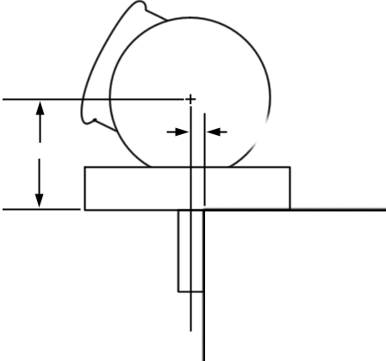
GD&T Inspection
Automatic Point Association

Slide 26
Working Without CAD
Remember your basics

Slide 27
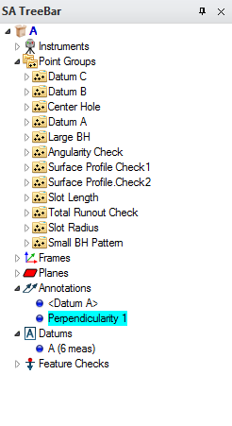
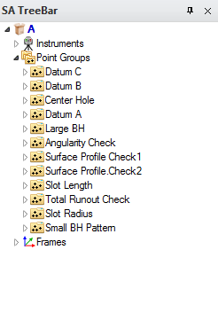
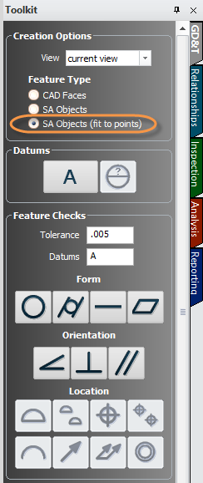
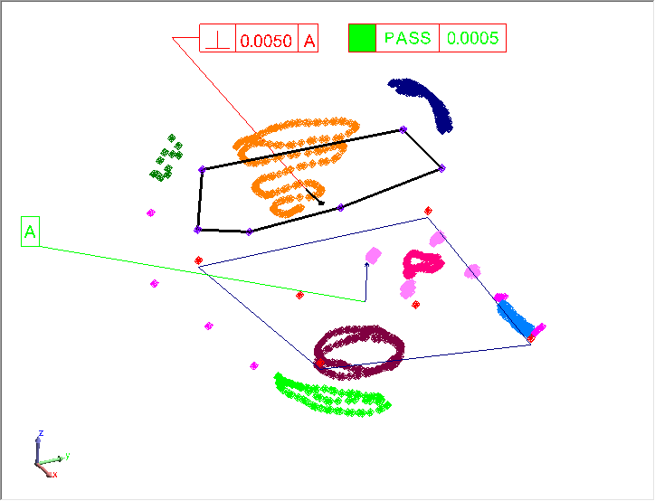
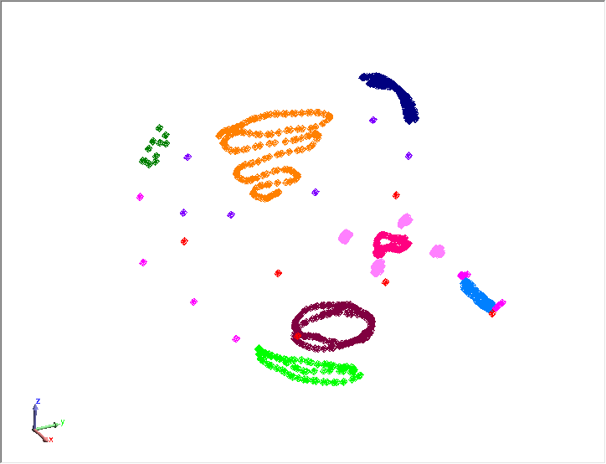
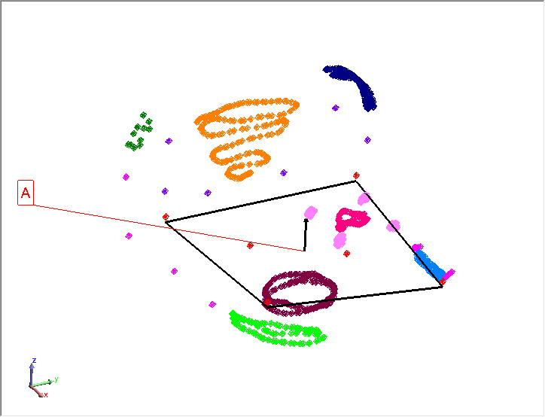
GD&T Inspection

Slide 28
GD&T Inspection

Slide 29
GD&T Inspection
GD&T Inspection - 2 Distinct Steps
1. Defining the Checks
Building Annotations
Tolerance Structure
Nominal designation

Slide 30
GD&T Inspection

Slide 31
GD&T Inspection

Slide 32
Report Options

Slide 33
Reporting

Slide 34
Reporting
Basic Report Display Options
Measured Deviation (GD&T Result)
Distance Out of Tolerance
Reports the Worse Value

Slide 35
Reporting
Basic Report Display Options
Measured Deviation (GD&T Result)
Distance Out of Tolerance
Alignment Transform
Datum Deviations Statistics

Slide 36
Reporting
Basic Report Display Options
Bonus Tolerance Information
Pattern Feature Deviation
Position and Profile Only

Slide 37
Reporting
Basic Report Display Options

Slide 38
Getting into the Details
Understanding Check Types

Slide 39
GD&T Annotations
Feature Checks Designation:
Form Checks
Datum Independent

Slide 40
Flatness
Standard Inspection (RMS):

Slide 41
Flatness
Flatness Evaluation Process within SA:
Two parallel planes are built bounding the extents of the data.
These planes are allowed to freely rotate to establish the minimum distance between them while still containing the data.

Slide 42
GD&T Annotations
Feature Checks Designation:
Form Checks
Datum Independent
Orientation Checks
Depend on 1 Datum

Slide 43
Orientation Checks
Nominal Angle
Deviation = Distance btw Planes
Datum

Slide 44
GD&T Annotations
Feature Checks Designation:
Form Checks
Datum Independent
Orientation Checks
Depend on 1 Datum
Location Checks
Can Include 1-3 Datums
Can Include 1-2 Tiers

Slide 45
GD&T Annotations
Surface Profile:
GD&T Reports:
Measured Deviation (GD&T Result)
Distance Out of Tolerance
Vectors Report:
Radial Deviation
Distance out of Tolerance

Slide 46
GD&T Annotations
Composite True Position:

Slide 47
GD&T Annotations
Dimensional Tolerances
Notes:
Feature Check selection simplifies check assocation

Slide 48
GD&T Annotations
Dimensional Tolerances

Slide 49
GD&T Annotations
Feature Checks Categories:
Cross Section
Checks

Slide 50
GD&T Annotations
Cross Section Checks:
Runout
Cross Section
Check
Total Runout
Surface Check

Slide 51
GD&T Annotations
Cross Section
Checks

Slide 52
Feature Check Properties
Going a Bit Deeper

Slide 53
Building Feature Checks
Offset Compensation
Inspection Controls
Evaluation Method

Slide 54
Building Feature Checks
Cylinder Evaluation Method
Circle Fit Evaluations:
Axis Fit Evaluations:

Slide 55
Building Feature Checks
Cylinder Evaluation Method
Extrapolate Axial Extents
Off…

Slide 56
Building Feature Checks
Cylinder Evaluation Method

Slide 57
Datum Alignment

Slide 58
Datum Alignment
Right- Click Datum Category
Select “Align”

Slide 59
Datum Alignment
Datums and Degrees of Freedom
Geometry Type
Sequence
A
Rx, Ry, Z
C
3 DoF Remain
X,Z, Rx, Ry, Rz + Y
B
Rx, Ry, Z + X, Rz
1 DoF Remains

Slide 60
Datum Alignment
Datums and Degrees of Freedom
Geometry Type
Sequence
A
Rx, Ry, Z
B
3 DoF Remain
C
X,Y,Z, Rx,Ry, + Rz
Rx, Ry, Z + X, Y
1 DoF Remains

Slide 61
Datum Alignment
Offset Compensation

Slide 62
Datum Alignment
Enable Datum Alignment

Slide 63
Datum Alignment
Aligning to Curved Surfaces
Surface Datums require “Offset Object” designation
Constrains (Rx, Ry, Z )
but not (Rz, X or Y)
Constrains (X,Z,Rx,Rz )
but not (Y or Ry)

Slide 64
Datum Alignment
Aligning to Curved Surfaces
Surface Datums require “Offset Object” designation

Slide 65
Datum Alignment
Aligning to Curved Surfaces

Slide 66
Evaluations Tools

Slide 67
Questions?

Slide 73
Troubleshooting
Check Computation
Geom Relationships
Datum Alignment
Curvy Surfaces

Slide 74
Demo- Basic Fit & Link
Notes:
Objective is to demonstrate:
Setting a view for the Annotations
Adding Datums Annotations
Adding Feature checks Annotations
Opening the Properties and changing properties
Controlling Graphical Placement
End with Direct CAD Import with all the annnotations

Slide 75
Reporting
Basic Report Display Options

Slide 76
Reporting
Basic Report Display Options

Slide 77
Reporting
Inspection
Controls

Slide 78
Reporting
Callout layer control now supports Annotations

Slide 79
Datum Alignment
Z,Rx,Ry
Start thinking:
Datum Priority
Degrees of Freedom
Offset Compensation
X,Y,Z
X,Y,Rx,Ry
X,Y,Z,Rx,Ry
X,Y,Z,Rx,Ry,Rz
All 6 DoF are constrained with 1 datum…

Slide 80
Concentricity
Cross Section Checks:
Concentricity
Cross Section
Check

Slide 81
GD&T Inspection
Why GD&T???
GD&T answers the following questions:
1. How did you align to the part?
2. What evaluation method did you use?
3. What tolerance did you use?
Will the bolt fit in the hole, YES or NO?
Notes:
SA’s GD&T Inspection tools provides engineer’s the ability to perform standardized Geometric Dimensioning and Tolerancing
with complete confidence that their inspection is in accordance with the guidelines of the ASME or ISO standard.

Slide 82
GD&T Annotations
Datum and Datum Target Designations
(Hold down A-Z to pick a letter)
Click-point defines leader line anchor point

Slide 83
Building Annotations Demo
Notes:
Objective is to demonstrate:
Setting a view for the Annotations
Adding Datums Annotations
Adding Feature checks Annotations
Opening the Properties and changing properties
Controlling Graphical Placement
End with Direct CAD Import with all the annnotations

Slide 84
Associating Data
Working with Datums and Feature Checks

