Slide 1
Zach Rogers & Ashley Woolard
New River Kinematics
Snap-fit assembly with SA

Slide 2
Virtual Assembly
Determine fit-up, before you don’t fit-up

Slide 3
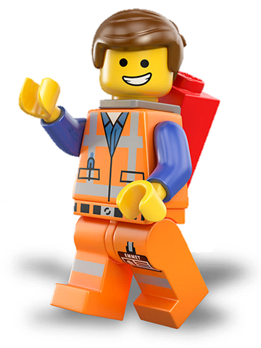
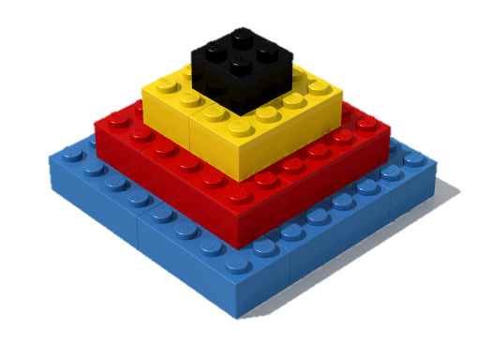
Solve Problems
Virtual Assembly helps solve many challenging manufacturing problems
Dealing with tolerance stack-up
Managing conflicting requirements
Impossible tolerances
Match-fit construction

Slide 4
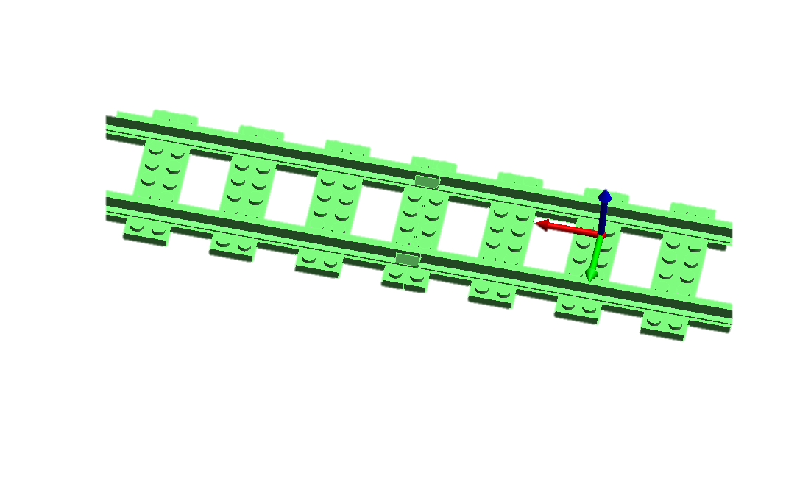
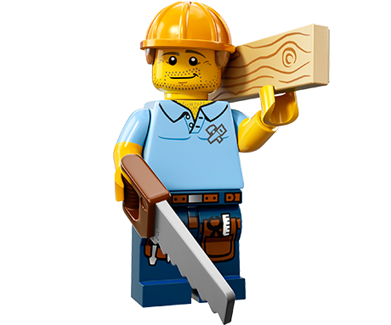
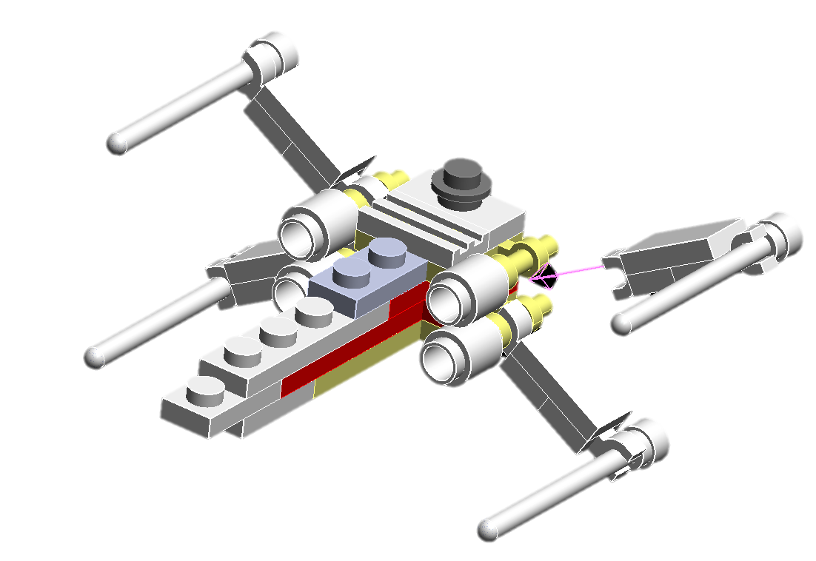
What you can do with Virtual Assembly
Perfect guide, track, and magnet alignment
Weldments and block assembly
Mate/Join Operations

Slide 5
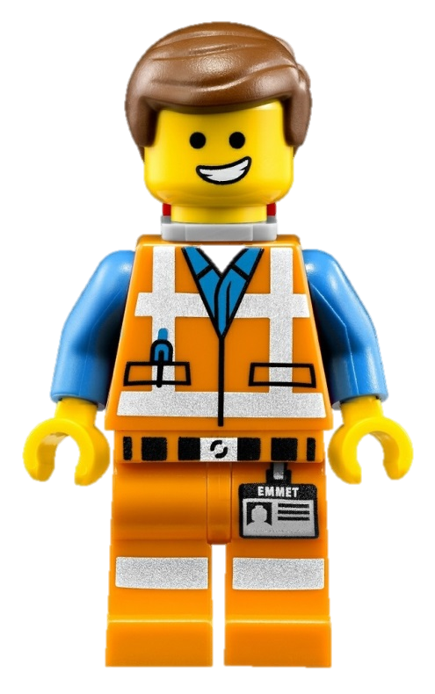
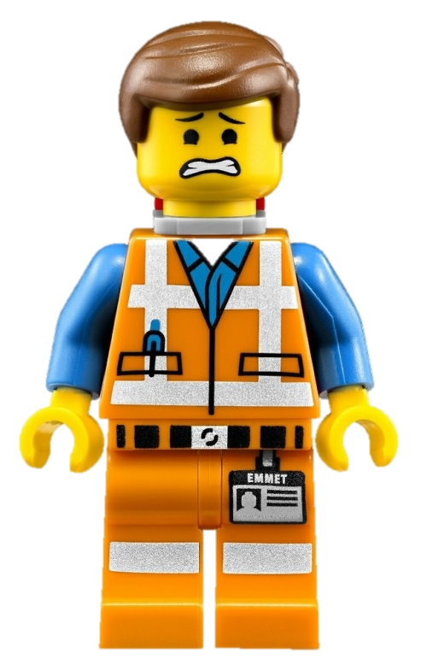
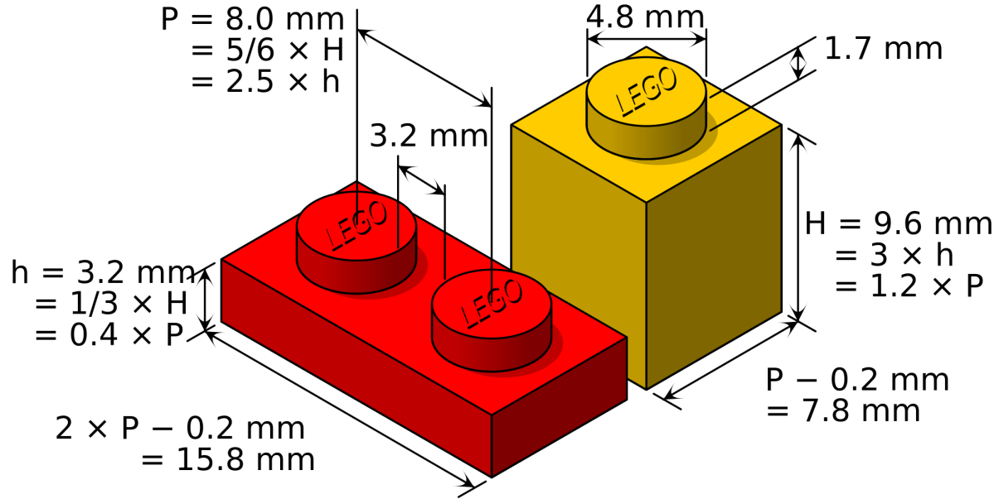
Relationships = Virtual Assembly
Relationships can define how parts come together
Fits can be evaluated before assembly takes place
Why is this important?
Tolerances.

Slide 6
Relationships = Virtual Assembly
Can be used like queries (e.g. how far as these points from that surface)
Are DYNAMIC, so unlike queries, they update continuously

Slide 7
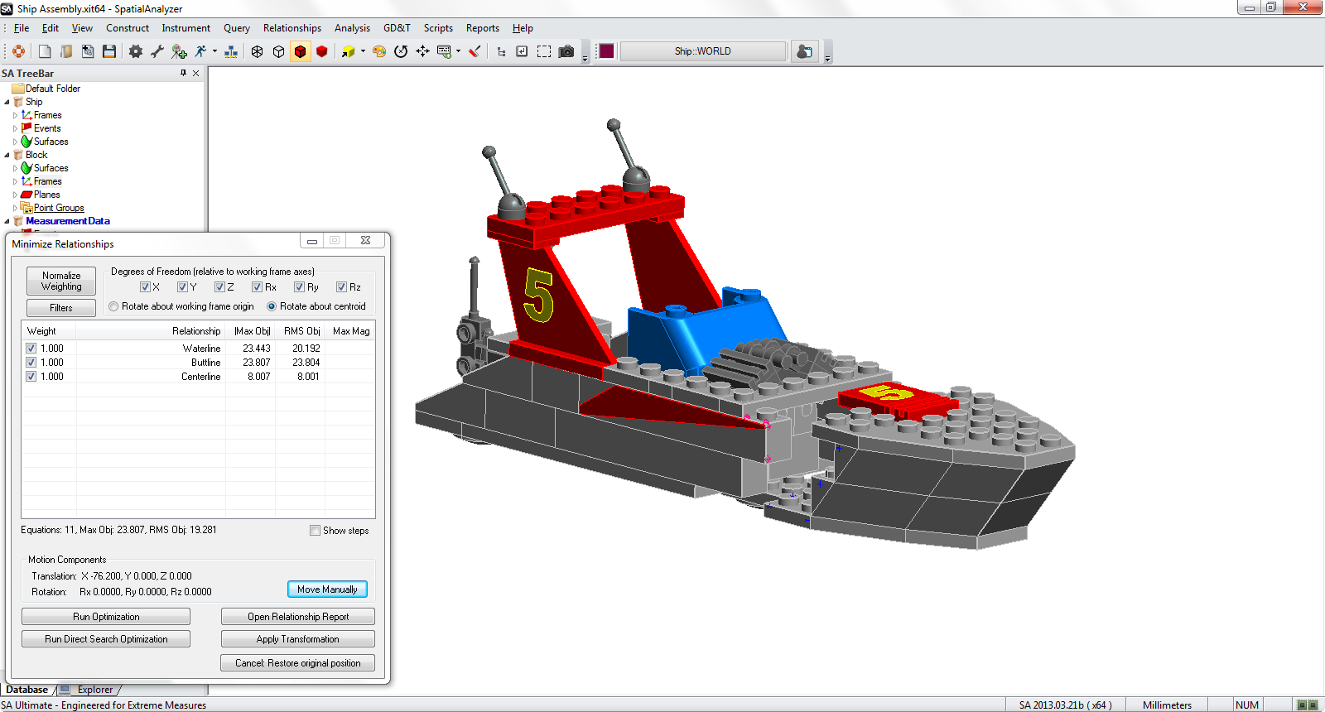
Relationships = Virtual Assembly
Are DYNAMIC, so they can be used for fitting too!

Slide 8
How To: Use SA to Assemble a boat

Slide 9
Construct Base Components

Slide 10
Measure Interfaces Between Components

Slide 11
Define Relationships between interfaces

Slide 12
Optimize Relationships via Relationship Fit

Slide 13
Optimize Relationships via Relationship Fit

Slide 14
Optimize Relationships via Relationship Fit

Slide 15
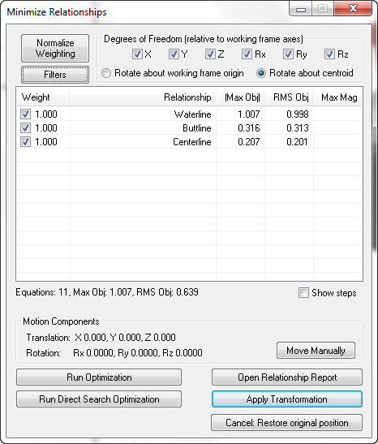
Evaluate & Refine Relationship Fit
Relationship Constraints provide for Gap & Interference management

Slide 16
Evaluate & Refine Relationship Fit
With Constraints defined, Relationships provide Optimized Position Determination

Slide 17
Finish perfectly fitting assembly

Slide 18
Finish perfectly fitting assembly

Slide 19
Relationships = Virtual Assembly

Slide 20
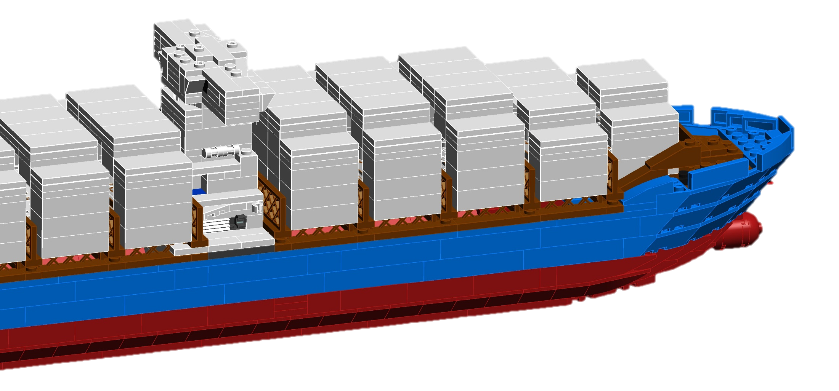
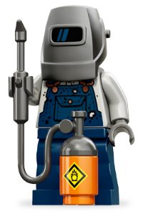
Relationships = Virtual Assembly

Slide 21
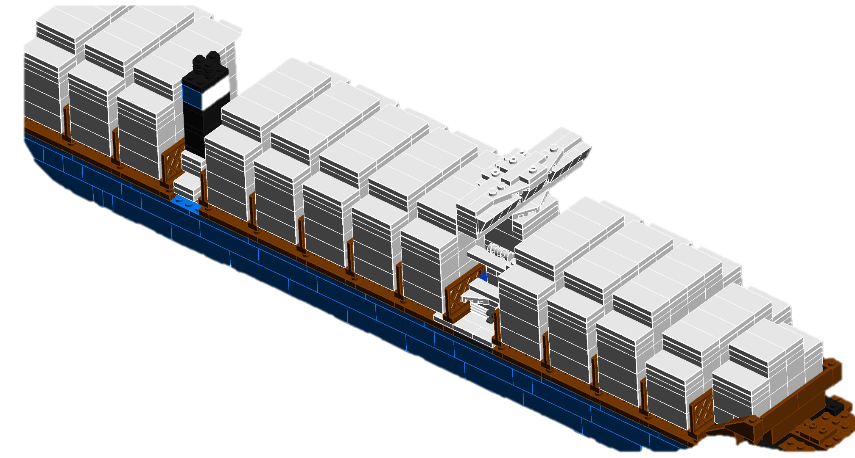
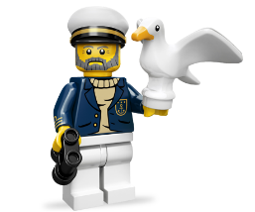
Questions?

