Slide 1

Optimization. Finding the best fit
Notes:
[Click] This section will address Relationship Fitting and how we can use this to Optimize our fits. These examples you will see are generalized but are simplified applications of things our customers do every day.

Slide 2
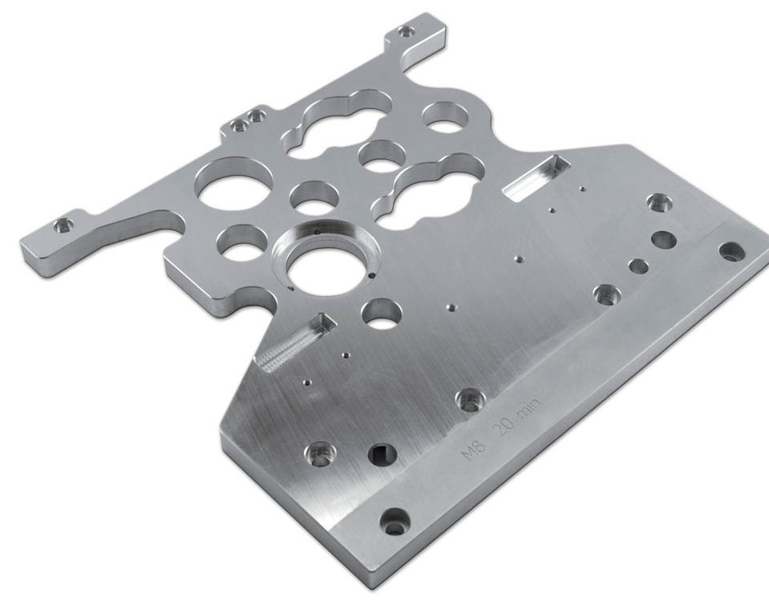
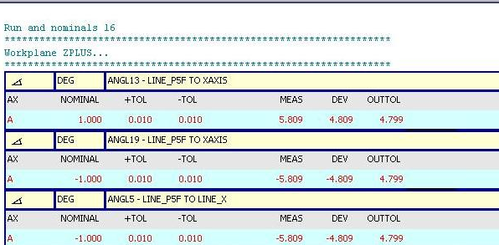
Traditional Part Inspection
Notes:
Typical measurement tasks look like this.
[Click] Lengths, angles and locations…tolerance…in or out, good or bad. All aligned to a rigidly defined datum scheme.

Slide 3

Traditional Datum Alignment & Go / No-Go
Nominal
Measured
Notes:
[Click] Consider a part like this. Dimensional relationships between an edge and 5 holes.
[Click] Say 2 of the features are in tolerance and 4 are not? Do we have to fail this part?

Slide 4
Traditional Datum Alignment & Go / No-Go
What if we can’t scrap?
What if we could use ALL available tolerance?
Could it pass?
OR
Could I find the minimal amount or rework?
Notes:
What if we cannot scrap this part or if we needed a way to find the minimal amount of rework required to make it pass.
[Click] We could use the excess tolerance in the two GOOD features to help bring the other 4 into tolerance and pass the part?

Slide 5
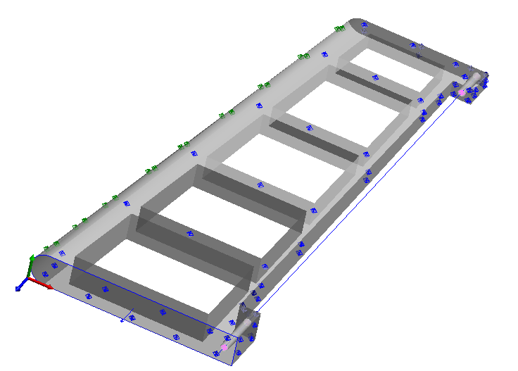
Relationships
Points to Features
Points to Surfaces
Points to Points
Features to Features
Etc.
Notes:
Measured features and their Nominal locations are really just a relationships of where something should be and where it actually is…in SA we define relationships in more broad terms. Make a relationship from anything to anything…measured to nominal, measured to measured, nominal to nominal, etc. This gives us a lot of flexibility in what we can do.

Slide 6
BEST-FIT
FUNCTIONAL SURFACES
THESE WILL DOMINATE
FIXED
PART TO BE ASSEMBLED (ALIGNED)
14 POINTS
31 POINTS
Notes:
In a best-fit alignment, each measurement is a part of the optimization equation. So if one surface has 31 points and the other has 14 points, the alignment will be weighted heavily towards the surface with the most points.

Slide 7


FITTING THE DOOR: “THE REAL LIFE”
Door Axis
Door
Hinge
Floor
Notes:
Let’s consider a real life example. For those that have ever hung a door you know this is not a case of best-fitting the door in the frame so that the gap is the same all the way around.
It’s a matter of fitting the door into the hinges and hoping the other 3 sides fall within a reasonable tolerance of the frame so the door will latch and you will not see daylight out of the top or bottom.

Slide 8
FITTING THE DOOR: “THE REAL LIFE”
GroupHinge
Measured point
Hinge
Object1
Group1
Group2
Object2
Object3
Group3
Notes:
If we look at this as a metrology problem; We have a Hinge Group with a very tight tolerance, and 3 other groups with a significantly looser tolerance. Since we only have 3 points to solve the Hinge-line relationship it will naturally get weighted lower.

Slide 9
FITTING THE DOOR: “THE REAL LIFE”
These points will dominate
REGULAR BEST-FIT
Notes:
Thus a best fit will not yield a practical alignment. [Click]

Slide 10
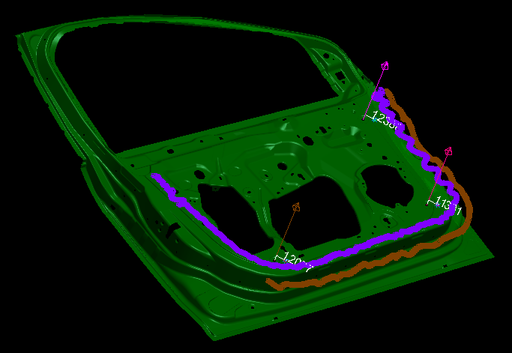
The Car Door
Notes:
Let’s take a look at a more familiar example and show how Relationship Fitting can help solve this problem.

