Slide 1




Application Engineer, NRK

Slide 2


Slide 3

Learn the PRIMARY keyboard shortcuts!
Notes:
The most fundamental thing you can do to become a power user is to learn the primary keyboard shortcuts. Keyboard shortcuts will easily save you tons of time when working in SA.

Slide 4


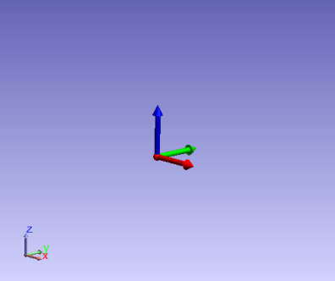
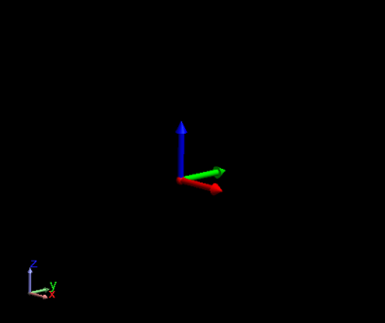
Speeding up SA
Use solid color backgrounds
Notes:
There are a number of tips you can follow to speed up the graphical view in general.
-Use solid color backgrounds, which update faster than gradients (and are easier to read).

Slide 5
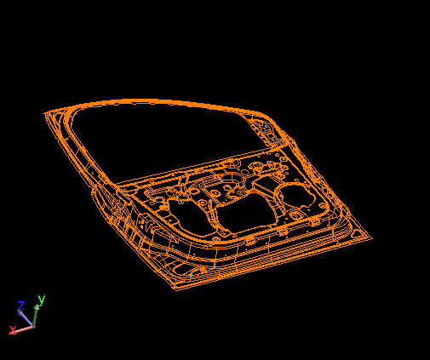
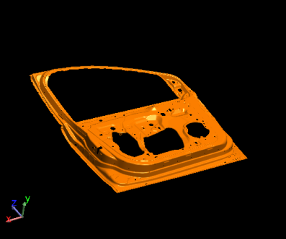
Speeding up SA
Depending on graphics card, solid rendering may be faster.
Notes:
Depending on your graphics card, it may actually be faster to view CAD surfaces in solid shaded mode rather than wireframe.

Slide 6
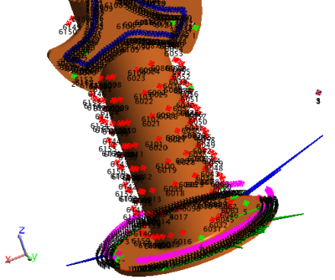
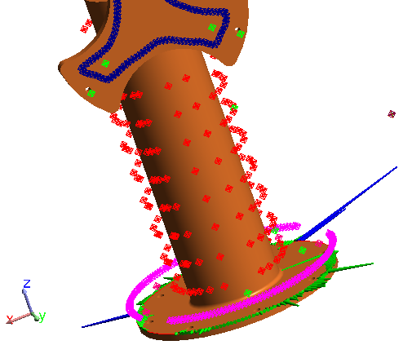
Speeding up SA
Turn off labels when not needed
Notes:
-Another action you can take is to turn off point labels when not in use.

Slide 7
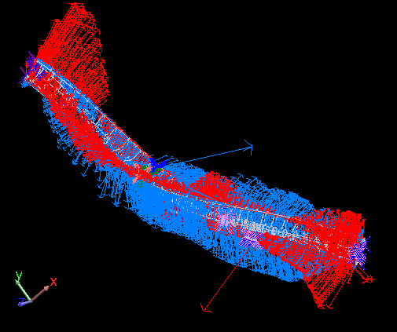
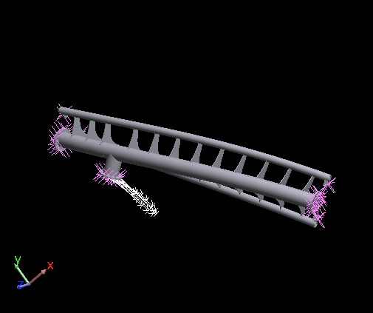
Speeding up SA
Hide entities when not in use.
Notes:
-It’s always best to hide entities when they’re not in use—not only to speed up the graphics, but to reduce clutter in the graphical view.

Slide 8
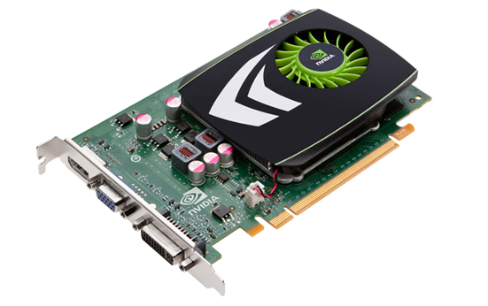
Speeding up SA
Update graphics drivers
Notes:
-Update your graphics drivers to the latest. Reduces graphics issues, but also can result in better performance.

Slide 9
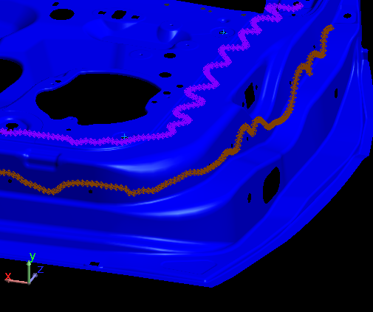
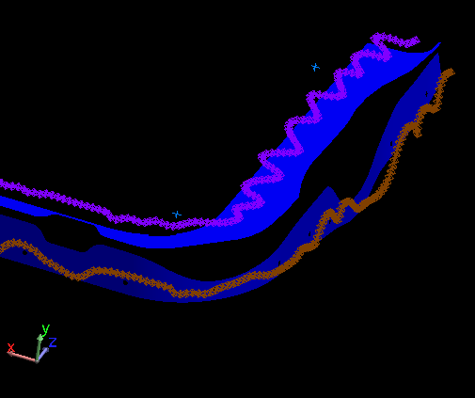
Speeding up SA
Remove unnecessary surfaces
Notes:
-You’ll want to remove unnecessary surfaces (delete) from the model. Don’t put them in relationships either (for optimizing relationship fits).
graphics, but to reduce clutter in the graphical view.

Slide 10
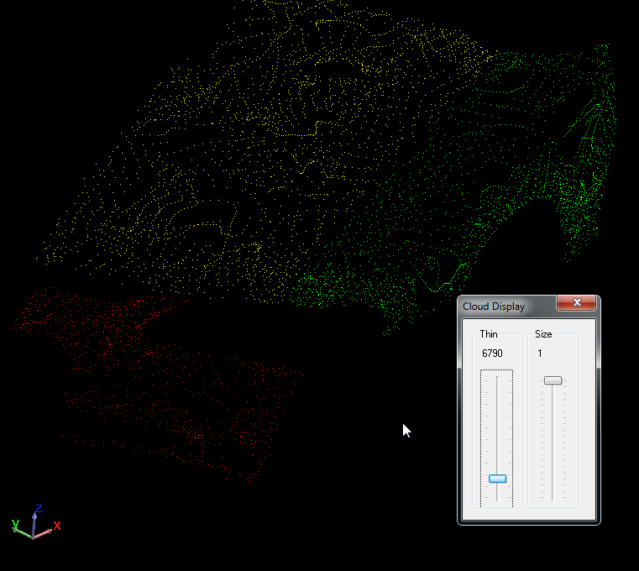
Speeding up SA
Cloud display control
Notes:
-And finally, use Cloud Display Control (Ctrl+T) to thin point clouds.

Slide 11
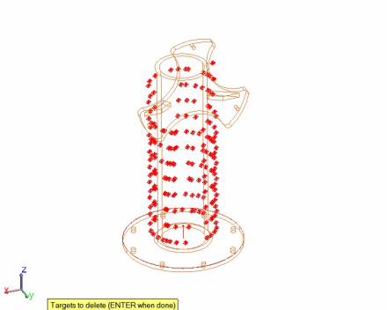
Selection:
Boolean Subtraction
ALT+SHIFT
Notes:
There are a few tips related to selection that are useful to know. The first is that you can perform boolean subtractions in SA by holding down the ALT key. So for instance, to subtract a selection of points from the current selection, hold down Alt+Shift while in point selection mode.

Slide 12
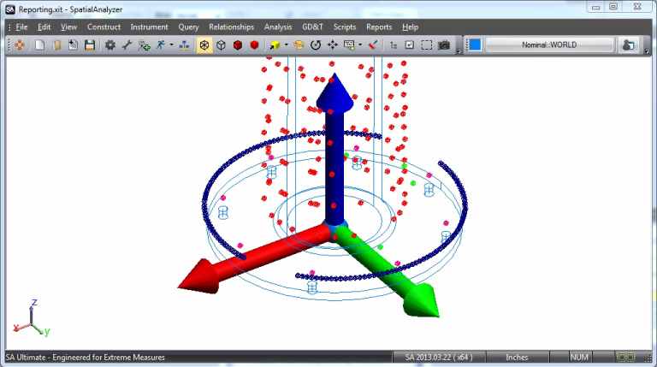
Select by color
Notes:
The next is selection by color. If you click on the Graphical Selection mode Icon, there’s a button labeled “Select Objects by Color” that’s normally grayed out. However, if you’re in a command that’s expecting object selection, you can click on this button. You can then click on an object, and all objects with this same color will be selected.
One great way to group related items is by color. If you organize all objects in a set to have the same color, you can select them all at once using this method.

Slide 13
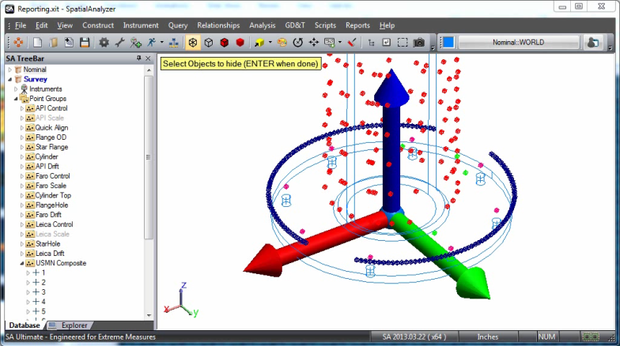
Select by color (Part Deux)
Notes:
By the way, you can also do this through the F2 window, which allows you to explicitly select the color instead of clicking on an object.

Slide 14
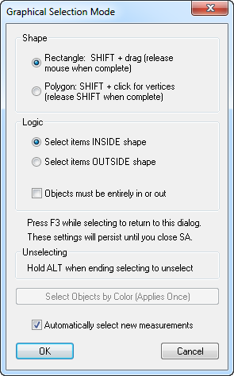
Measurement Selection
Notes:
Measurement selection allows you to actually trap measurements for commands. For instance, to fit a line to a series of measurements, you can select Construct > Line > Fit to Points, then measure a series of points, and when you hit ENTER, those points will be selected.
This is enabled in the Graphical Selection Mode dialog using the “Automatically select new measurements” option.

Slide 15
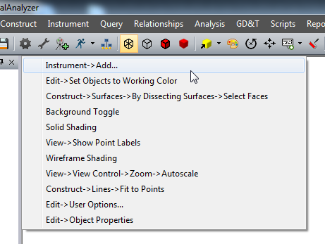
Repeating commands
Repeat command: Ctrl+Tab
Command History: CTRL+SHIFT+TAB
Notes:
The Repeat command and command history keyboard shortcuts are also exceedingly useful. Repeat command will repeat the last command that you executed, whereas “command history” will allow you to view a list of about a dozen of the most recent commands to choose from. This is especially useful if you’re repeatedly switching back and forth among a small subset of commands.

Slide 16
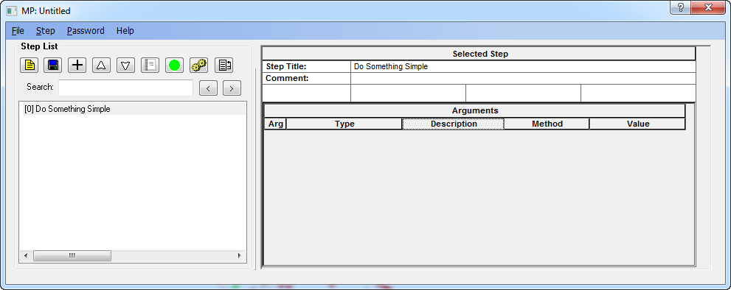
Repeating commands
short MPs can save considerable time.
Notes:
Also: Don’t forget that even short MPs that take just a few minutes to put together can still save you a considerable amount of time.

Slide 17
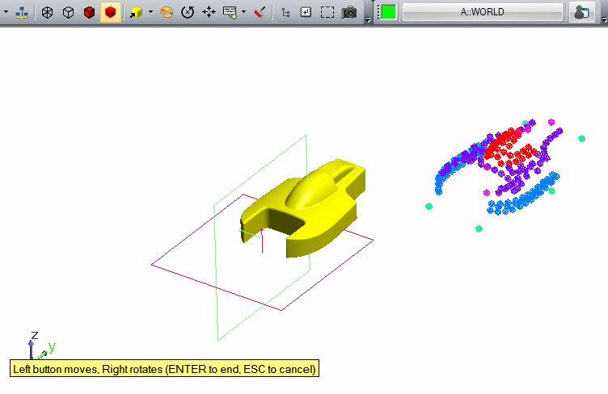
Dragging from multiple views
Notes:
Another situation you may come across is when you want to line something up in 3 dimensions. One example of this is positioning measurement data roughly in place in order to establish a good initial condition for a relationship fit.
If you try to drag the instrument from an oblique view or any view for that matter, you’ll only have control in two dimensions at a time. People will often line the items up in one view, press ENTER to complete the command, switch to another view, and repeat the steps.
However, it’s worthy of note that you can actually switch to different preset views within the drag command. This allows you to switch to orthogonal views to fine-tune the placement of something before committing the movement.

Slide 18
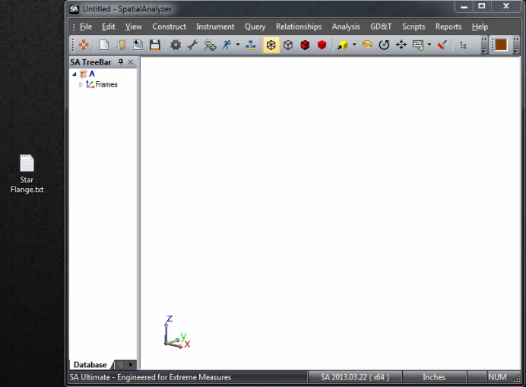
Importing points quickly
Notes:
If you have a set of points in a text or CSV file, you can very quickly import them by dragging the file directly into the graphical view.

Slide 19
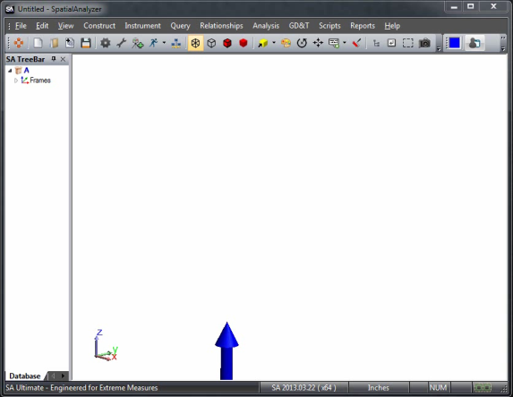
Importing points quickly (Part deux)
Notes:
Another way to import points quickly is to copy them to the clipboard, then paste them into SA using Edit>Paste Points from Clipboard.

Slide 20
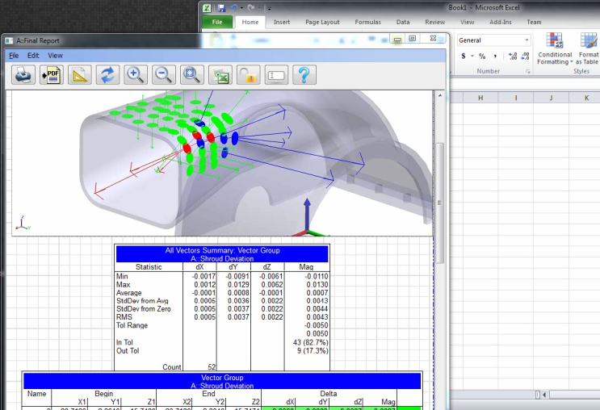
Extracting data from tables
Notes:
You may have a need to pull data out of a report table and put it into a text file or Excel spreadsheet. Rather than copy the values over manually, a much better method is to copy data from a table to the clipboard.
To do this, hold down SHIFT and drag a rectangle to encompass the data to copy. This data will be copied to the clipboard, and you can then paste it elsewhere, such as into an Excel spreadsheet.
A more advanced application of this is to hold down ALT + SHIFT when dragging a rectangle, which provides advanced options for how to delimit the data and where to send it.

Slide 21


Slide 22
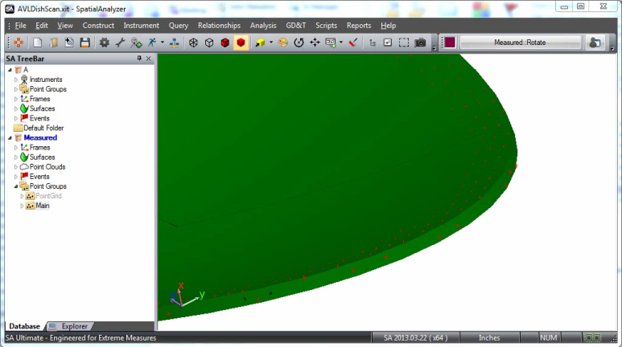
Creating normal vectors from surface points
Notes:
Sometimes you’ll have a nominal model with a series of points on the surface that represent locations to measure on a part. One common and very effective method for measuring these locations is to use Auto-Correspond with Vector Proximity triggers. But in this case, you want to convert these surface points to vectors to use the command.
You can easily create vectors at the point locations normal to the surface by performing a Query > Points to > Objects, and overriding the offset to a negative value such as -10, which will create vectors -10 units in length, pointing out of the surface.

Slide 23
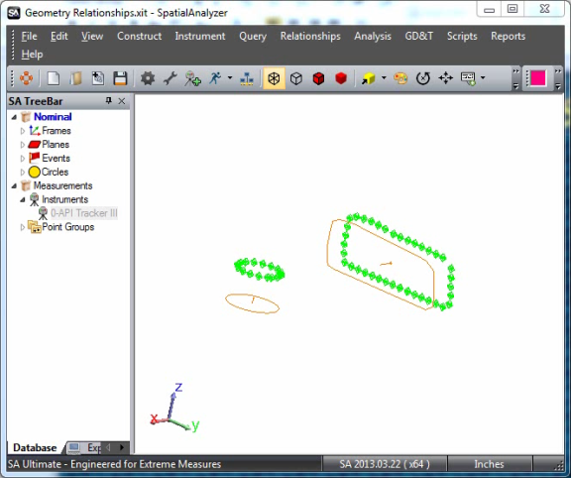
Verifying object associations
Notes:
Often times we perform transformations on instruments that are small, so they cannot be seen easily in the graphical view. In cases when you’re dealing with objects that are supposed to be associated with instruments, you may mistakenly believe that an object is associated with an instrument when it really isn’t—meaning a transformation gets applied to an instrument, but not the object.
The “official” way to check associations is to use Instrument > Object Associations > Highlight Associated Objects. This works fine, but another way to verify whether an object is associated with an instrument is to simply drag the instrument graphically using Instrument > Drag Instruments Graphically, then cancel the command with the ESC key.

Slide 24
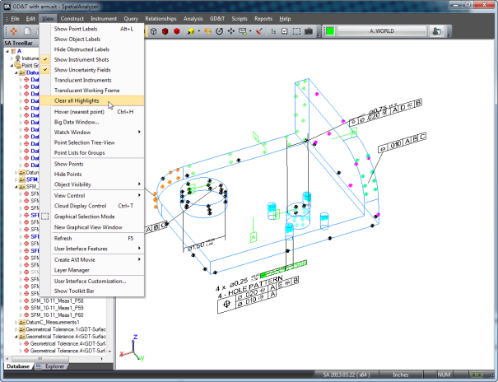
Clearing Highlights
Notes:
If you ever have a bunch of things highlighted, don’t right-click them in the tree and uncheck highlight. Too time-consuming!
Just go to “View>Clear All Highlights”. Problem solved!

Slide 25
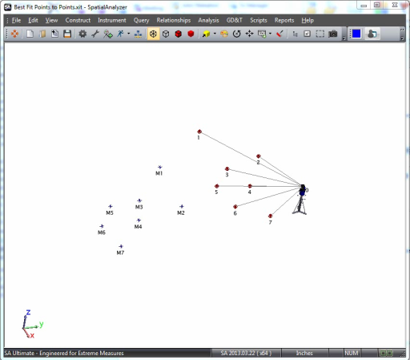
Renaming by
inter-point distance
Notes:
It’s not at all uncommon that you will have measured a set of common points for use in a best-fit or USMN operation. And you may find, after measuring the points, that you haven’t named them properly. Of course, for best-fit or USMN to work properly, common targets must share the same name.
Instead of fixing these names manually, you can use Rename by Inter-Point Distance.

Slide 26
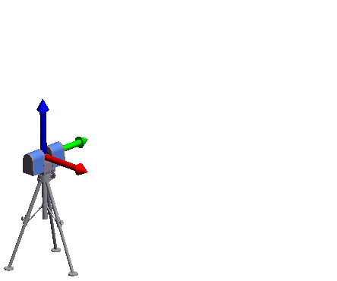
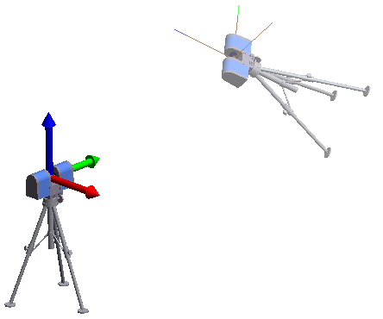
Recording transforms
Construct > FrameS > On Object [inStrument]
Frame to frame transformation
Notes:
One useful characteristic of a coordinate frame is that it represents a unique position and orientation in space. As a result, you can use a coordinate frame to keep a record of an object or instrument’s position and orientation in space. This is useful if, at some later time, you may wish to move an object back to an earlier position.
So to do this, you create a record of a transform by using either the Construct>Frames>On Object or Construct > Frames> On Instrument commands.
When you want to move something back to that position, create another frame on it’s current position, then use a Frame to Frame transformation command. (Or, alternatively, activate the old frame and then zero out the object’s transform).

Slide 27
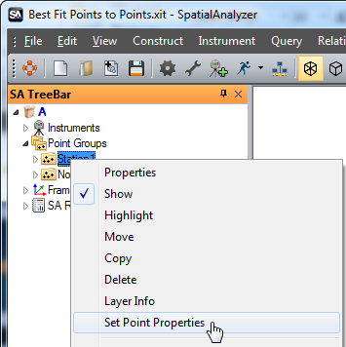
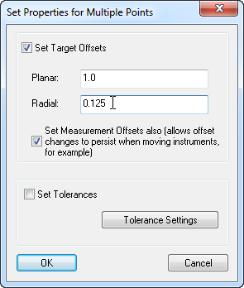
Fixing incorrect offsets
Notes:
If you’ve taken measurements with incorrect offsets set in an instrument interface, you can correct it by right-clicking the point group and selecting “Set Point Properties”.
[CLICK]Then check the “Set Target Offsets” and “Set Measurement Offsets also” checkboxes, and enter the new offsets.

Slide 28
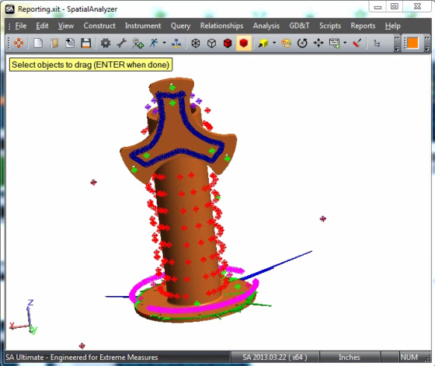
Recomputing targets
Notes:
If you inadvertently move a group of measured points relative to an instrument, this will break the association between the two and the measured points will instantly convert into constructed points. One reason for this is to alert you that the relative positioning between the instrument and the points has changed.
However, since SA records the raw instrument data inside each point, the measured points can be recomputed and “snapped” back into place. To do this, select Analysis>Recompute Targets from Shots.

Slide 29
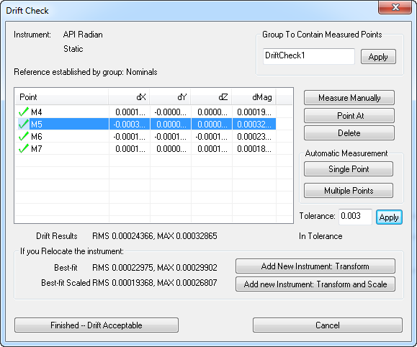
Drift Checks
Notes:
There are a few features that have been added to the Drift Check command that you may not be aware of. When you finish measuring your monuments, you’ll see a few options at the bottom:
Add New Instrument: Transform, Add New Instrument: Transform and Scale, and Finished—Drift Acceptable. What’s the difference between them?
If all of your numbers look good, that means that your instrument hasn’t moved or drifted, and we can continue. In that case, you want to click “Finished—Drift Acceptable”.
If the numbers only look good after the Best fit, then your station has likely moved, and you’ll want to use the “Add New Insturment: Transform” button. This will add a new instrument, best fit it to the nominals, and associate your measurements with the new instrument (so Drift acceptable means that the drift check looks good, and you want to continue measuring from the current station.
If the numbers only look good after the Transform and scale, then your station has likely moved AND scale has changed—for instance, if you have monuments on a tool, and the tool has changed temperature.

Slide 30
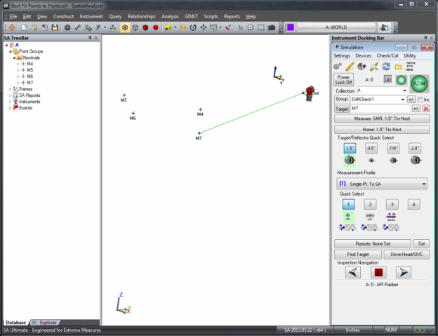
Drift Checks

Slide 31
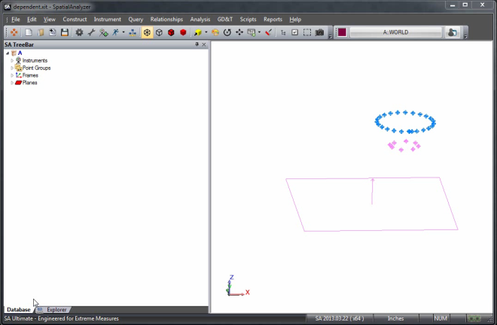
Dependent Relationships
Notes:
One thing that’s not widely-known is that you can create dependent relationships—this is really cool.
Say, for instance, you’re measuring a cylindrical object by two different diameter circles, and you want to compare the axis of that object to a plane’s normal.
You can create a geometry relationship for the first circle and turn on cardinal points—then repeat for the second circle. Then, you can create a line geometry relationship through the two circle centers, and a fourth relationship that compares the axis to the plane. All of this is dynamic. By deleting some circle points, the circle fit, line fit, and line relationship all update. And this is something that can be set up completely in advance.

Slide 32
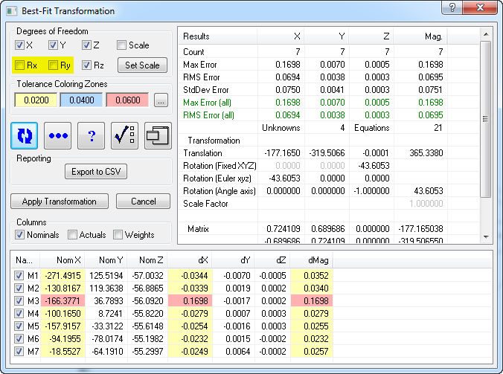
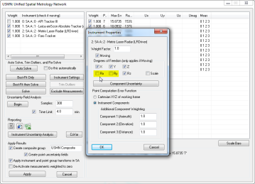
degree of freedom restrictions
Best fit:
Working frame
USMN:
INSTRUMENT AXIS
Notes:
There’s an important point to make when it comes to degree of freedom constraints when performing alignments. You may encounter a situation in which you’d like to hold an instrument level during an alignment. To do this, you would typically want to restrict the Rx and Ry degrees of freedom during the fit.
The important thing to remember is that during a best-fit operation, the degree of freedom constraints apply about the working coordinate frame. As such, to hold an instrument level its gravity frame must be active.
USMN, on the other hand, uses the instrument’s axis when dealing with degree of freedom constraints. So, disabling Rx and Ry for multiple instruments will restrict their motion about different degrees of freedom for each instrument.

Slide 33


Slide 34
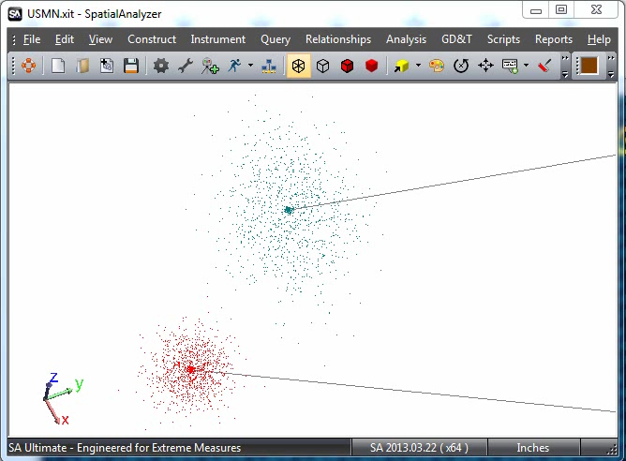
Uncertainty cloud queries
Notes:
If you have points with uncertainty clouds, you can query them to obtain the uncertainty of the distance between them using Query > Sensitivity Cloud to > Sensitivity Cloud.

Slide 35
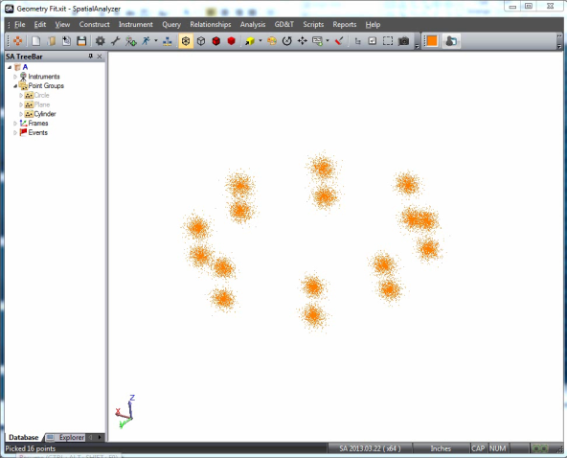
Geometry Uncertainties
Notes:
If you’ve measured a geometric feature and have uncertainty clouds for those measured points, then you can calculate geometry uncertainties. Geometry uncertainties essentially fit the geometry once for each combination of uncertainty cloud points, then performs statistics on the resulting set of geometries to calculate the uncertainty of the geometric feature.
In this example, we can calculate the uncertainty in the cylinder’s position, orientation, and diameter.

Slide 36


